Slide 1
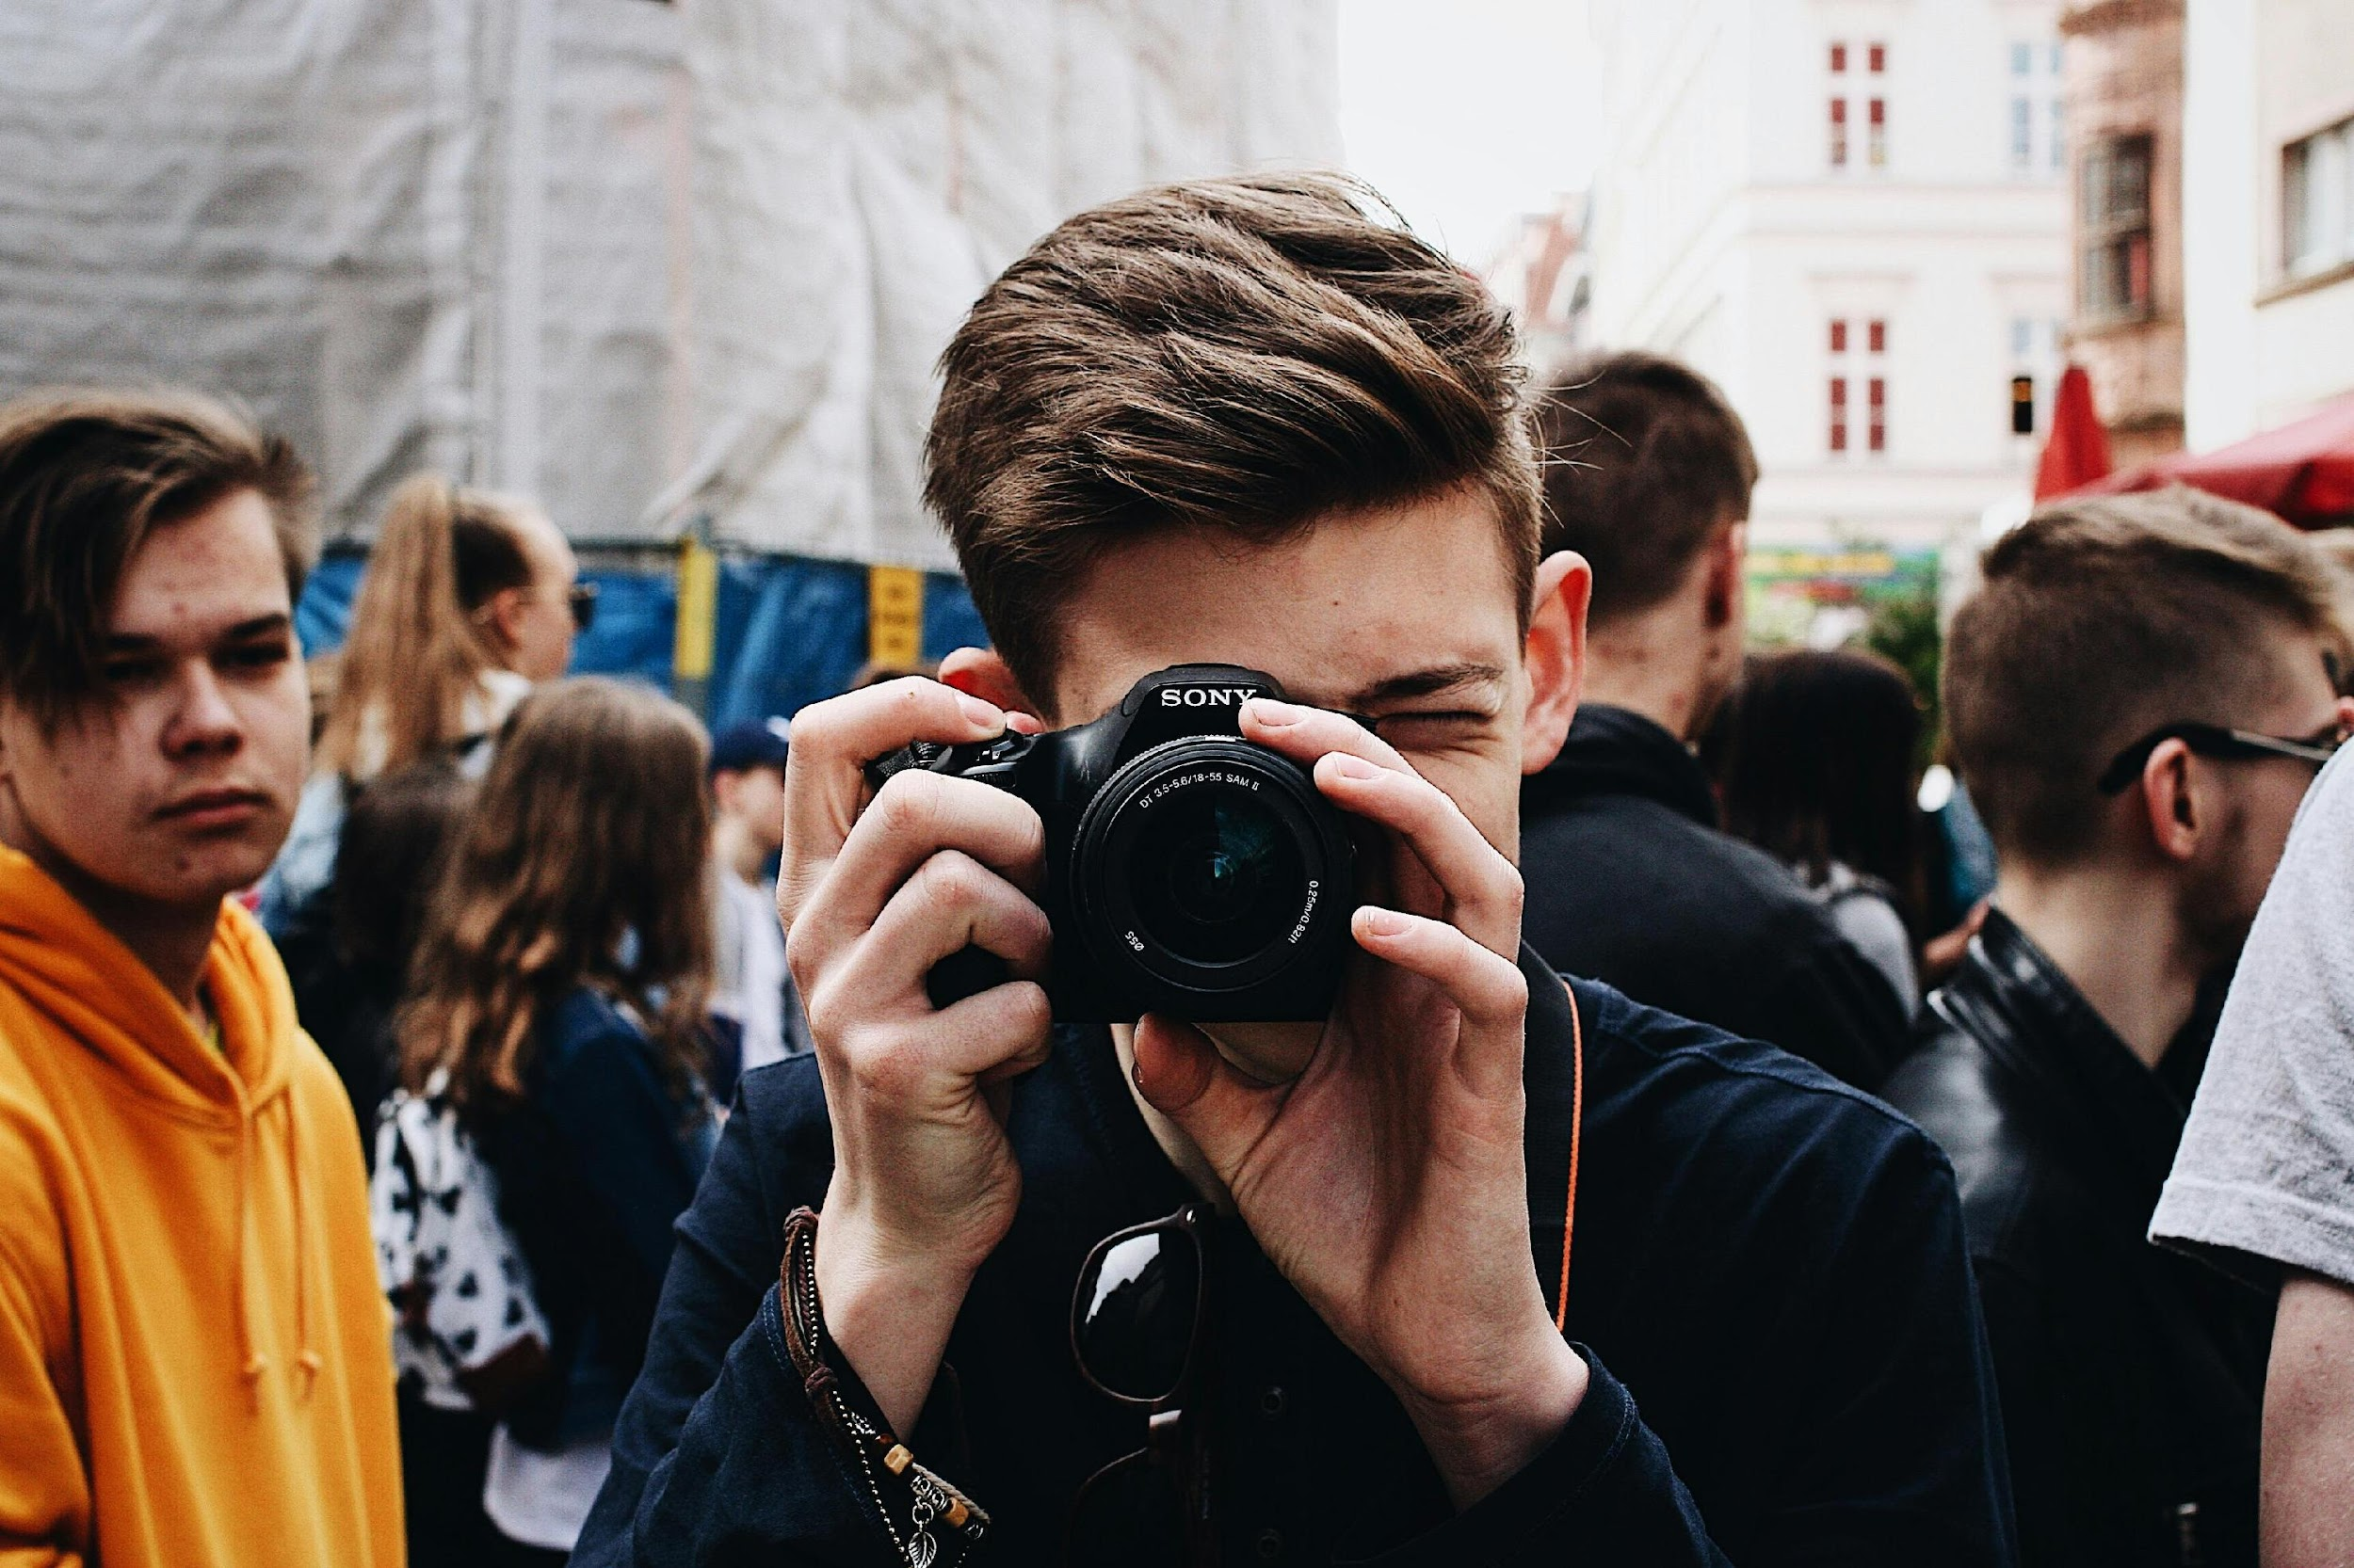
WP4 Multimedia Learning
AY Institute - Lithuania

Slide 2
Creating Digital Narratives - Storytelling Tools & Techniques
On social media
Kristina Petrauskė-Chistorikė

Slide 3
01
Funded by the European Union. Views and opinions expressed are however those of the author(s) only and do not necessarily reflect those of the European Union or European Commission. Neither the European Union nor the granting authority can be held responsible for them. [Project Number: 101196478]
INTRODUCTION

Slide 4
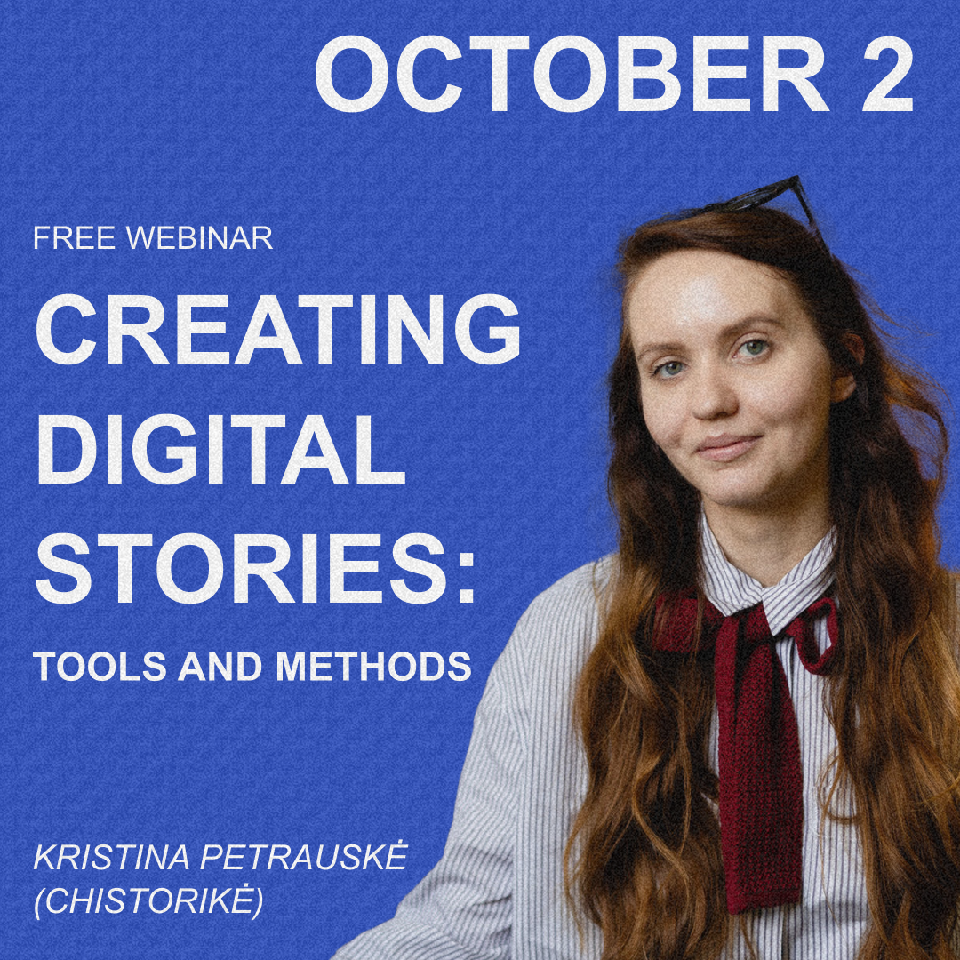
@chistorike
Kristina.petrauske@vdkaromuziejus.lt

Slide 5

Why this topic matters?

Slide 6

From where we learn?

Slide 7

SocMed

Slide 8
Why this topic matters?
Social media is where many first encounter history
Risk of distortion, trivialization, or denial
We must share with accuracy, empathy, and responsibility

Slide 9
Why it’s difficult?

Slide 10
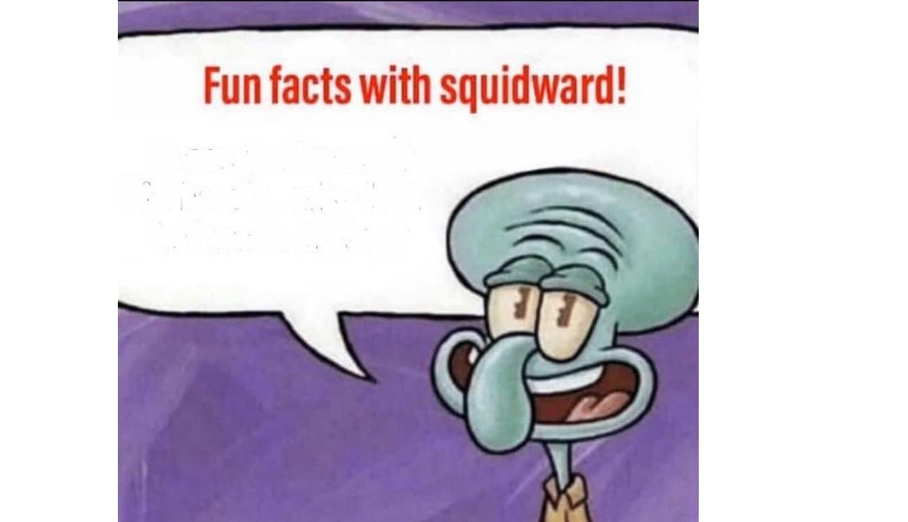
SocMed 🚫
Shock content
Conspiracy theories
Oversimplification
Almost no stories about roma, LGBTQ and over groups
Fatigue

Slide 11
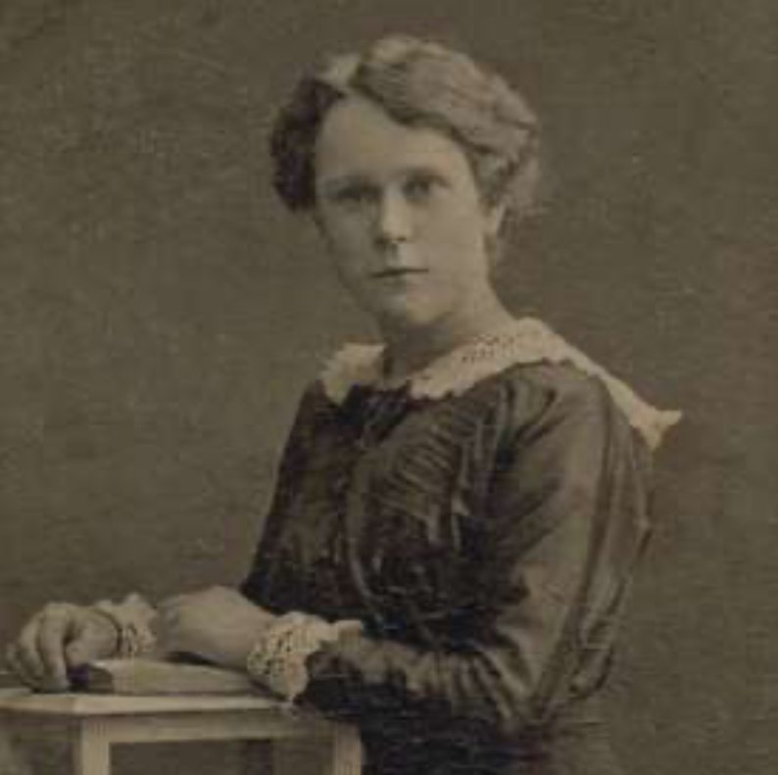
Aktion T4
Aktion T4 (1939–1941) was a secret Nazi program aimed at eliminating people with physical and mental disabilities whom the regime considered “unfit” or “life unworthy of life.” It was named after the address of its headquarters — Tiergartenstraße 4 in Berlin.
Around 275,000 people were killed through gas chambers, starvation, or lethal injections. The program was one of the precursors to the Holocaust and established many of the methods later used in extermination camps.

Slide 12
SocMed ✅
Focus on human stories and empathy
Highlight resilience, memory, and lessons learned
Content warning
Provide context
Use appropriate language
Use respectful visuals

Slide 13
Summary
✅ Do:
❌ Don’t:
Use shock content without context
Trivialize or memeify trauma
Spread unverified claims
Oversimplify history into slogans
Dehumanize victims
Give context
Humanize victims
Use respectful visuals
Warn about sensitive material
Highlight resilience & lessons
Be inclusive

Slide 14
Examples
@eva.stories – what if a girl had an Instagram in 1944
@Lily Ebert & Dov Forman;
Tova Friedman @tovatok;
Gidon Lev @Thetrueadventures
@Holocaustmuseum

Slide 15
Personal dimension: stories are anchored in individuals, their experiences, voices, and names.
Accessible format: using video, stories, Q&A — rather than long essays.
Respect and dignity: avoiding sensationalism or gratuitous imagery.
Interactivity: inviting questions, reactions, or dialogue with followers.

Slide 16
FOLLOW OUR
JOURNEY

Slide 17
The power of storytelling
Ewelina Dobrawolska

Slide 18

Introduction
Foster Holocaust remembrance, especially highlighting often forgotten victim groups – the Roma community, LGBTQ+ people, and people with disabilities.
www.memory-makers.eu

Slide 19
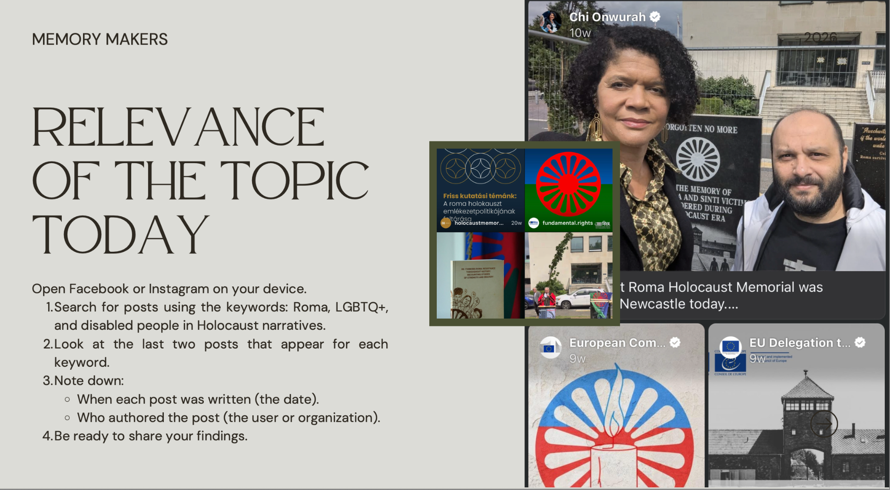

Slide 20
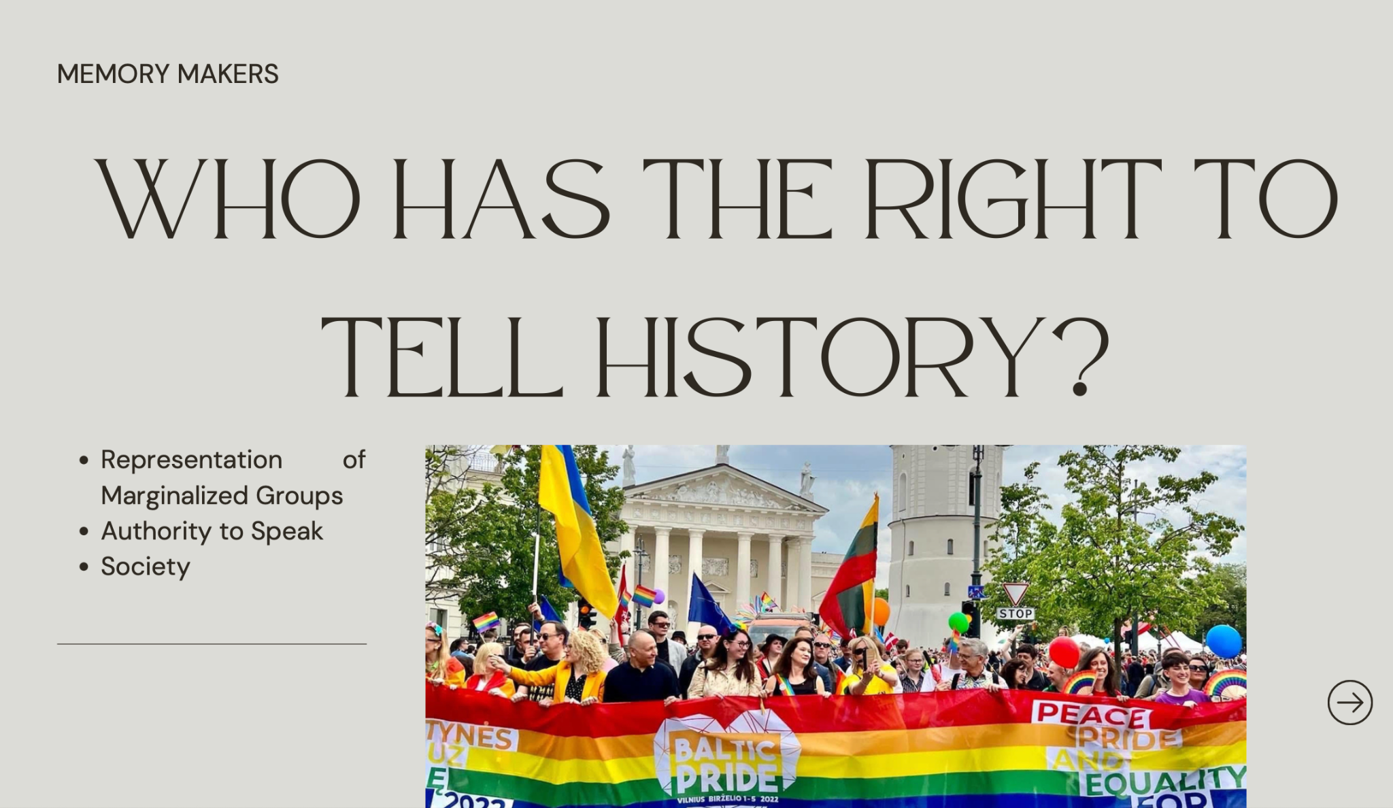

Slide 21
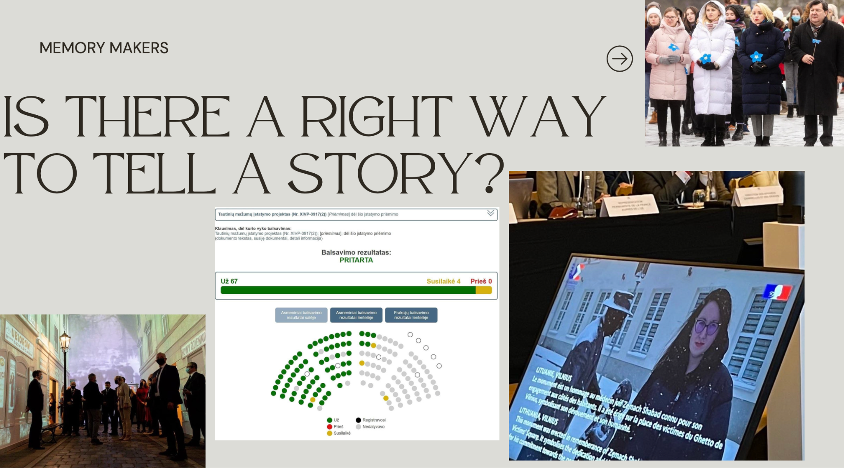

Slide 22
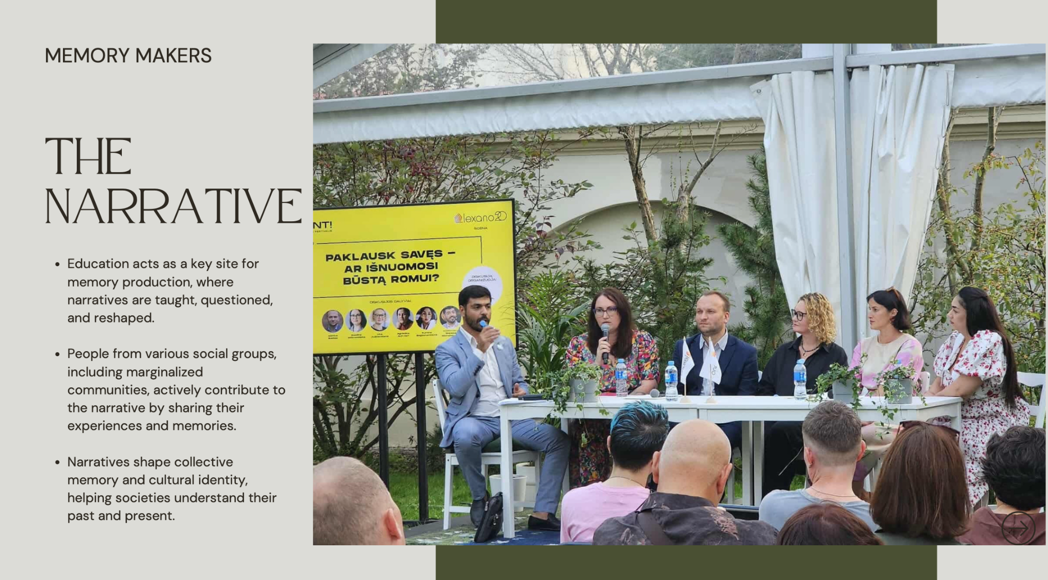

Slide 23
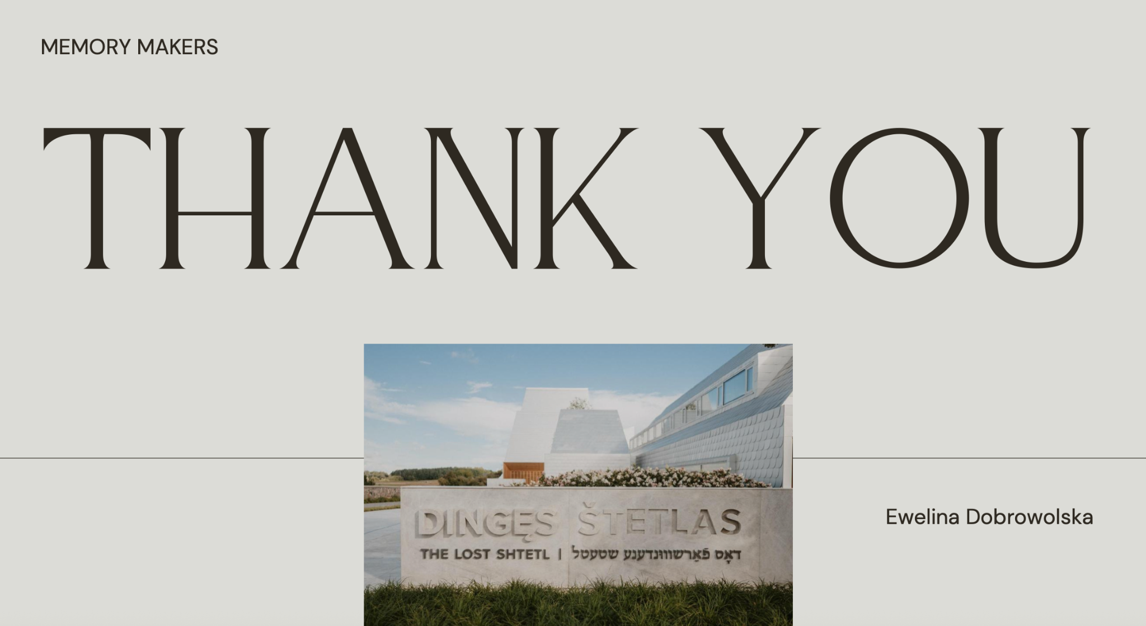

Slide 24

FOLLOW OUR
JOURNEY

Slide 25
How social media and online platforms can empower youth activism, turning empathy into action and messages into impactful campaigns
Tomas Vytautas Raskevičius

Slide 26
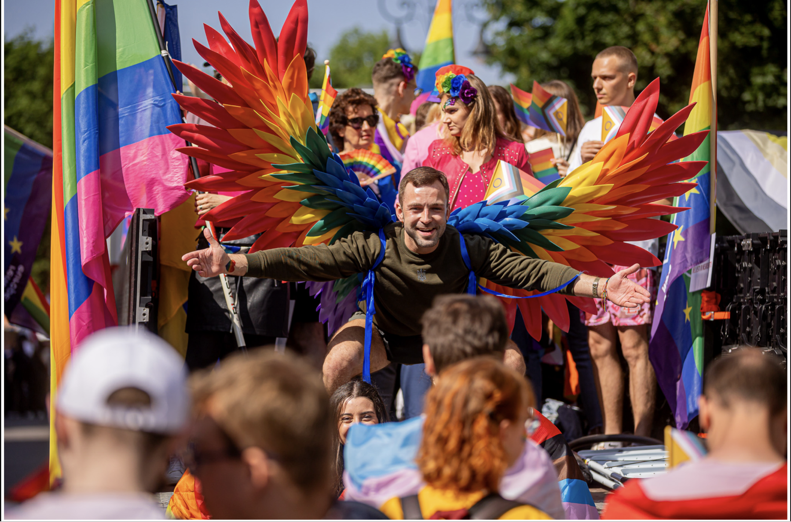

Slide 27
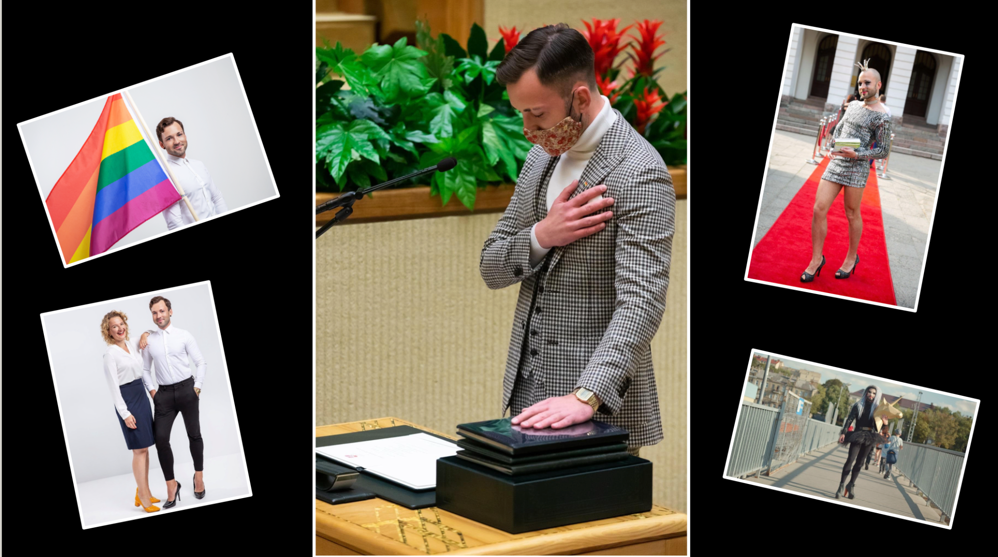

Slide 28
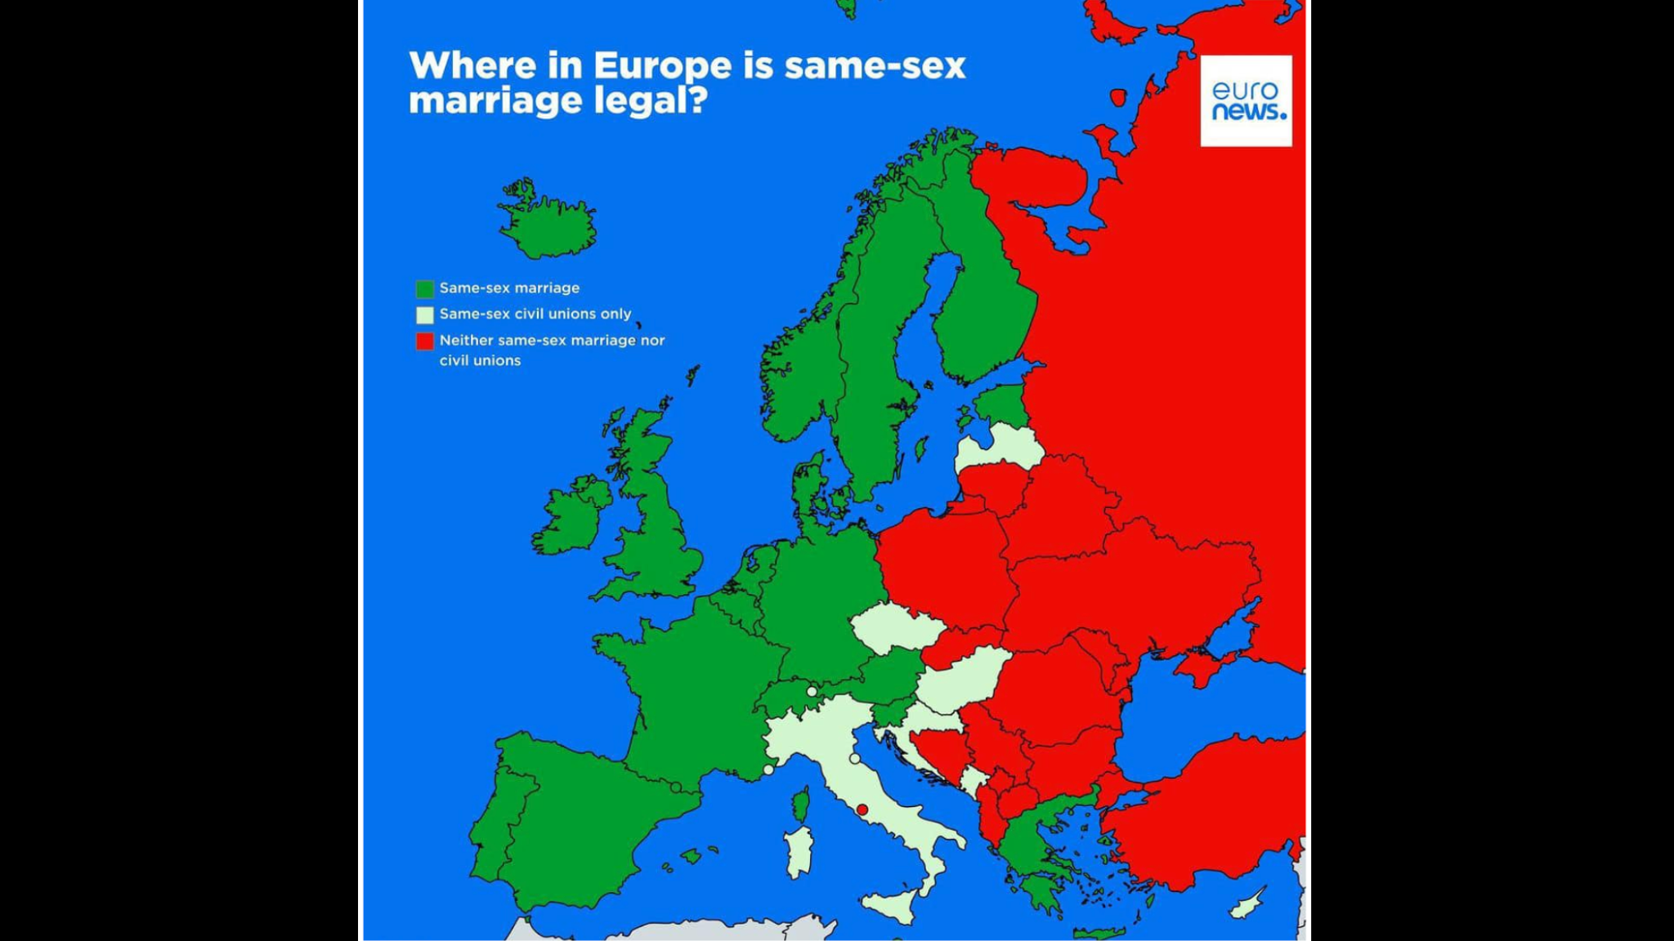

Slide 29
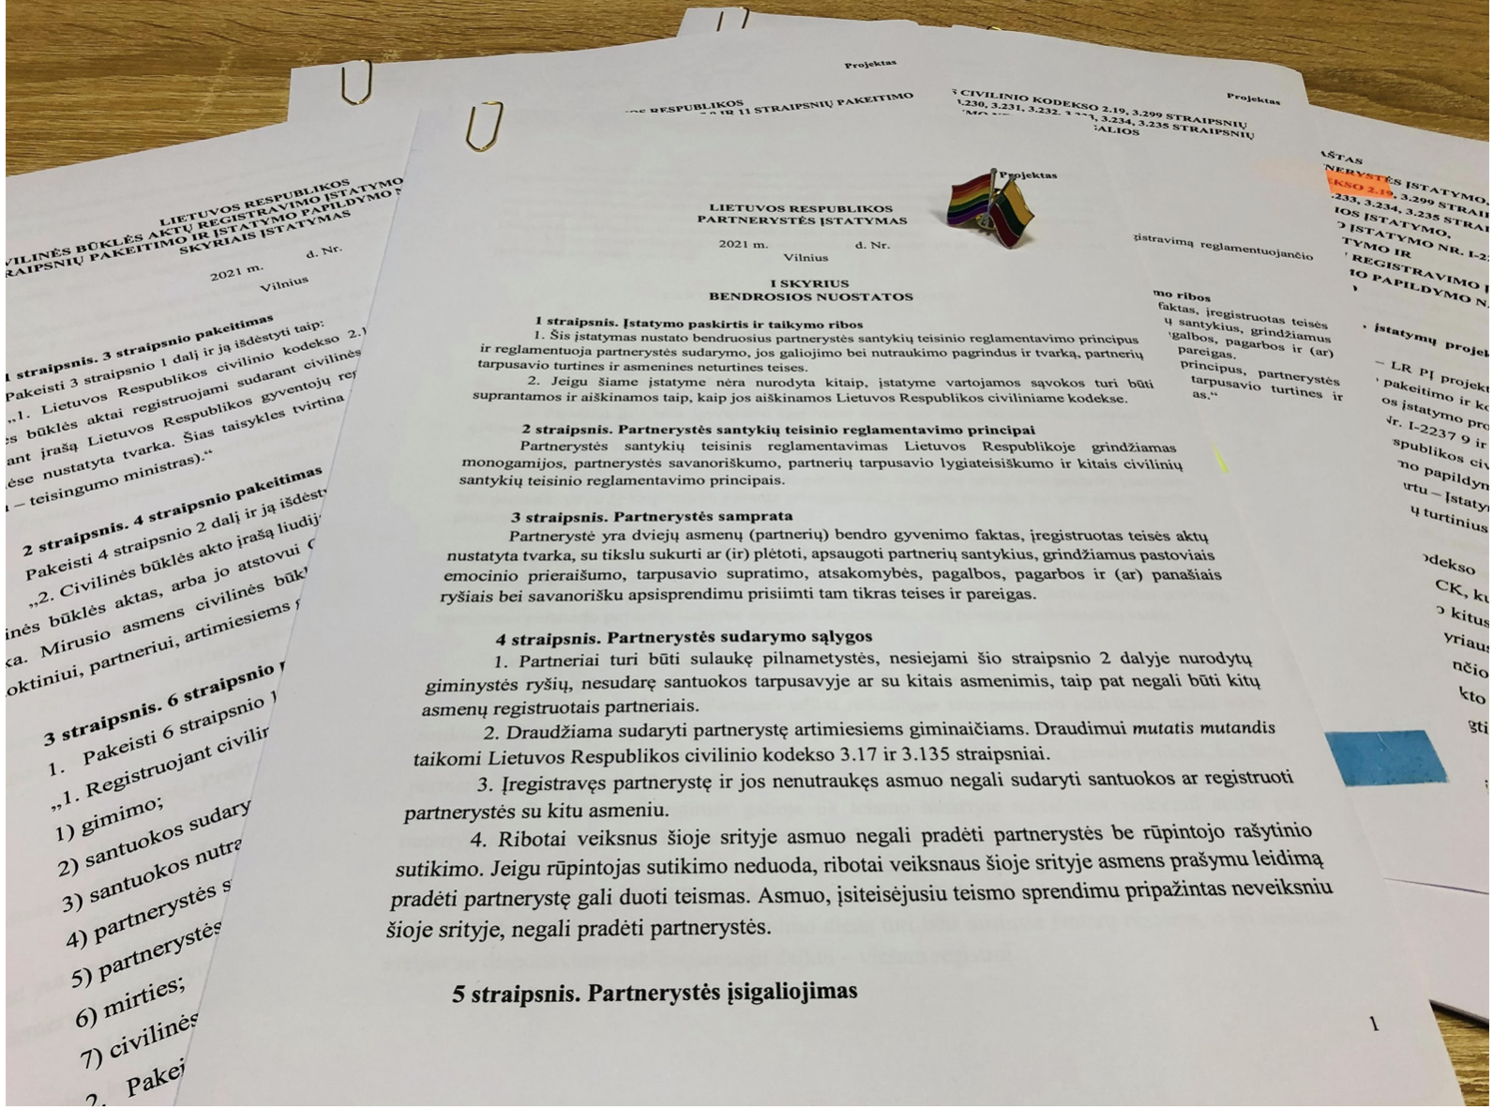

Slide 30
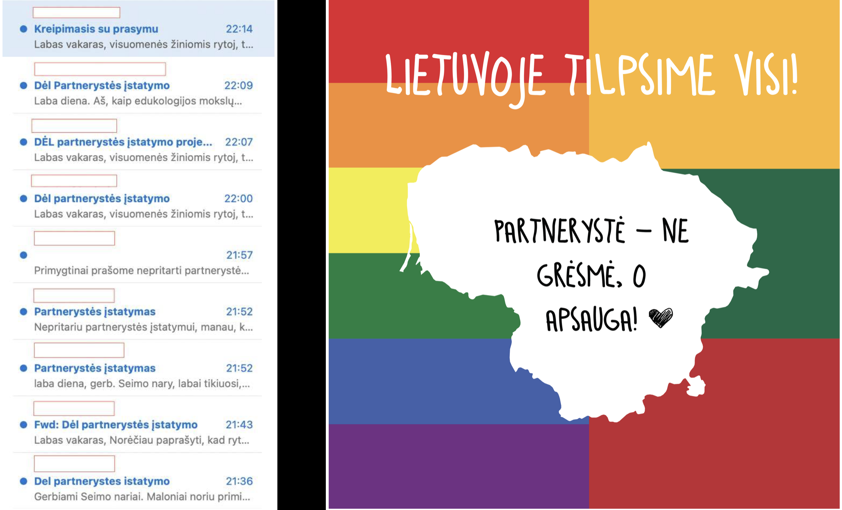

Slide 31
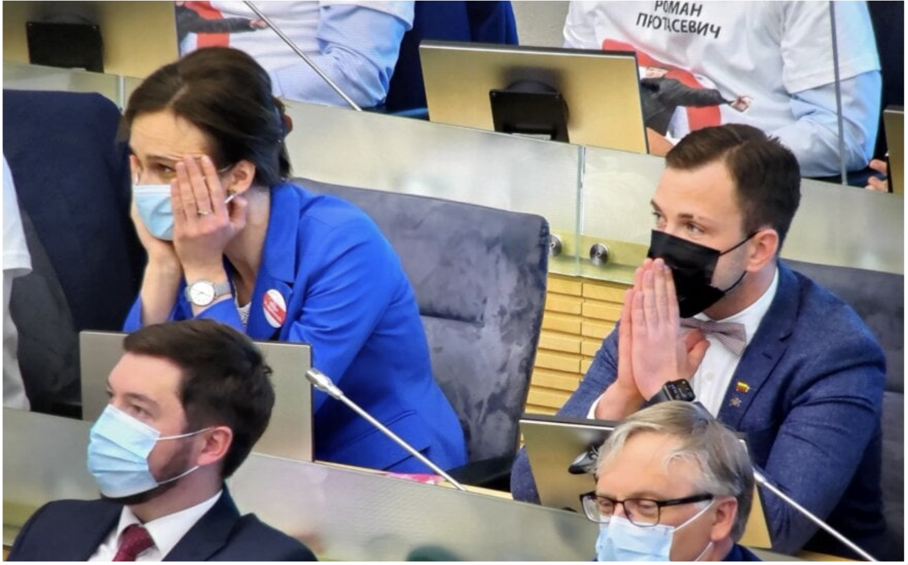

Slide 32
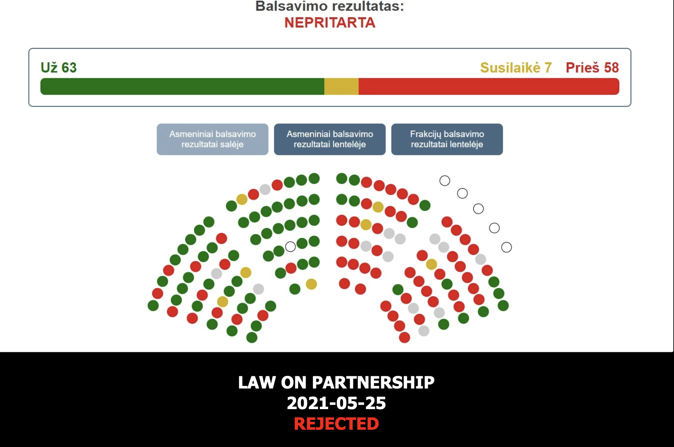

Slide 33
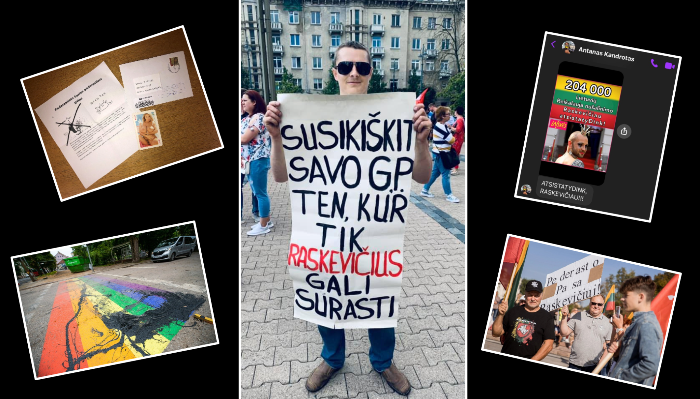

Slide 34
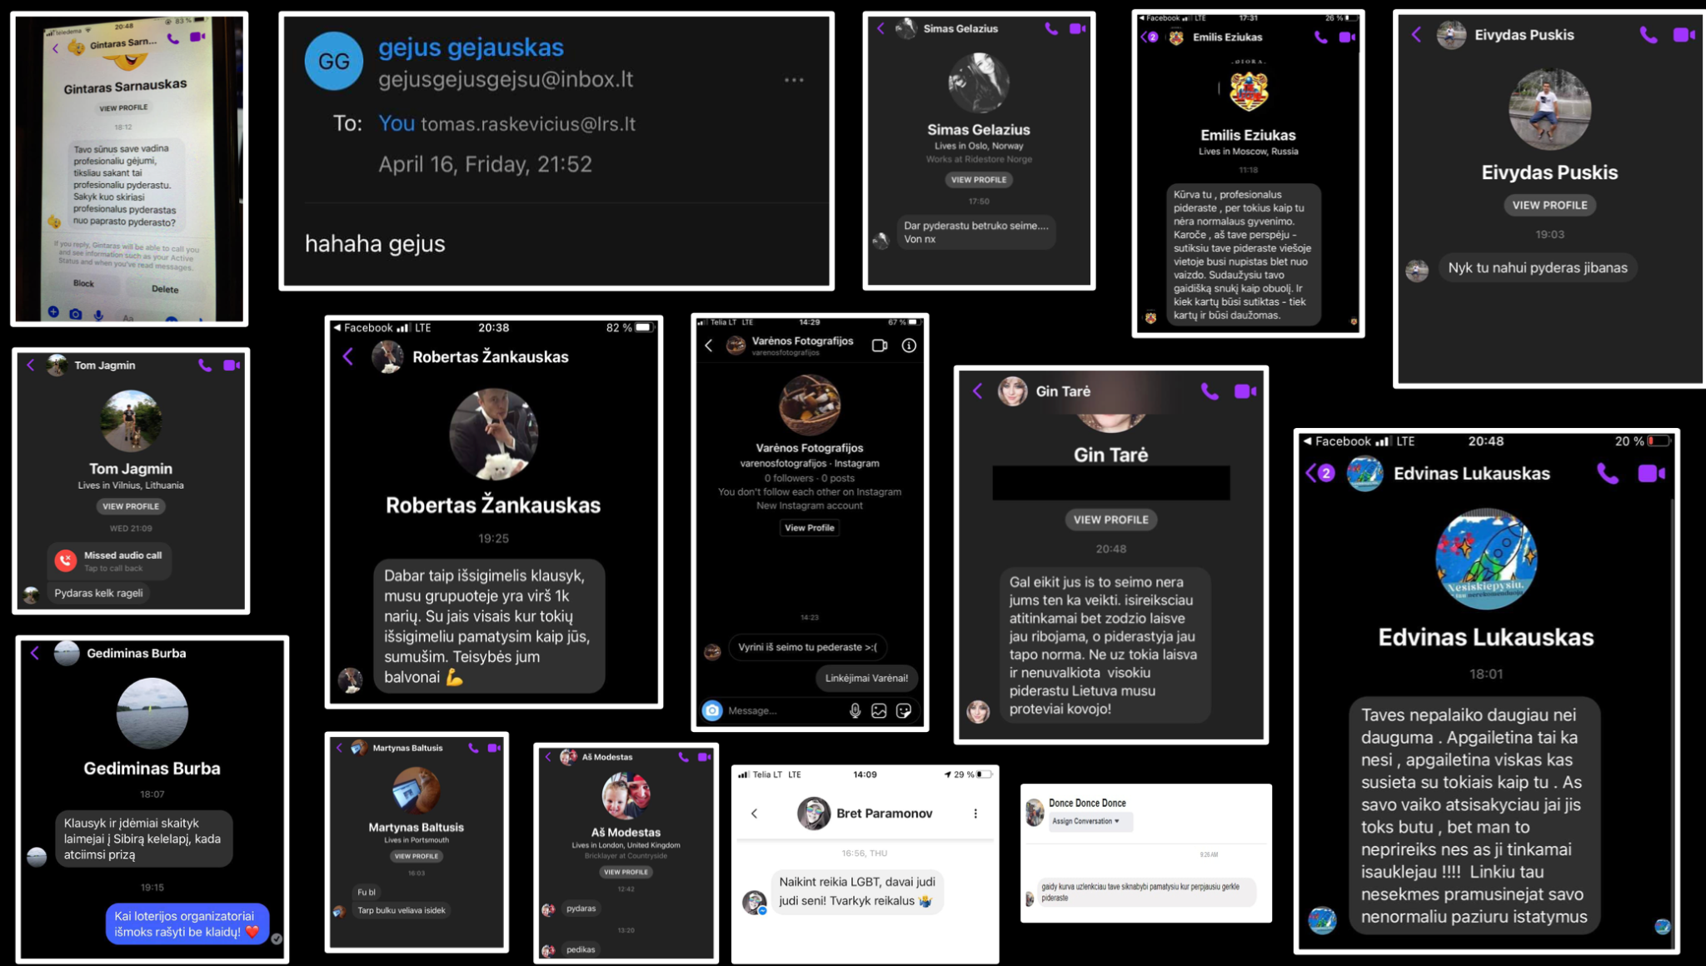

Slide 35
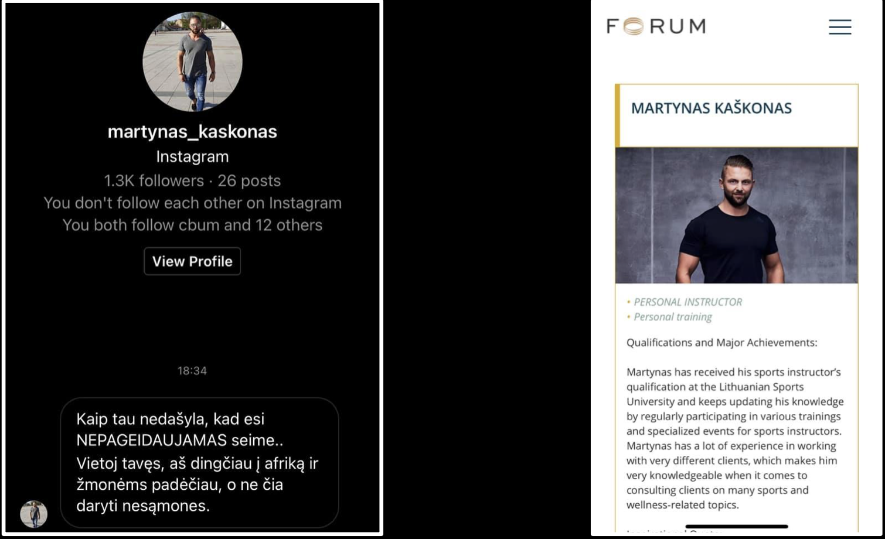

Slide 36
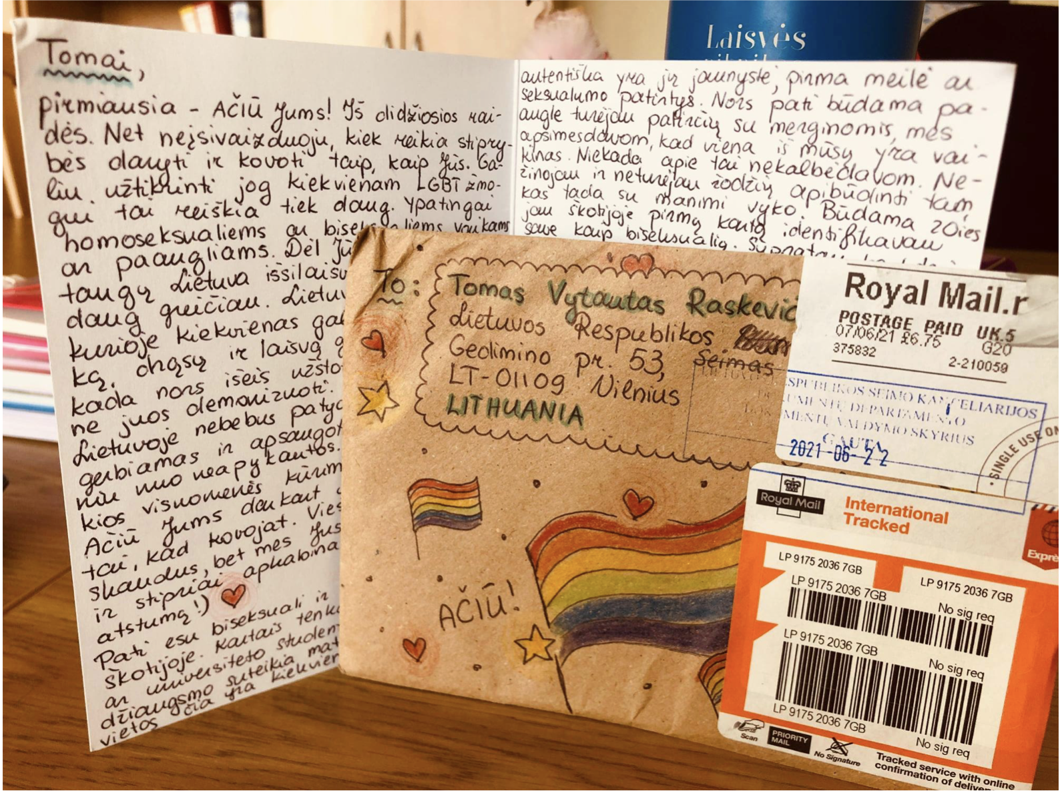

Slide 37


Slide 38
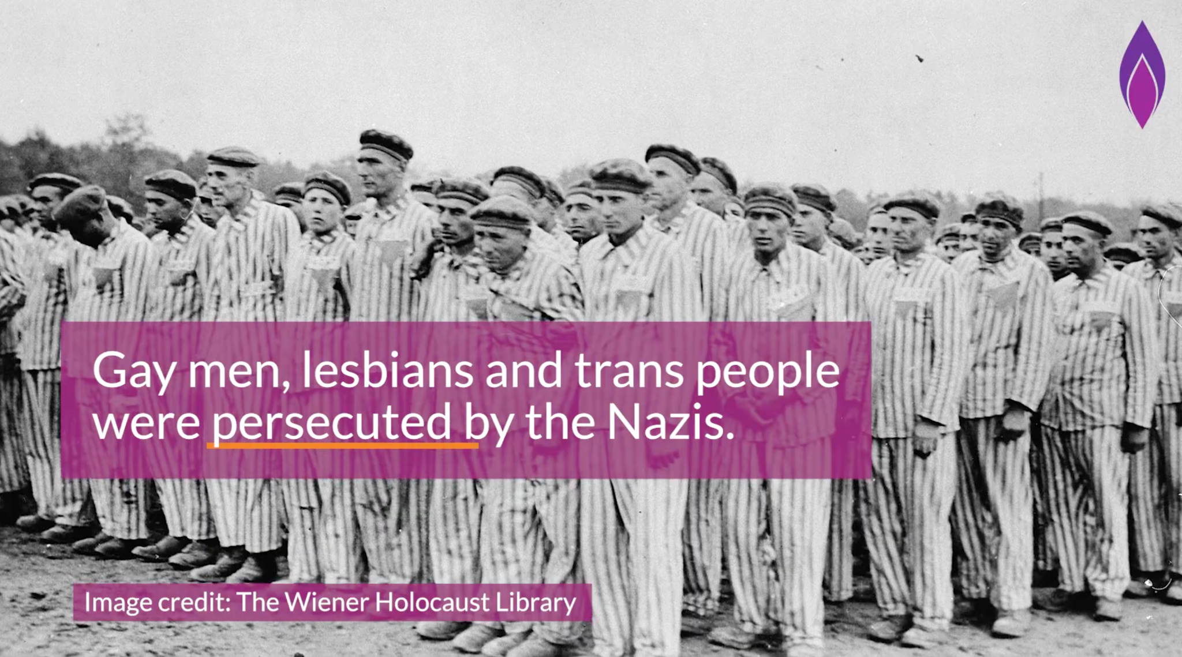
https://www.youtube.com/watch?v=Qlj5kQQYOWo

Slide 39
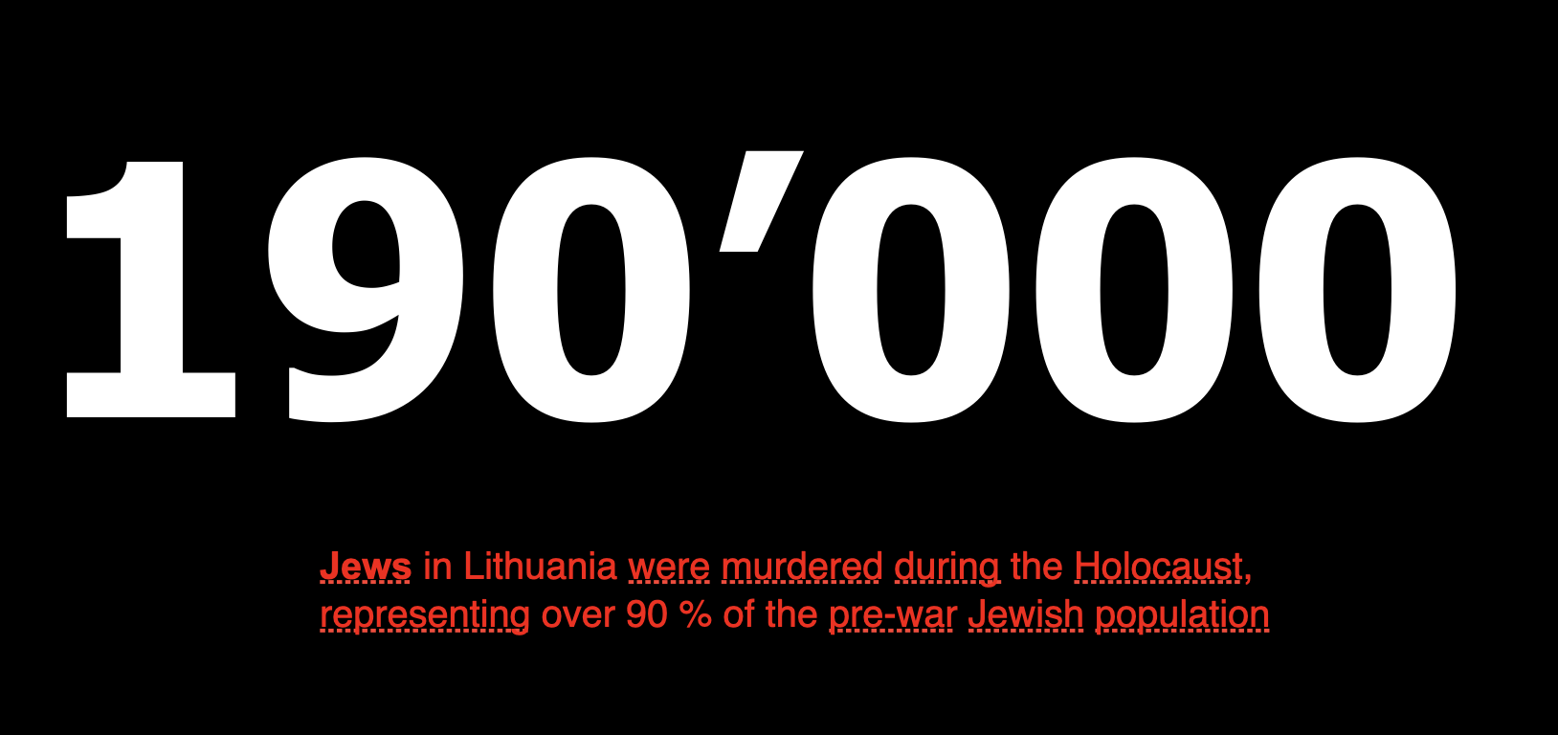

Slide 40
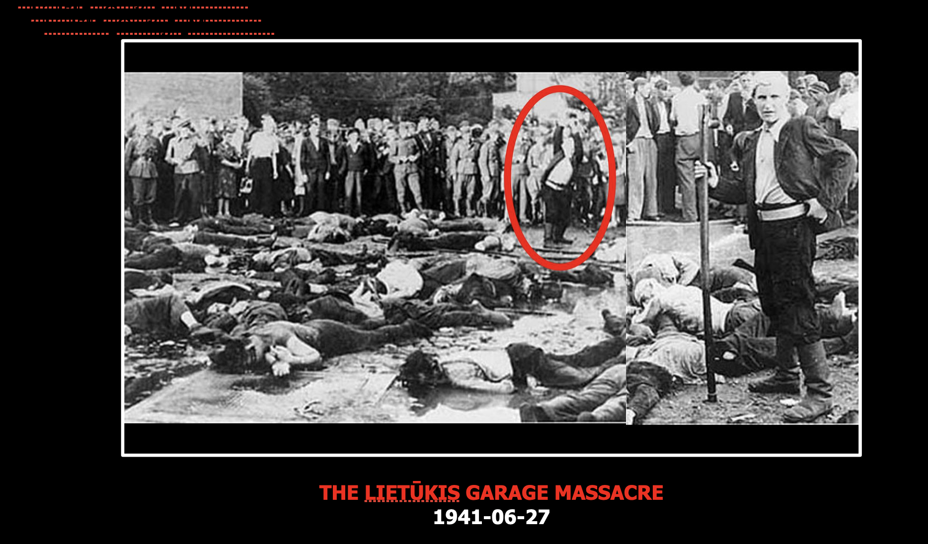

Slide 41
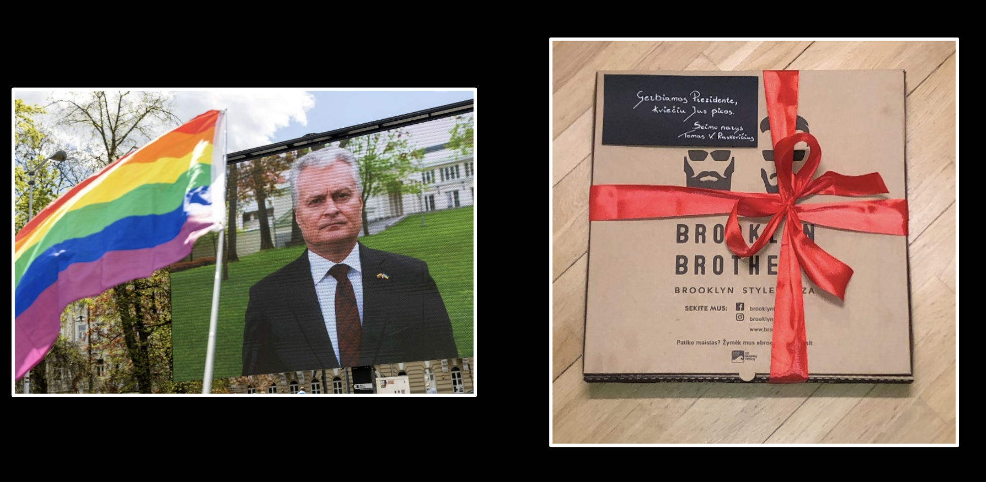

Slide 42
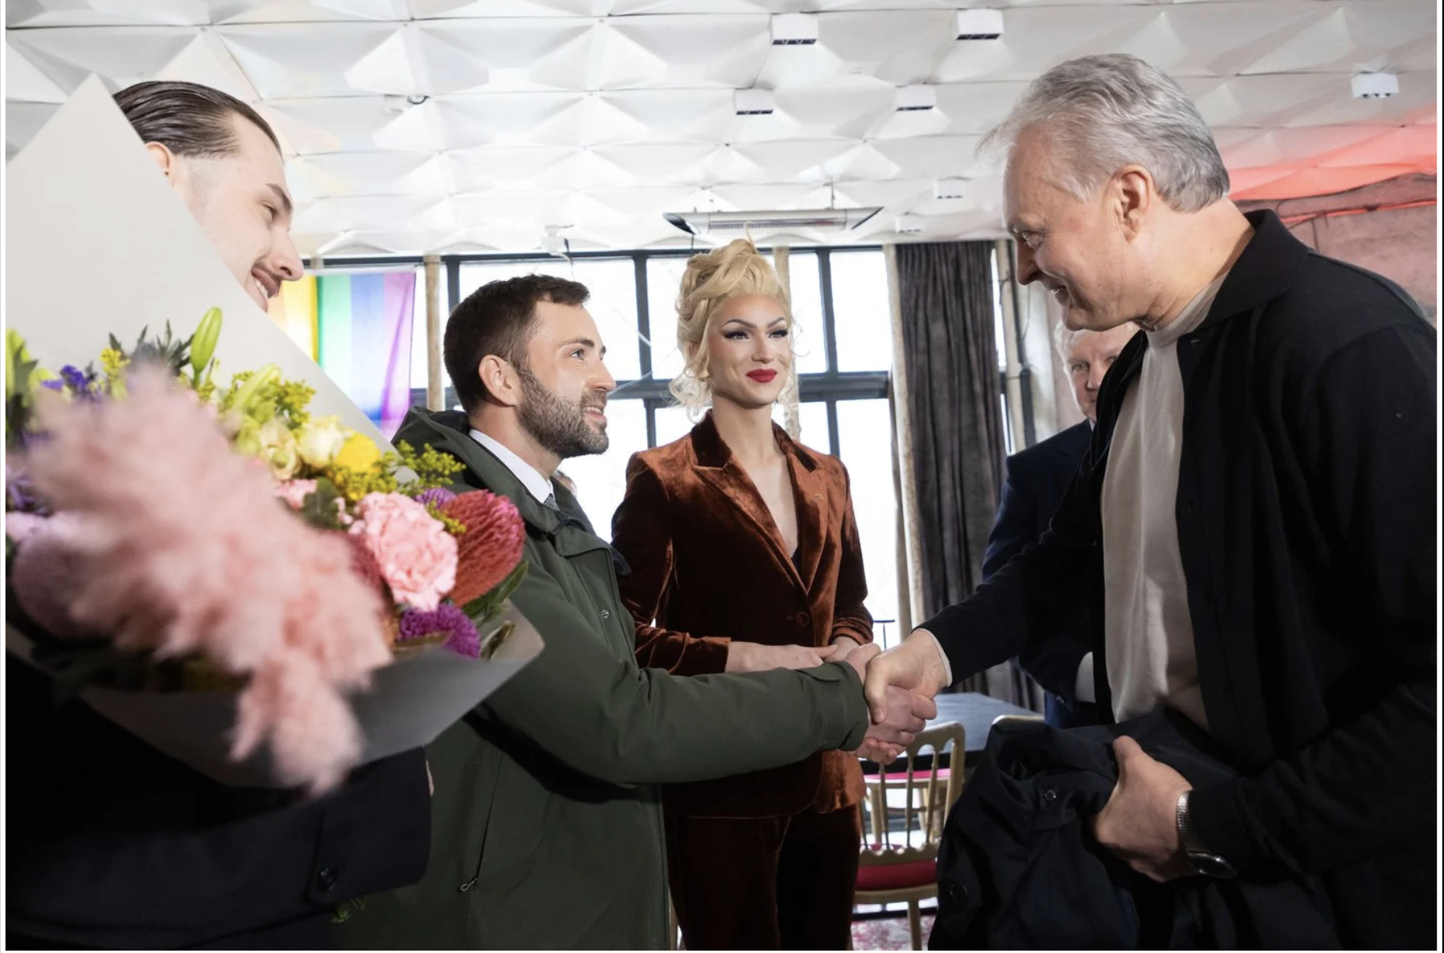

Slide 43
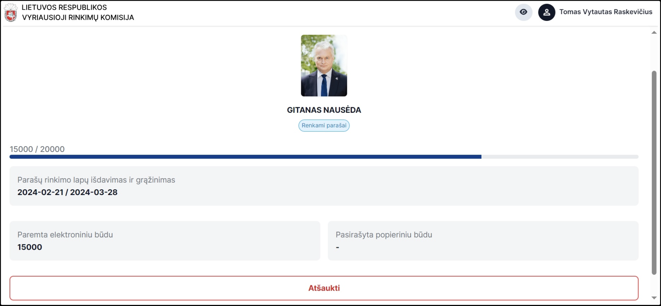

Slide 44
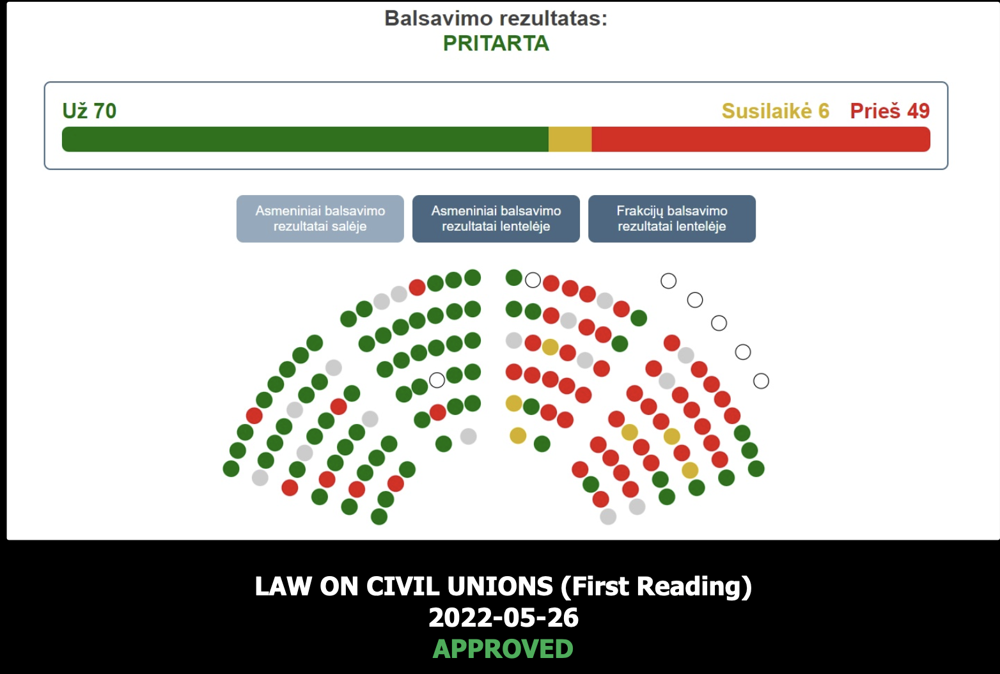

Slide 45
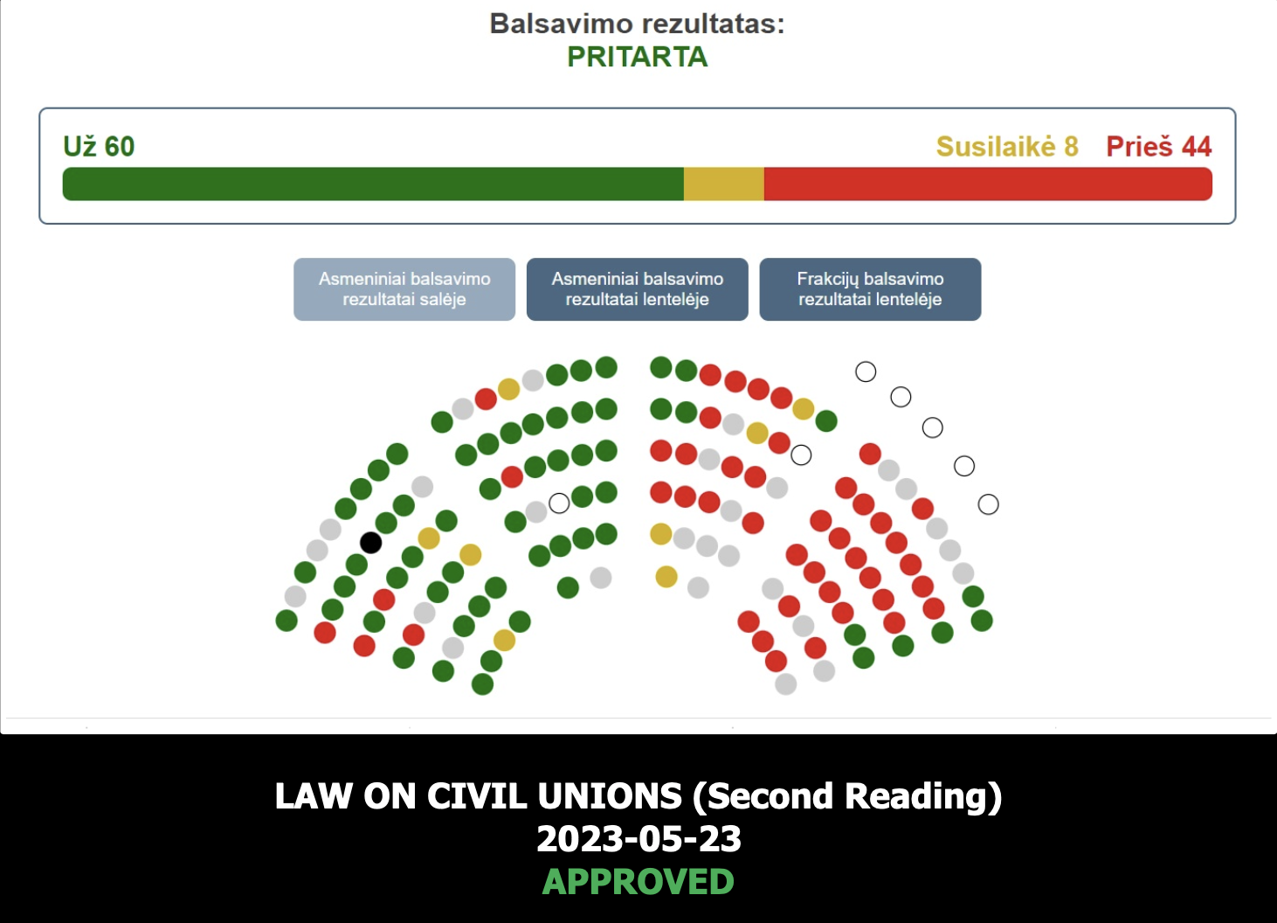

Slide 46
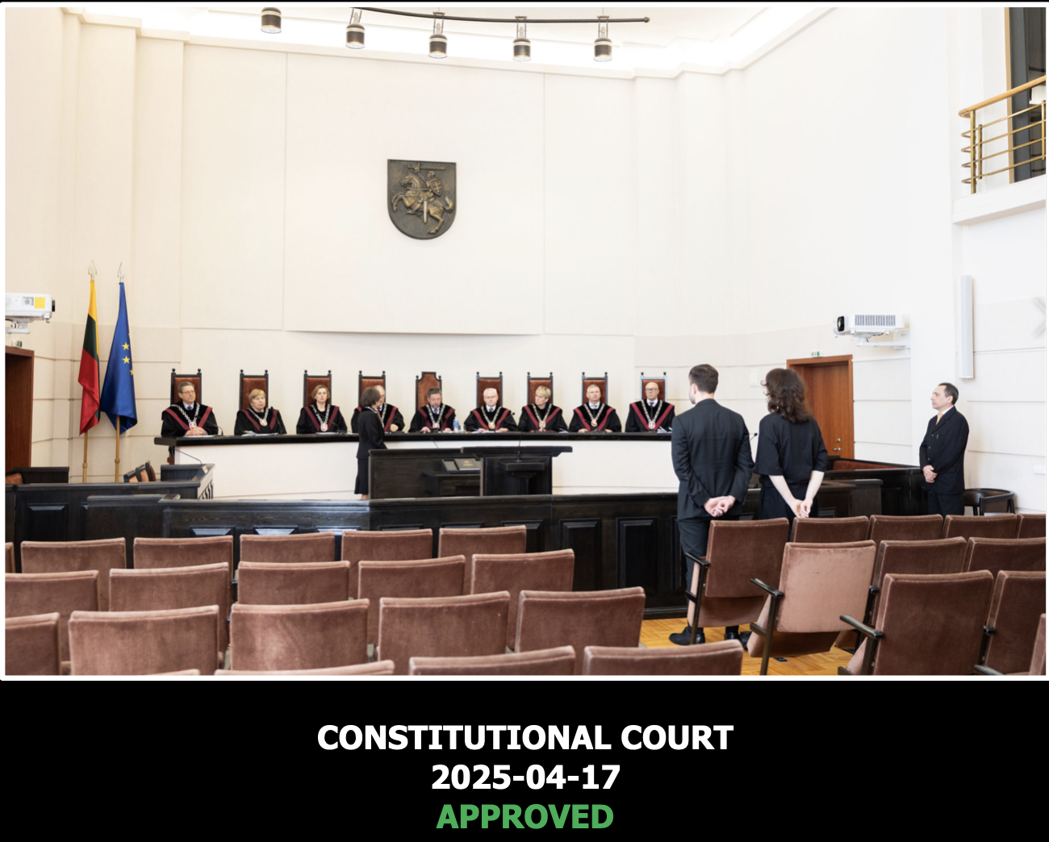

Slide 47
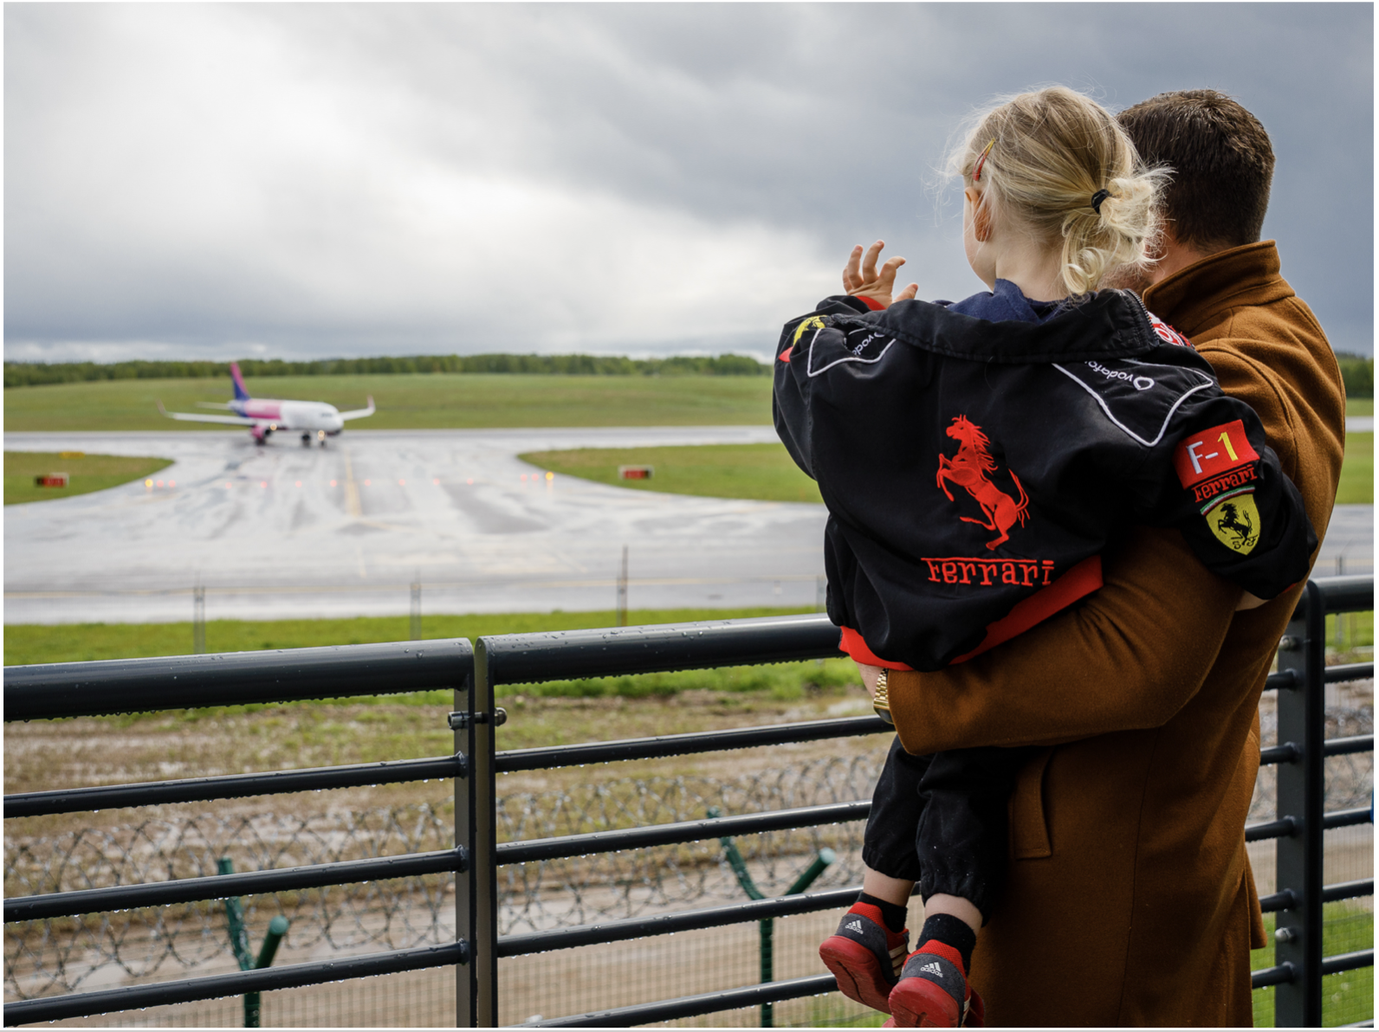

Slide 48


Slide 49
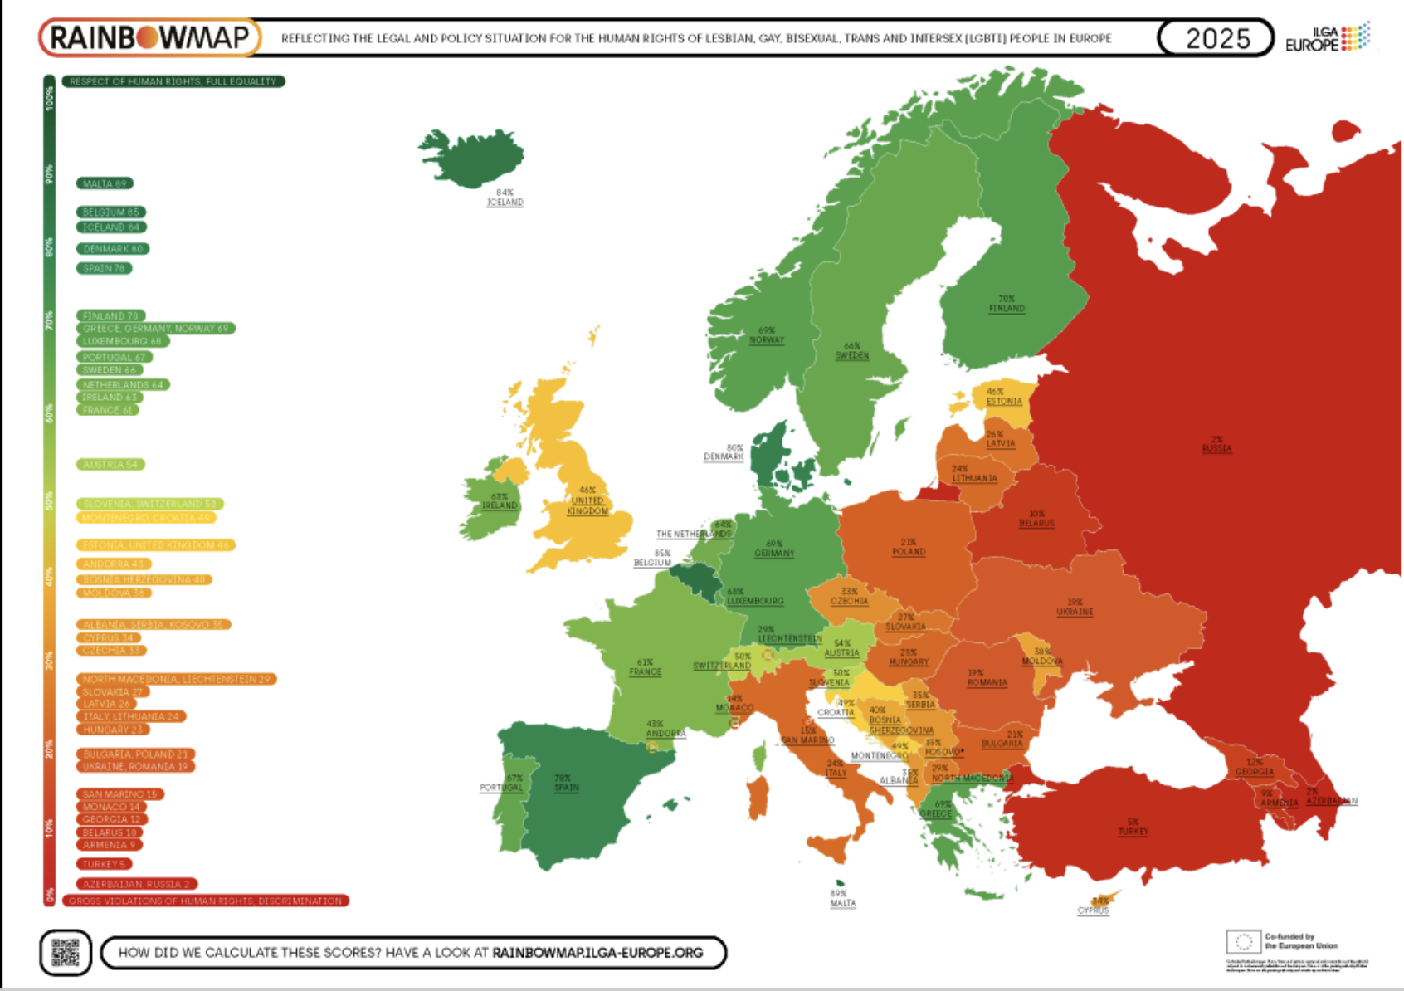

Slide 50
FOLLOW OUR
JOURNEY

Slide 51
Archival Material In Digital Formats:
Photos, documents, testimonies
Karolina Vilkelienė

Slide 52
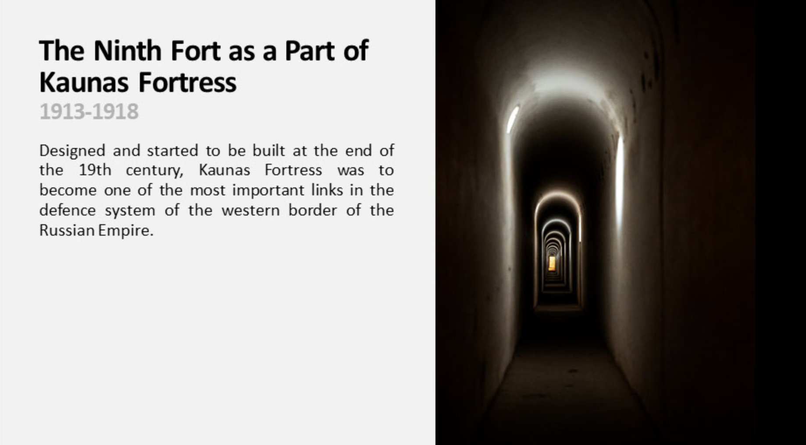

Slide 53
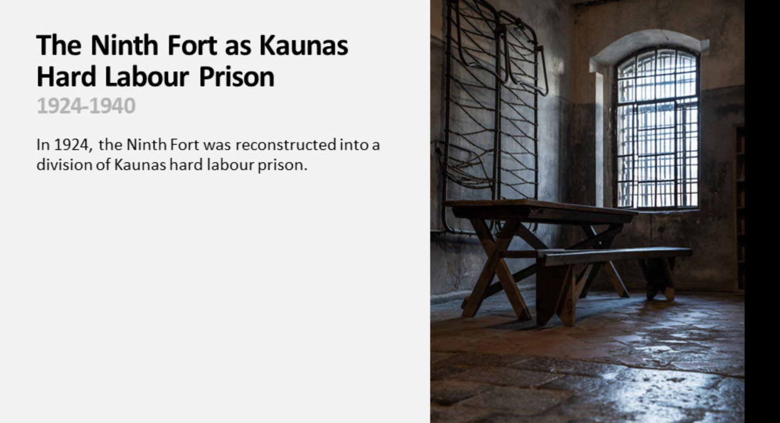

Slide 54
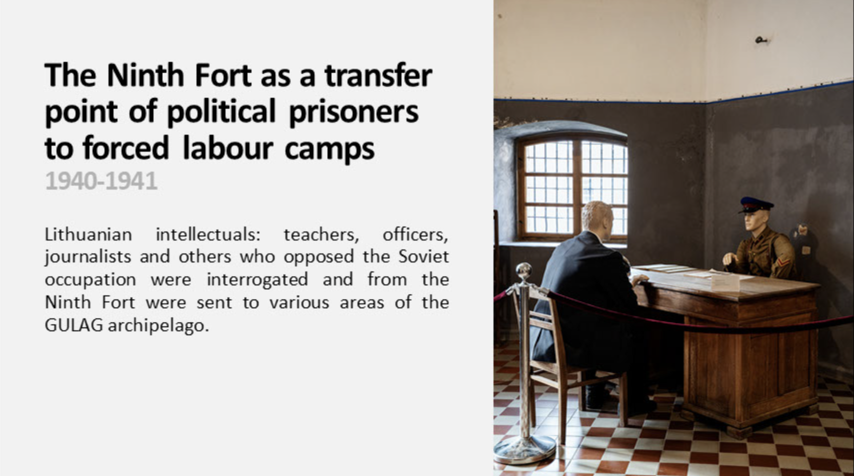

Slide 55
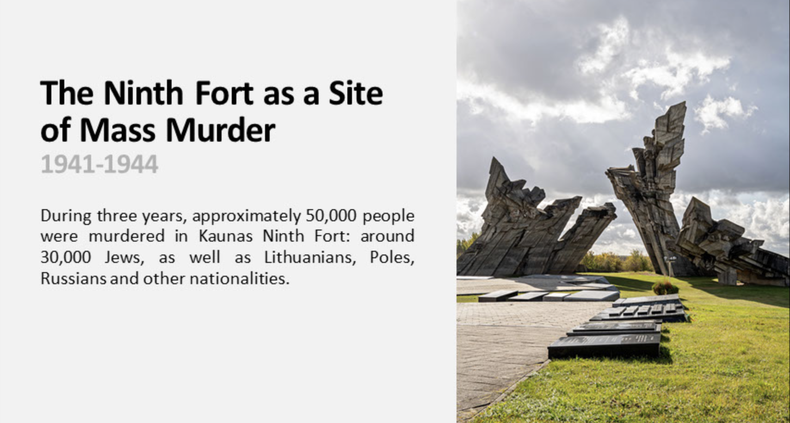

Slide 56
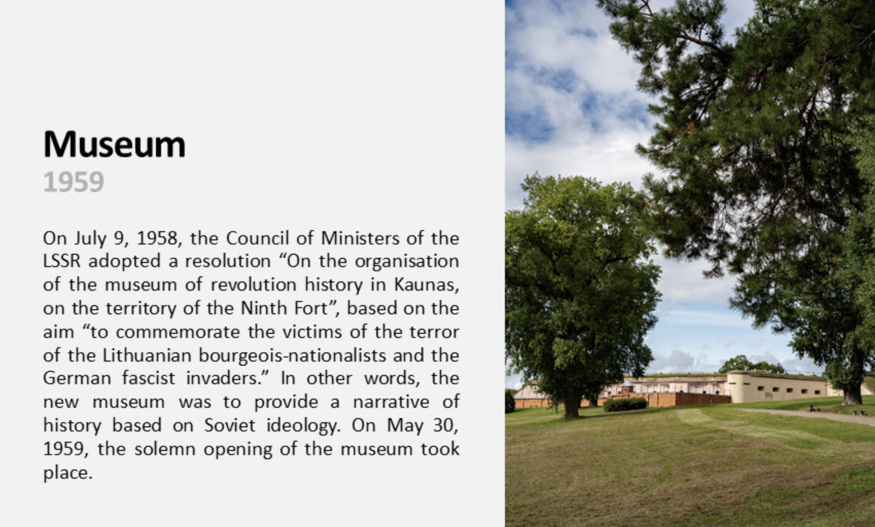

Slide 57
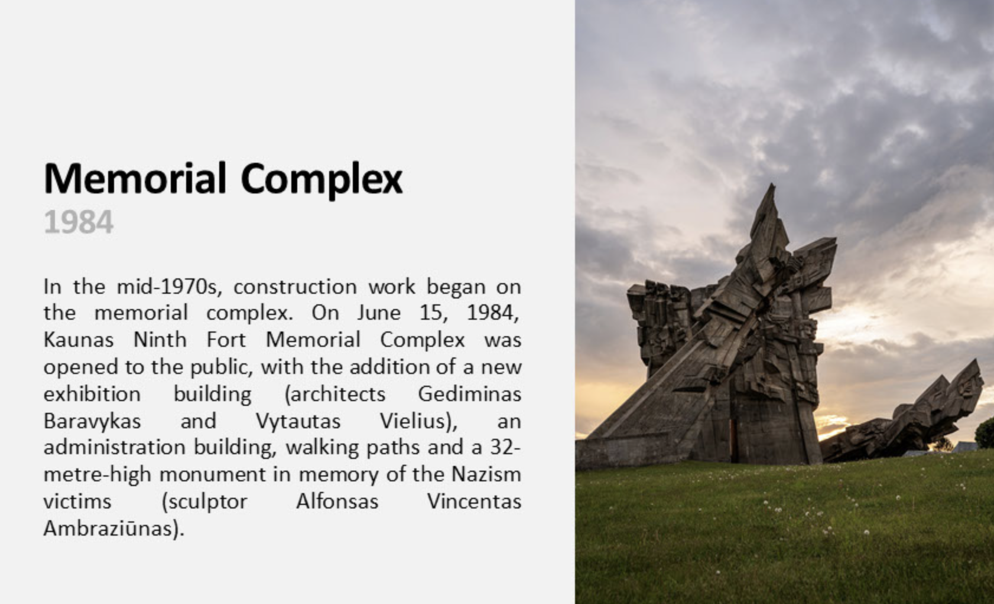

Slide 58
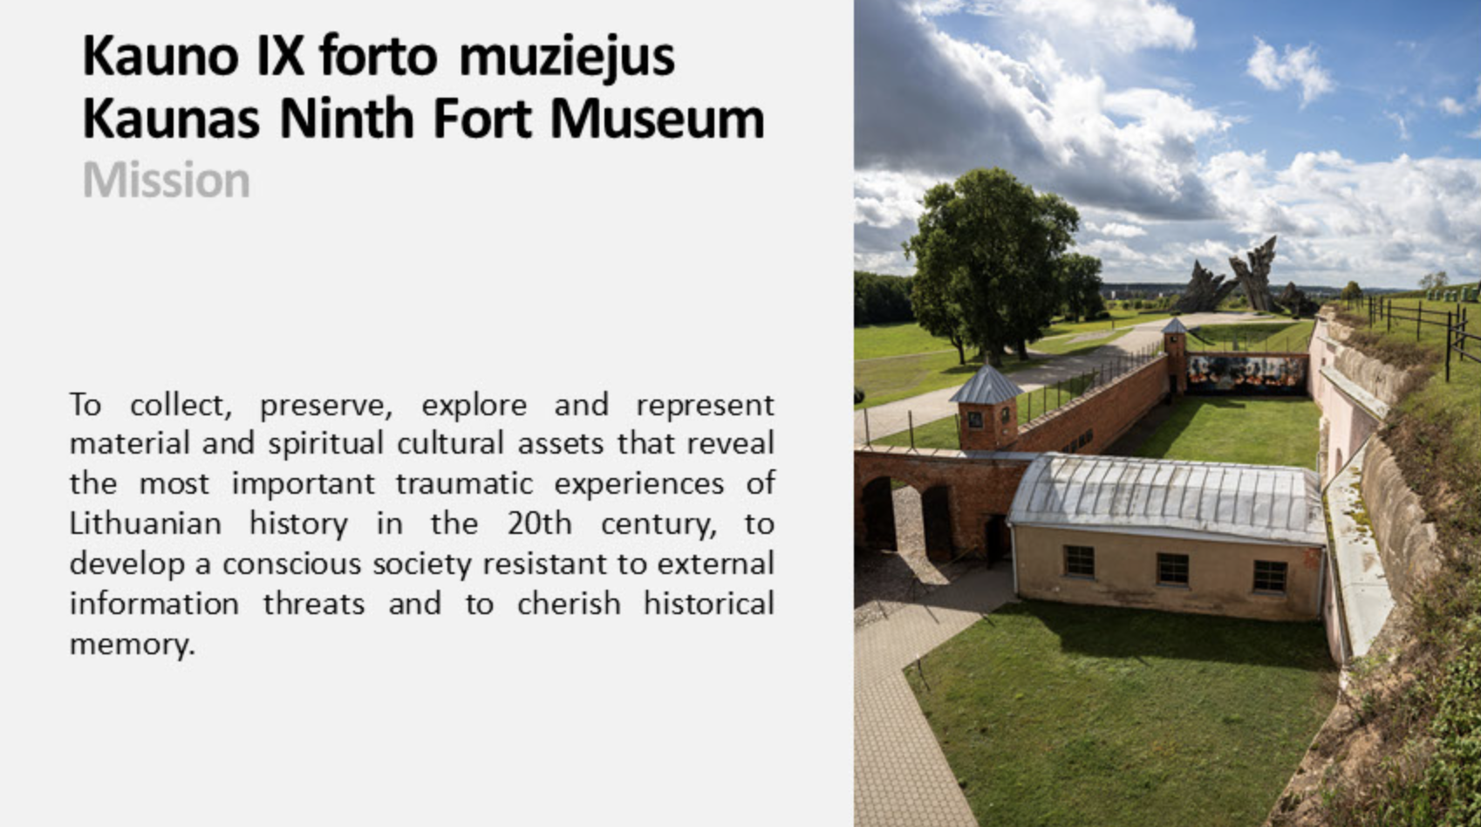

Slide 59
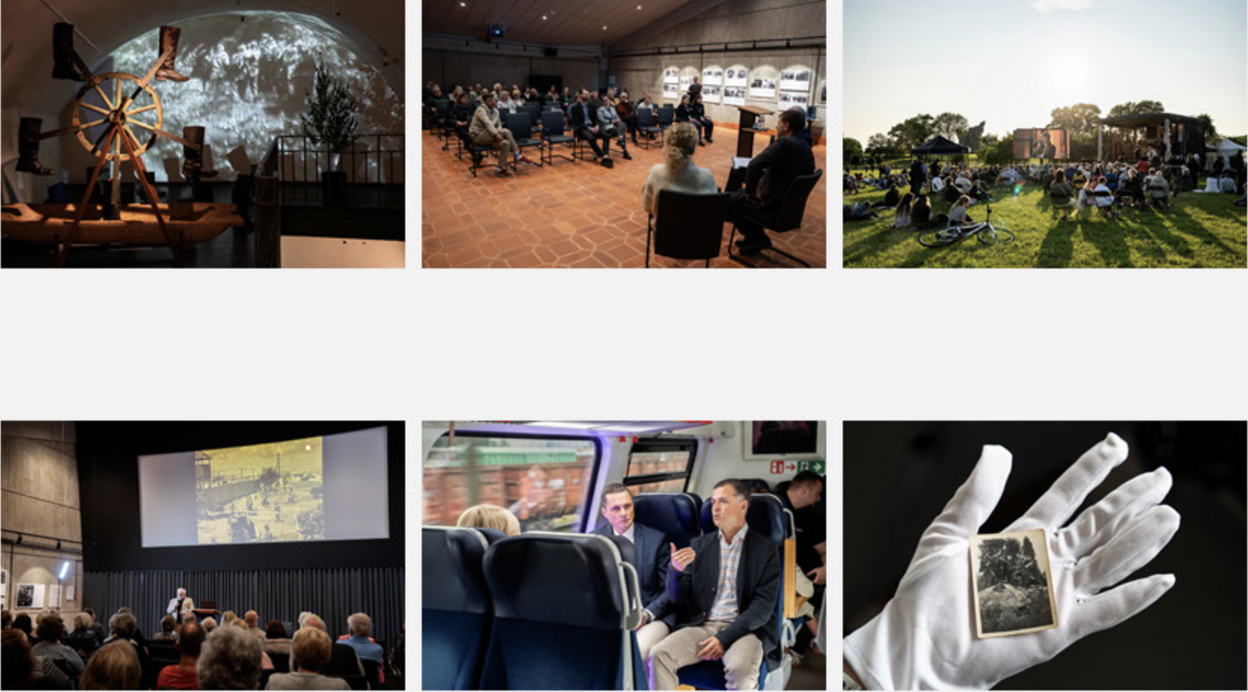

Slide 60
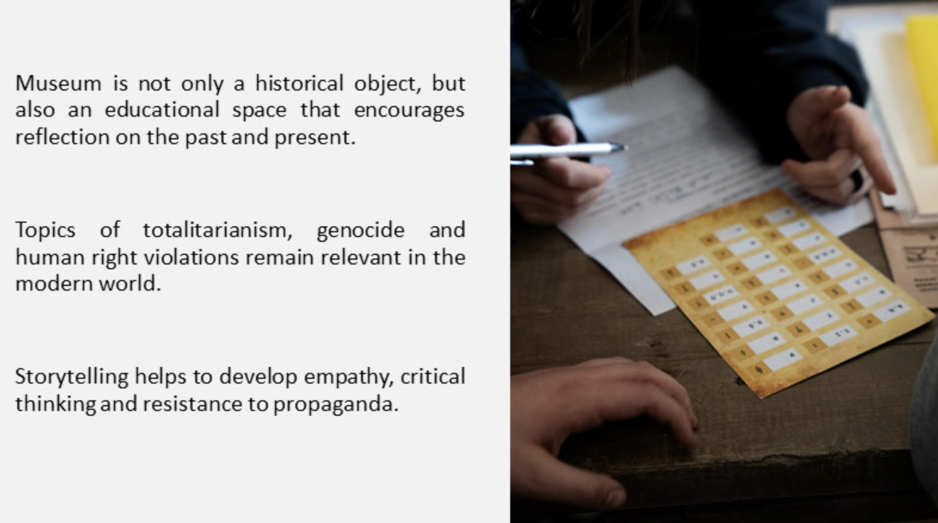

Slide 61
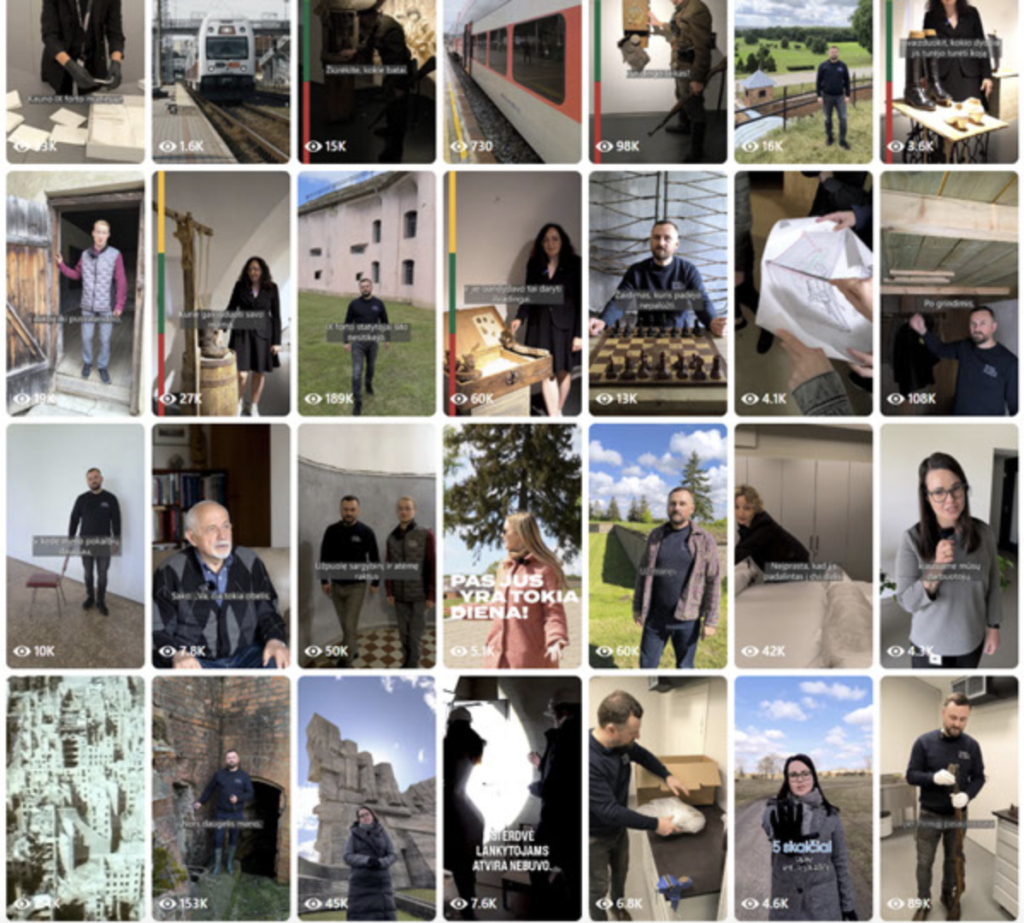

Slide 62
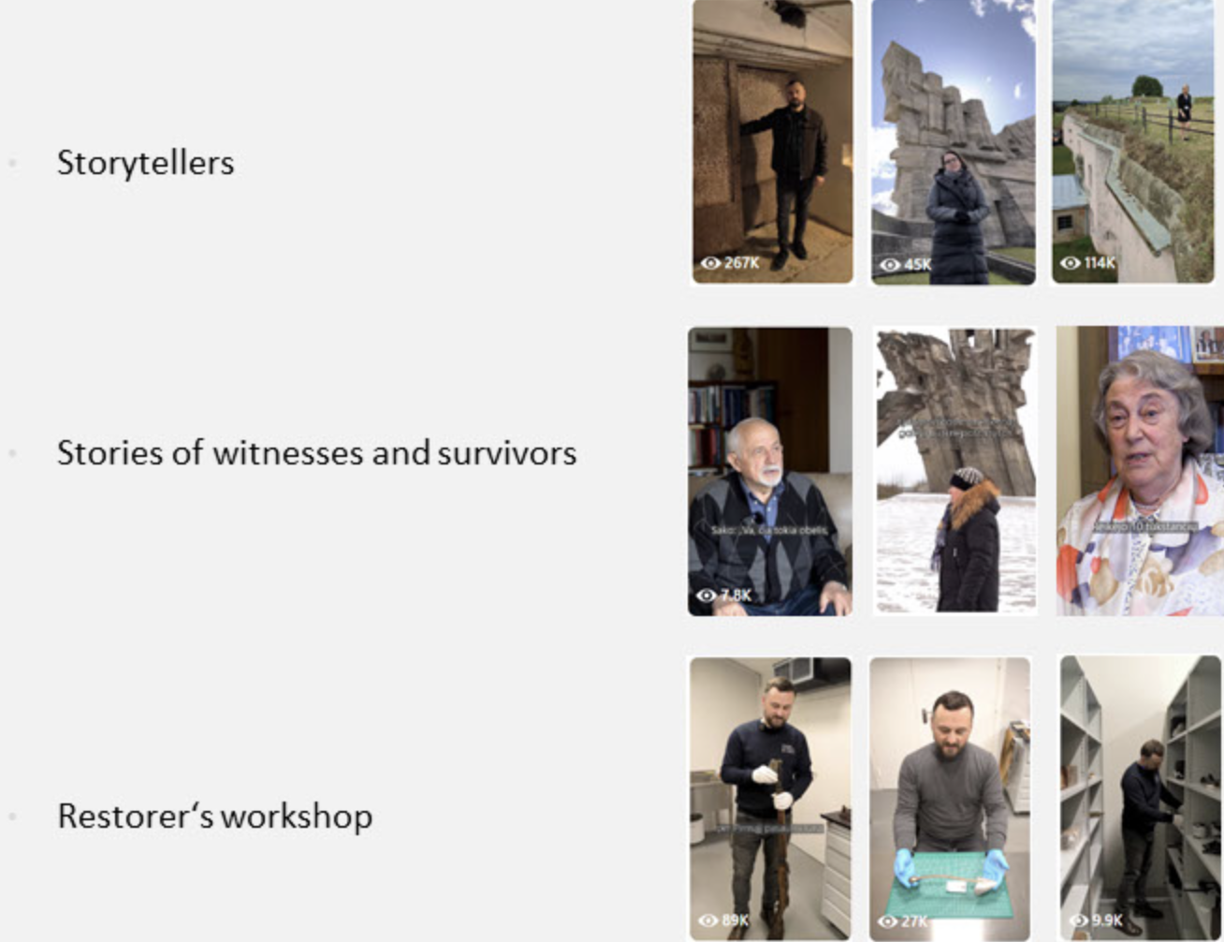

Slide 63
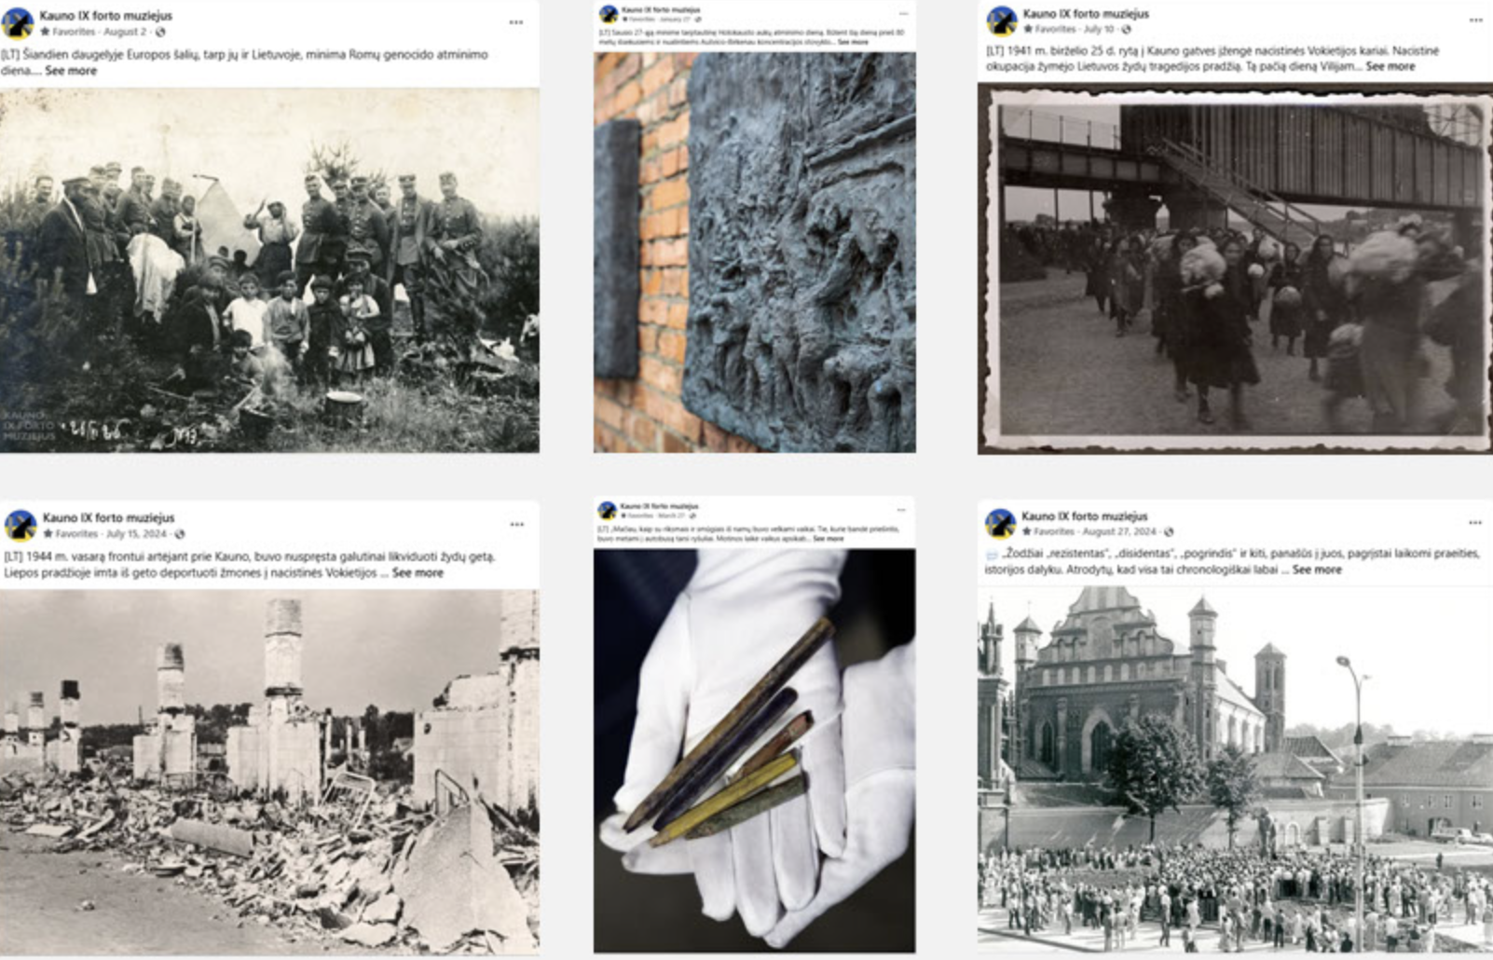

Slide 64
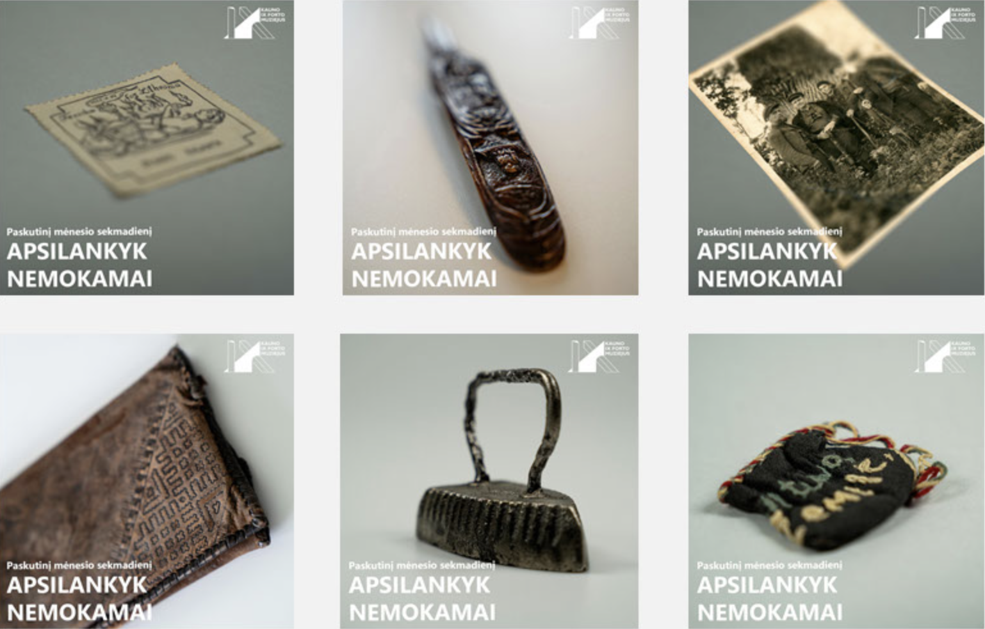

Slide 65
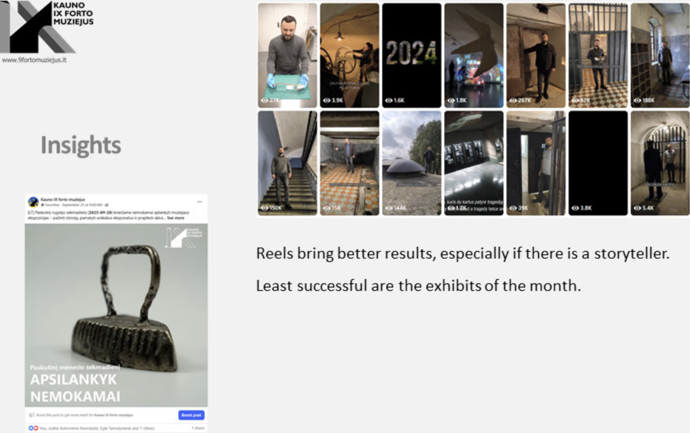

Slide 66
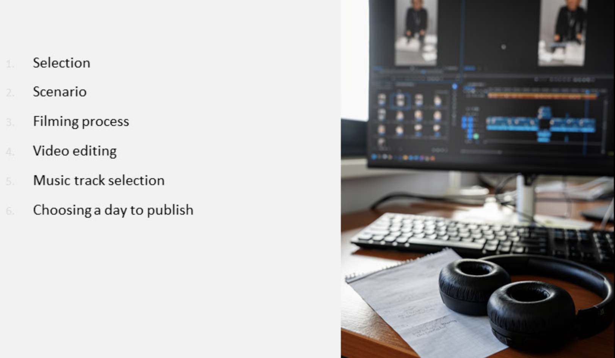

Slide 67
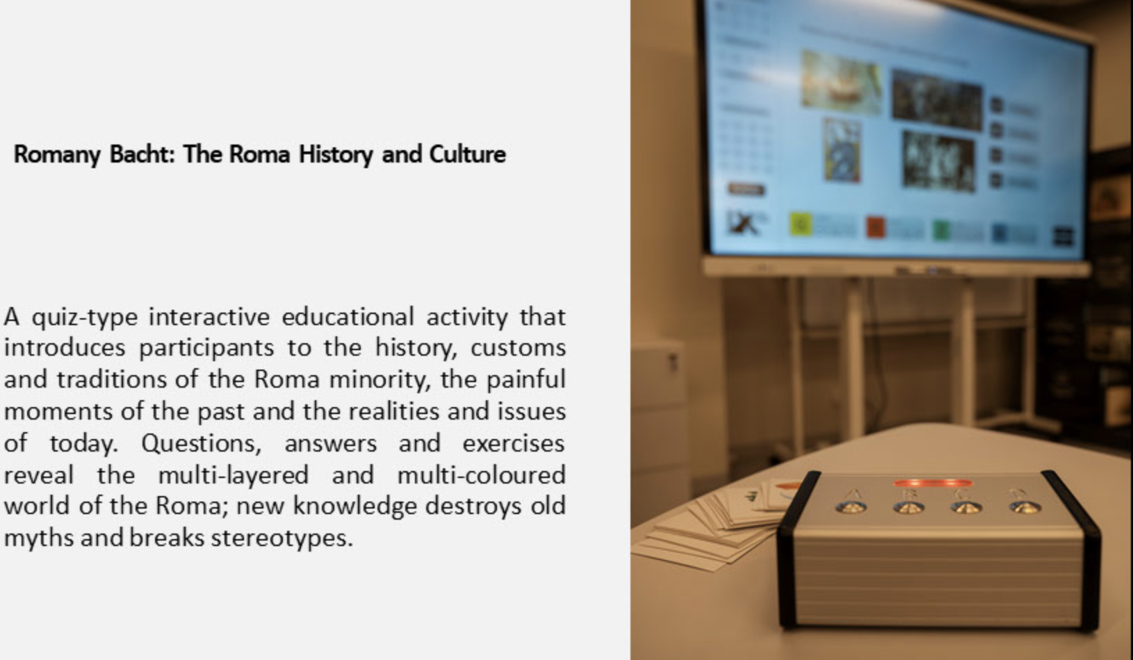

Slide 68
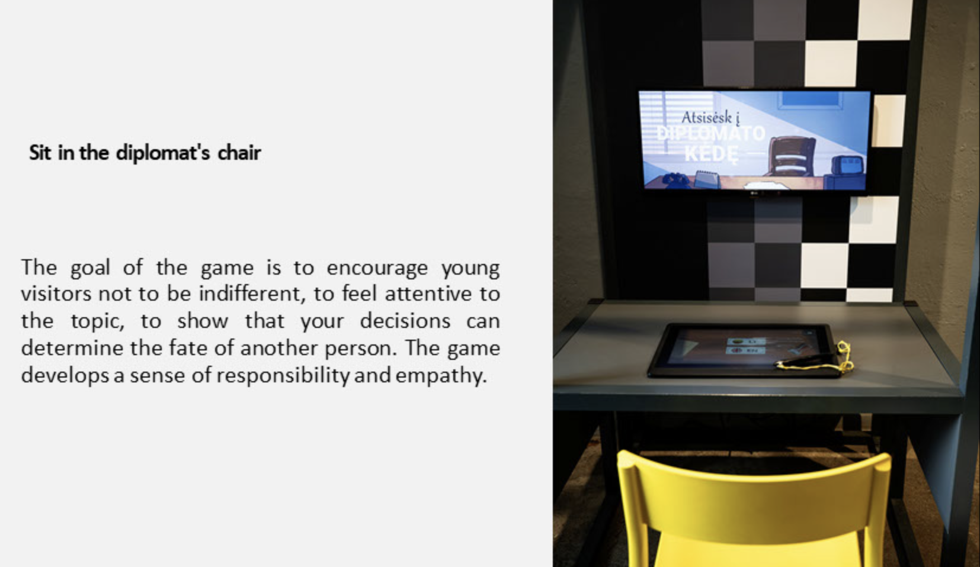

Slide 69
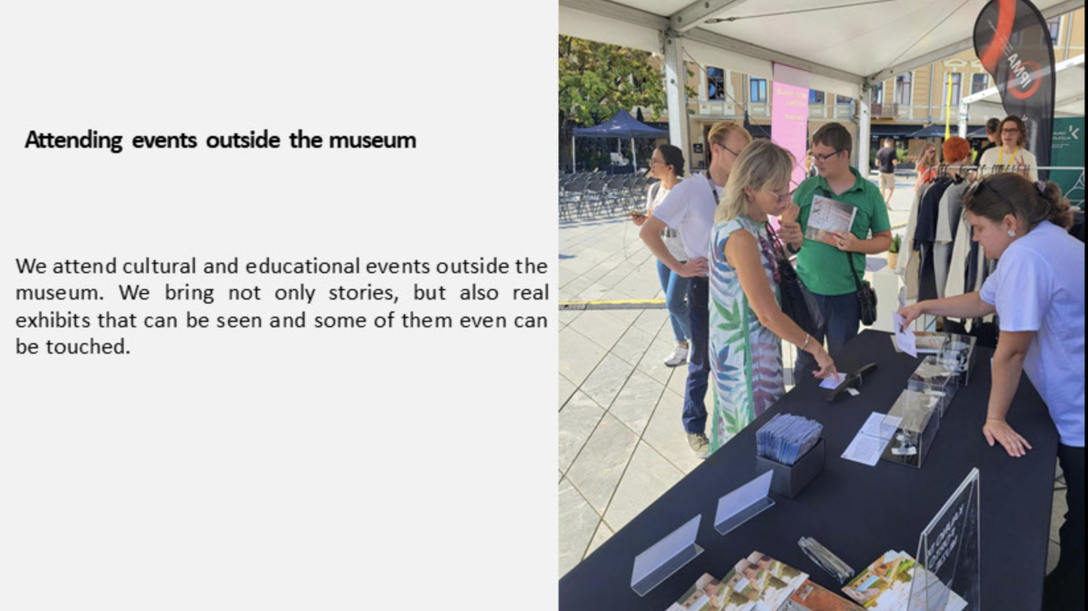

Slide 70
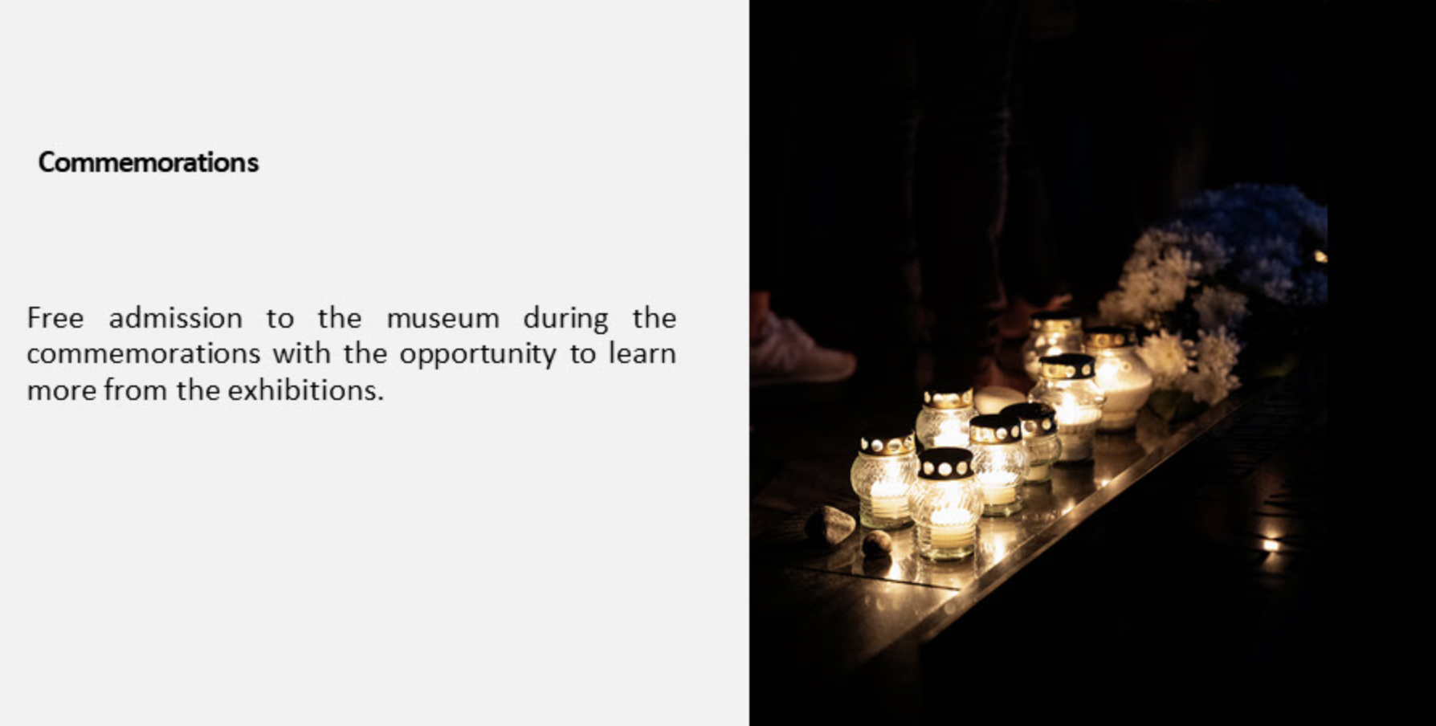

Slide 71


Slide 72


Slide 73


Slide 74


Slide 75
FOLLOW OUR
JOURNEY

Slide 76
Funded by the European Union. Views and opinions expressed are however those of the author(s) only and do not necessarily reflect those of the European Union or European Commission. Neither the European Union nor the granting authority can be held responsible for them. [Project Number: 101196478]

