Slide 1
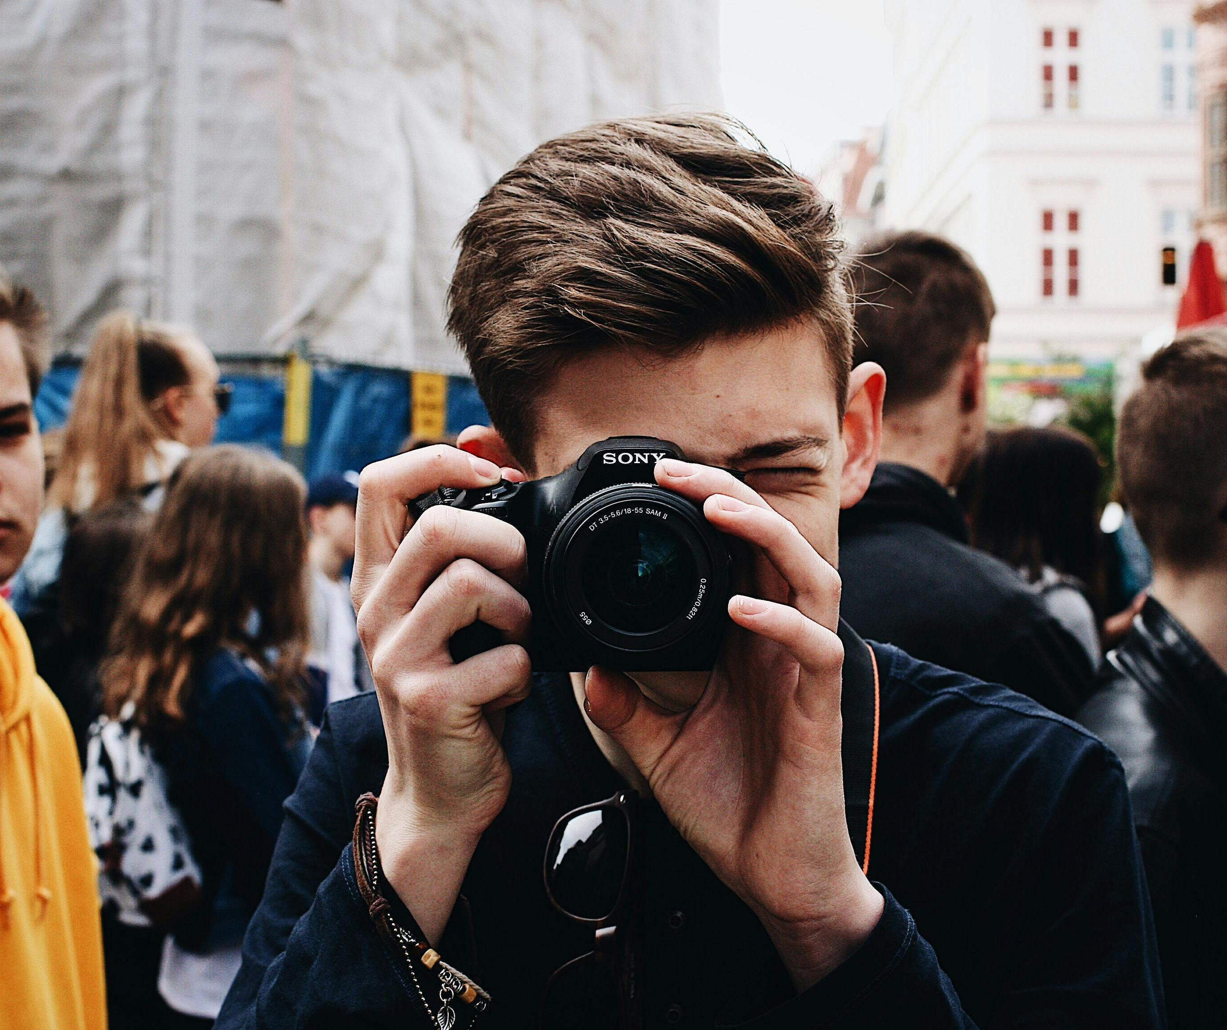
AI & VISUAL DISTORTION
OF HOLOCAUST MEMORY
www.memory-makers.eu

Slide 2
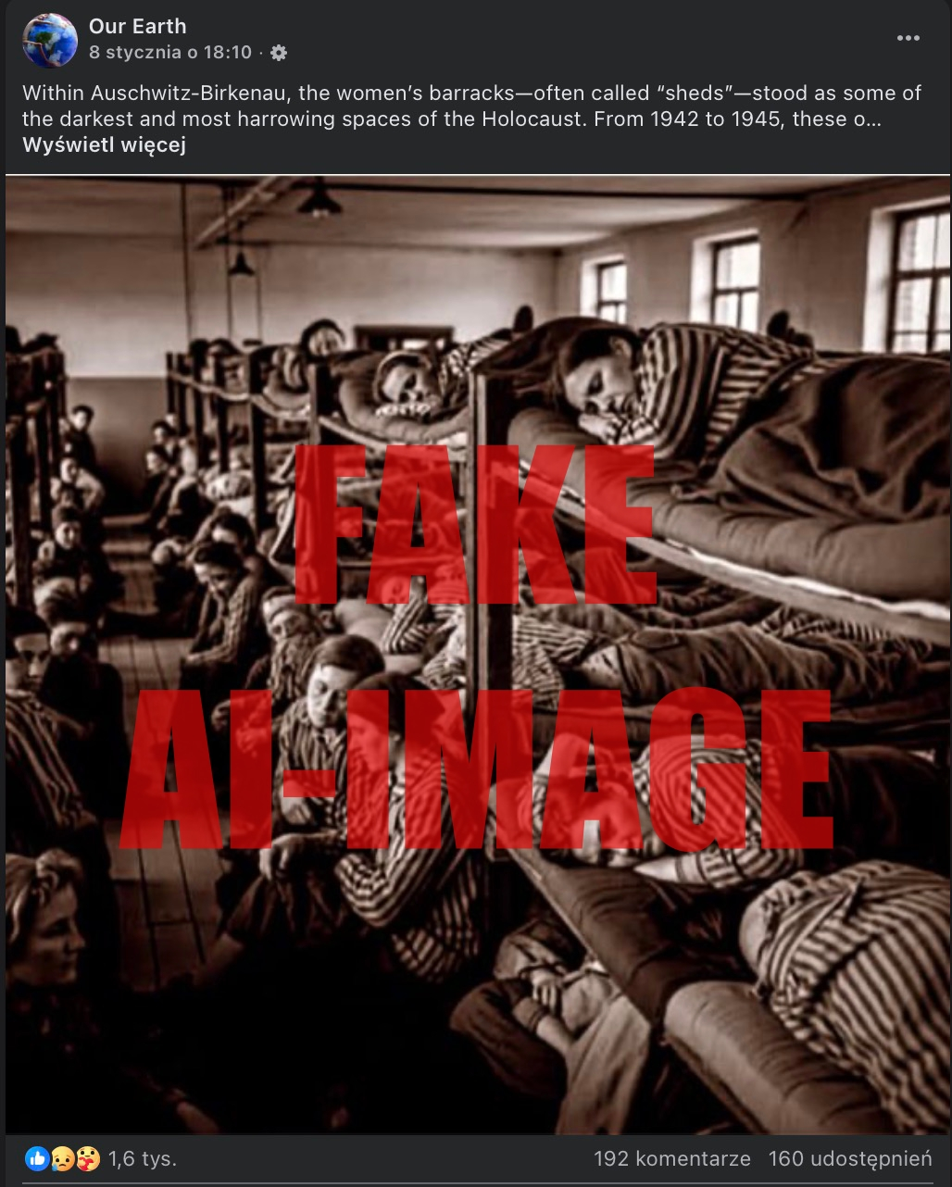
Bartosz Kwieciński (JU)

Slide 3
Remember
Creating fake, AI-generated images of Auschwitz and other camps is a dangerous act of distortion. Social platforms - especially Facebook - are directly responsible for enabling and amplifying their spread. This matters because such content does not merely falsify history; it actively harasses the memory of the victims.
Photography has always carried an implicit social contract: when we look at a photograph, we trust that a photographer stood in a real place, at a real moment, and preserved a fragment of reality. This trust is foundational to historical documentation. Camp photographs from Auschwitz are not illustrations; they are evidence…
MEMORIAL AND MUSEUM
AUSCHWITZ-BIRKENAU
FORMER GERMAN NAZI
CONCENTRATION AND EXTERMINATION CAMP

Slide 4
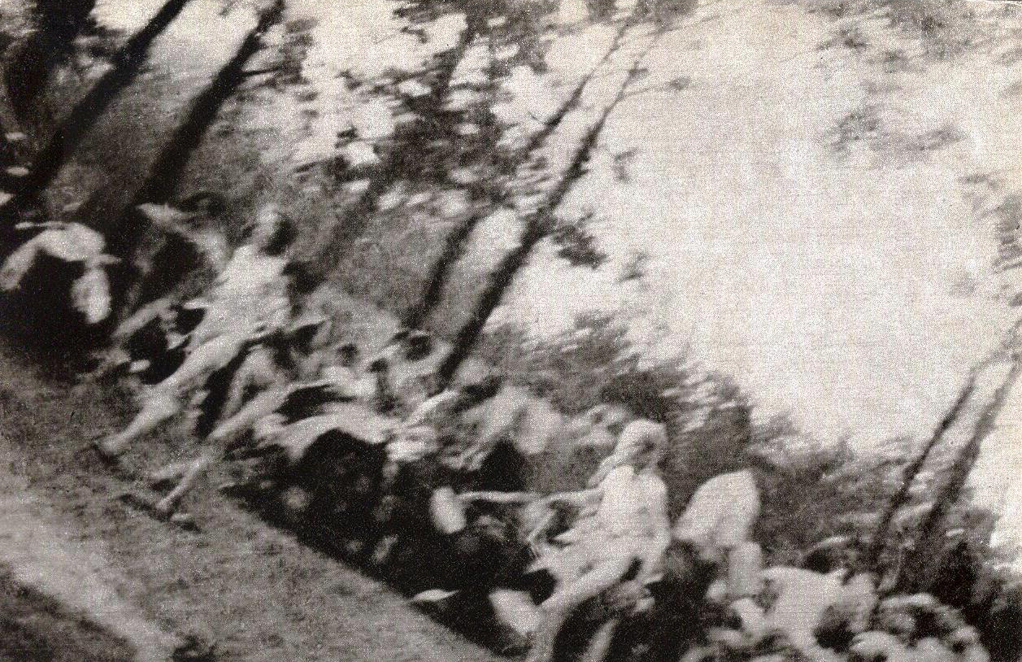
Holocaust Photography as an Ethical Challenge/The Uniqueness of Holocaust Photography
Perpetrator’s Perspective – many photographs were taken by perpetrators (SS, German soldiers).
Historical Evidence – photographs function as documentary proof of events and places.
Visual Testimony – images bear witness to violence and suffering.
Violence of the Camera – as Susan Sontag noted, photographing can resemble an act of aggression.
Rare Victim Images – clandestine photographs taken by Sonderkommando in Auschwitz II-Birkenau (eg.).
Fragmentary Archive – the visual record of the Holocaust is limited and incomplete.

Slide 5
Forms of Distortion: Aesthetic Distortion/Emotional Amplification
Aesthetic distortion occurs when documentary photographs of the Holocaust are altered to appear visually attractive or stylistically refined. Processes such as colorization, cinematic lighting, or artistic enhancement may transform images of historical testimony into aesthetically pleasing objects. This risks weakening their documentary and evidentiary character
Emotional amplification refers to the manipulation of images in order to intensify their emotional impact. Visual elements may be exaggerated or added to provoke stronger reactions such as pity, horror, or empathy. While such modifications may increase engagement, they can also distort the historical reality represented in the original photograph.

Slide 6
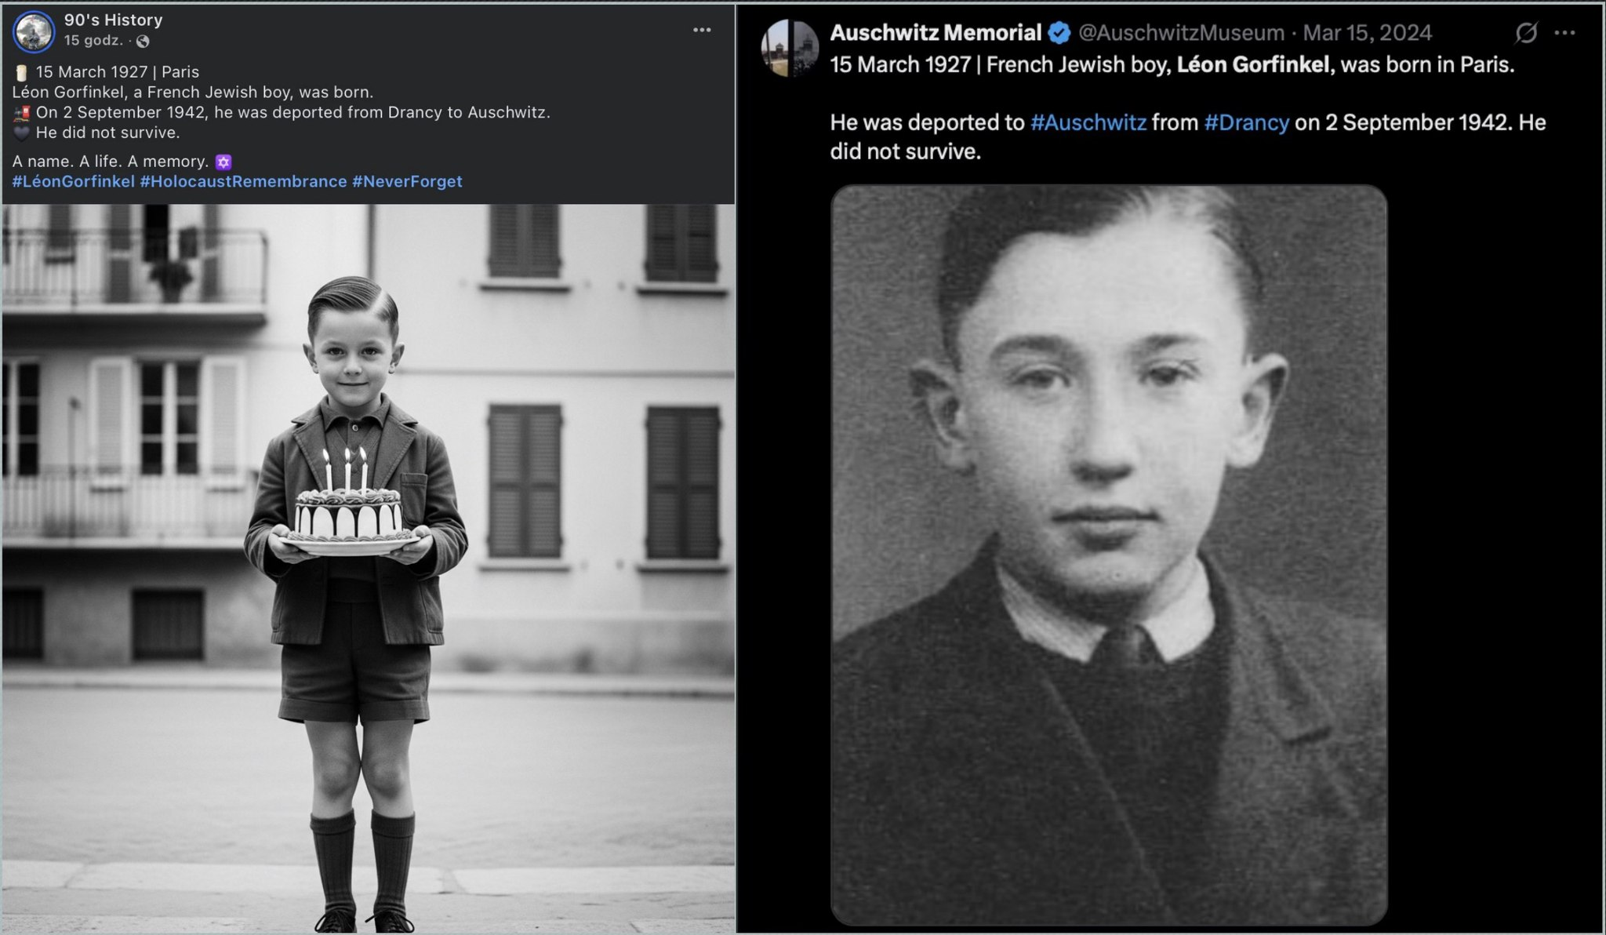

Slide 7
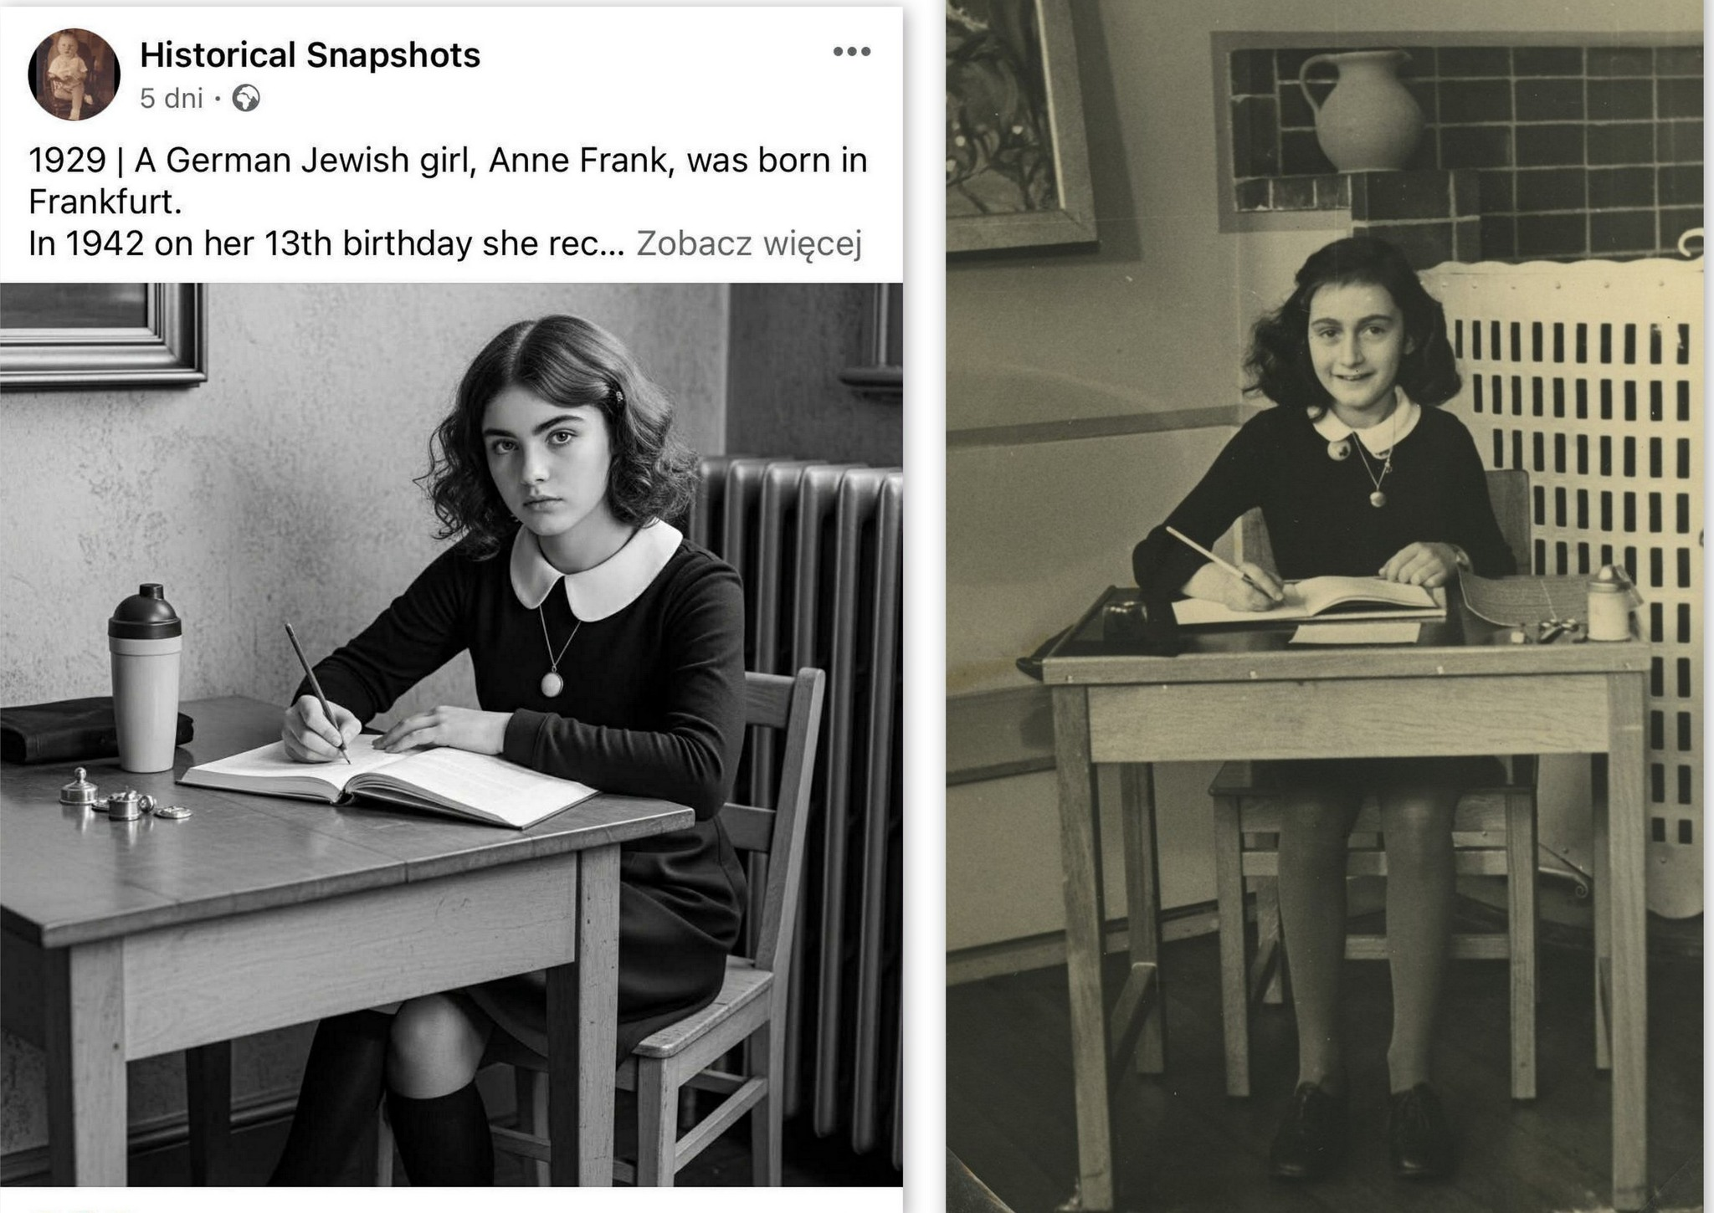

Slide 8
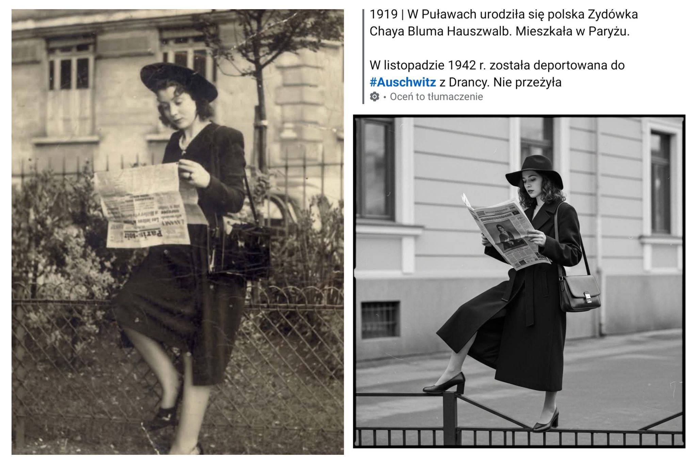

Slide 9
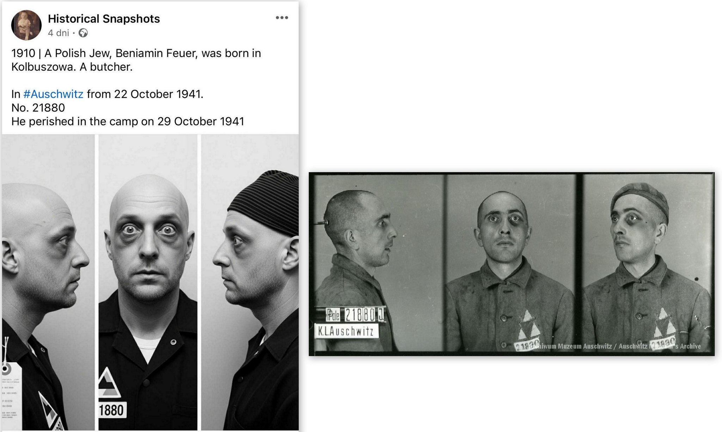

Slide 10
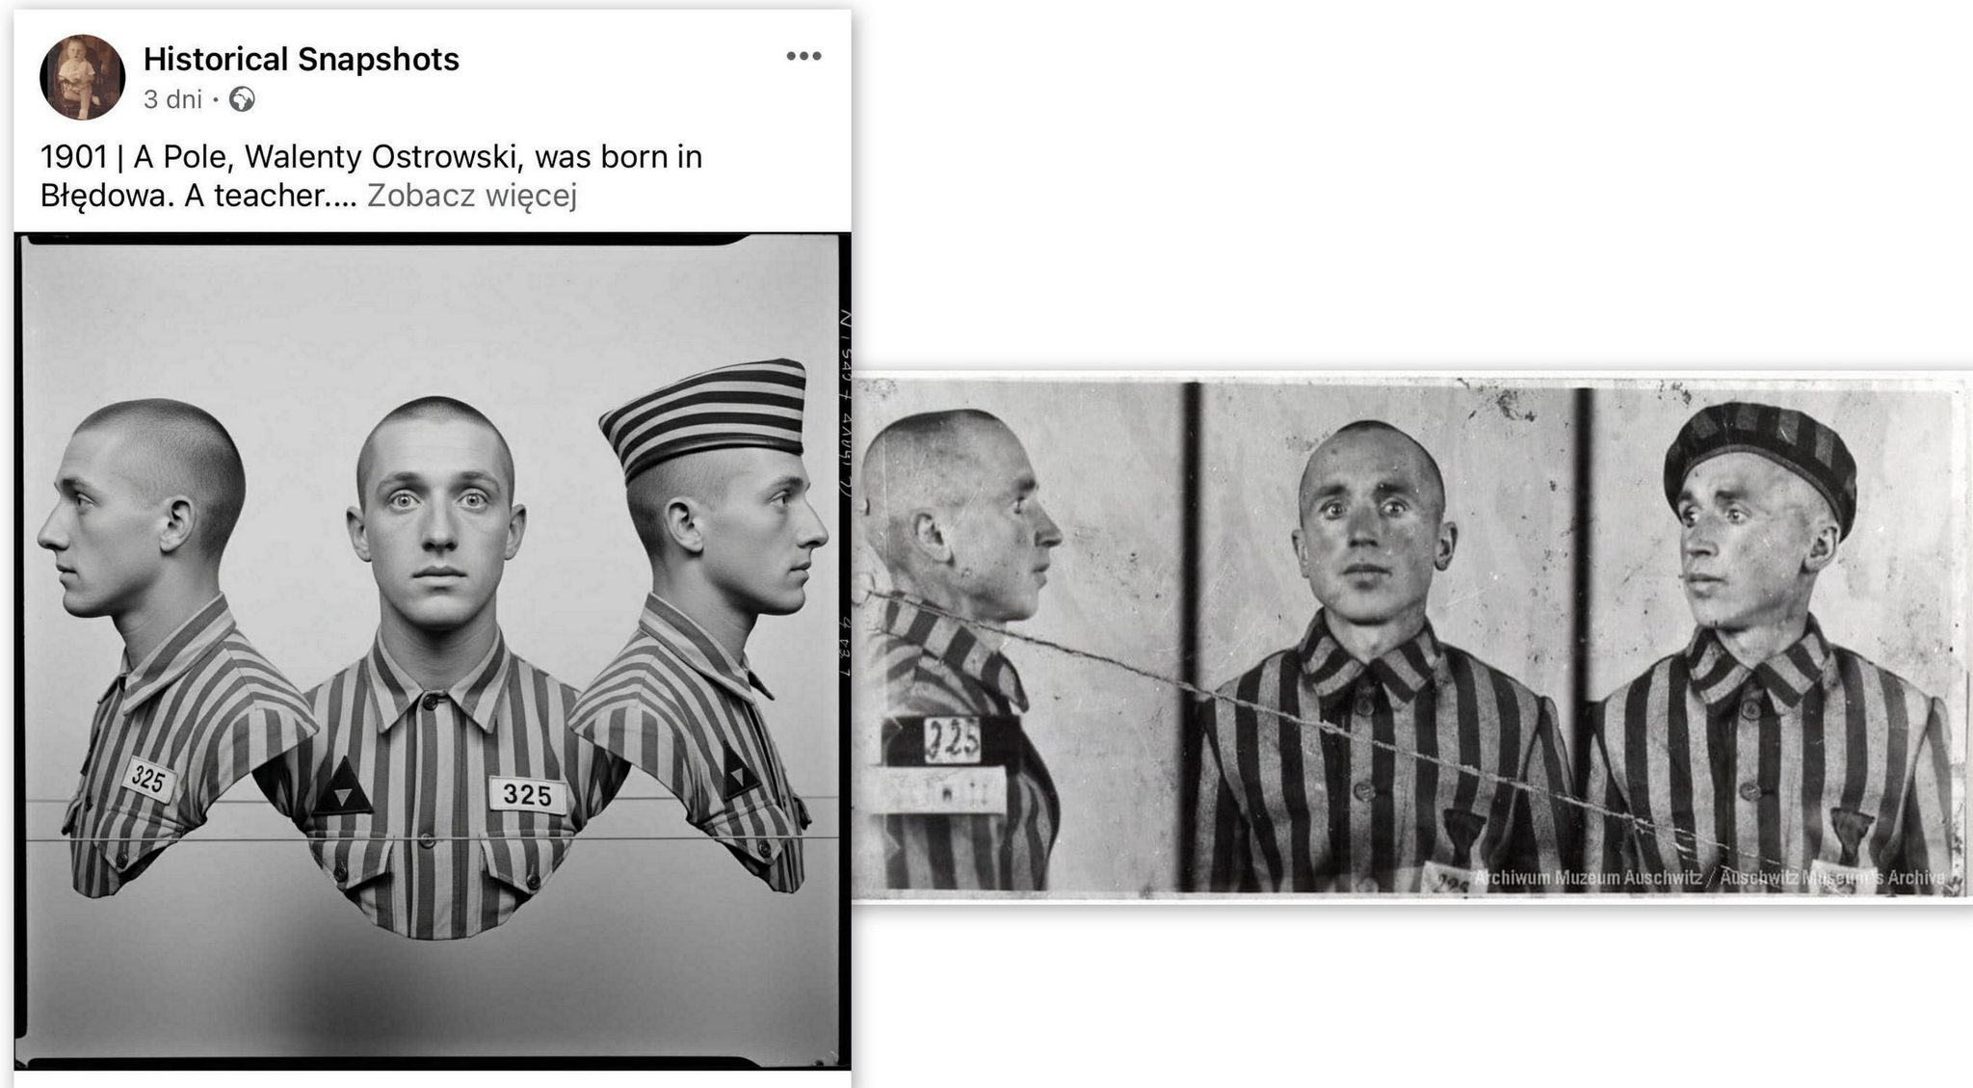

Slide 11
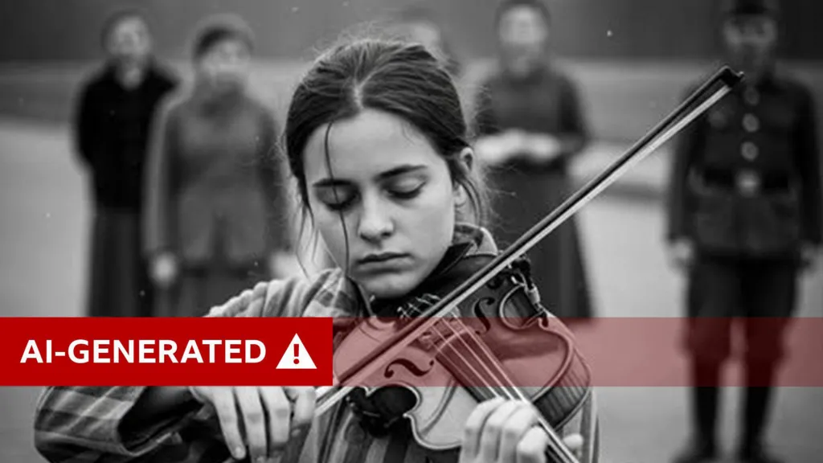

Slide 12
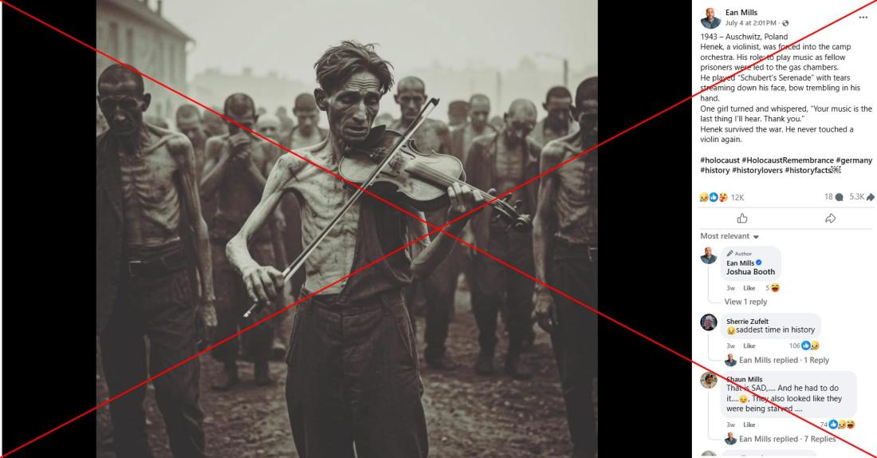

Slide 13
Fabrication of Scenes/Narrative Confabulation
Fabrication of scenes involves the creation of images depicting events or situations that never actually occurred. Using archival photographs as visual references, new scenes can be generated that appear historically authentic but have no basis in historical evidence. Such fabrications blur the boundary between documentation and imagination.
Narrative confabulation occurs when fictional or inaccurate stories are attached to images. Photographs may be accompanied by invented biographies, incorrect identifications, or misleading historical explanations. As a result, the meaning of the image becomes shaped by false narrative frameworks rather than verified historical knowledge.

Slide 14
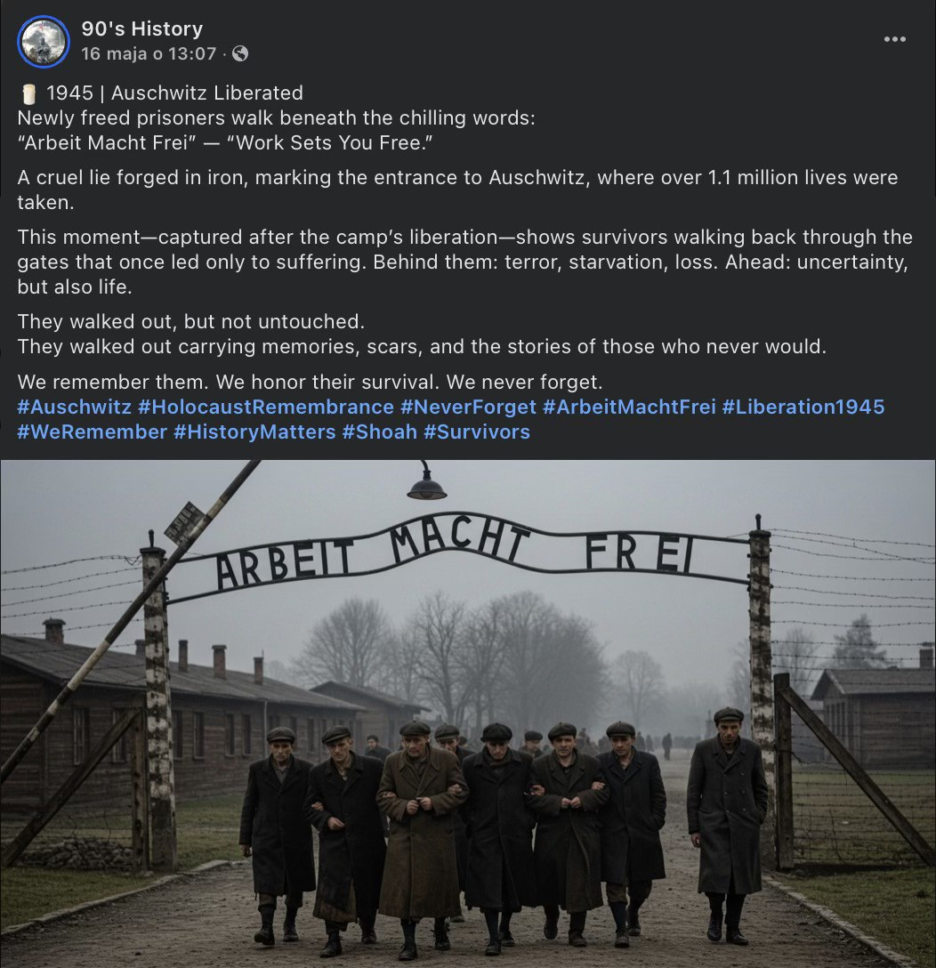

Slide 15
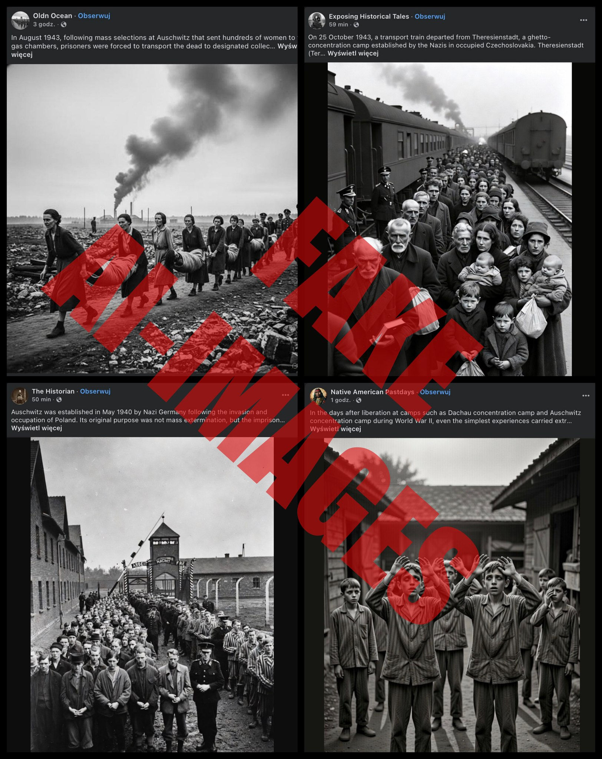

Slide 16
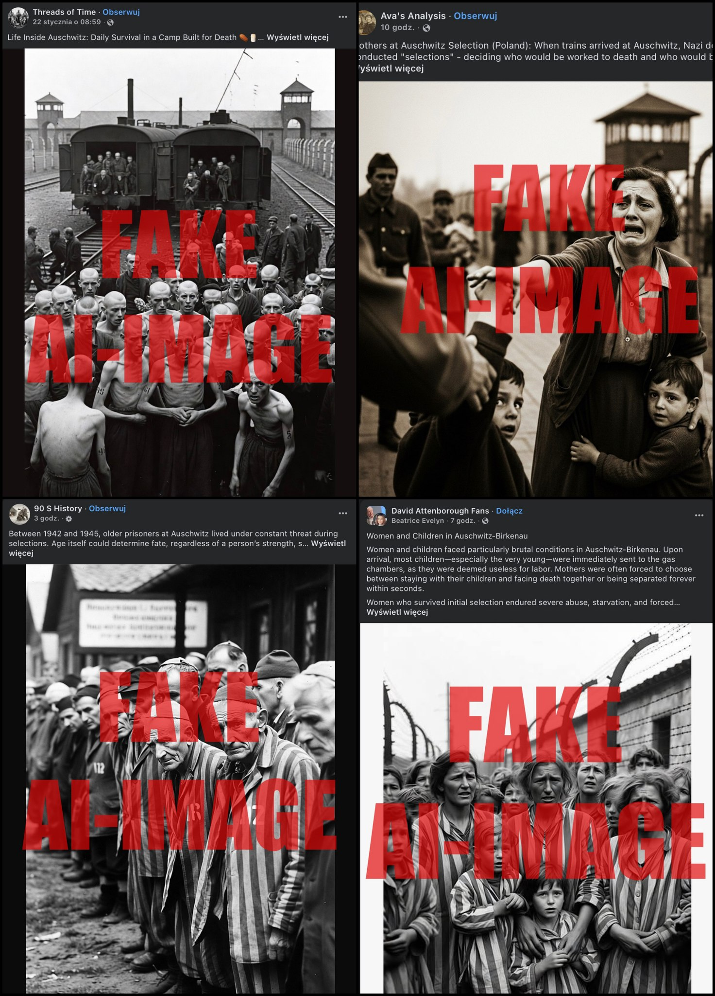

Slide 18
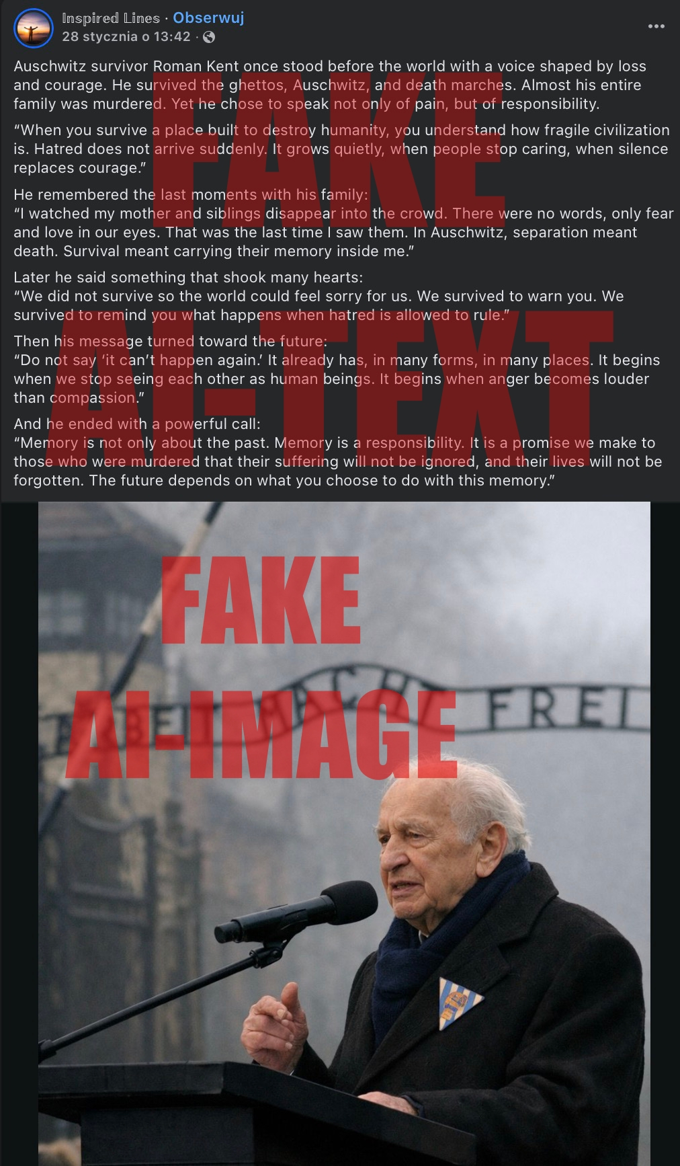
Contextual Distortion
Contextual distortion happens when authentic photographs are presented with incorrect or misleading contextual information. Even when the image itself is genuine, changing the caption, date, location, or historical background can fundamentally alter its interpretation and significance.

Slide 19
Intentions of Distortion
Ideological Manipulation
Images may be distorted in order to support a specific ideological or political agenda. Manipulated photographs can be used to reinforce propaganda, promote denialist narratives, or reshape historical responsibility. In this case the distortion serves a strategic narrative goal.
Emotional Instrumentalisation
Some distortions aim to intensify emotional reactions in the audience. Images may be altered to provoke stronger empathy, shock, or outrage, often in order to mobilize public opinion or attract attention. The ethical problem arises when emotional impact becomes more important than historical accuracy.
3. Creative or Speculative Experimentation
Some distortions aim to intensify emotional reactions in the audience. Images may be altered to provoke stronger empathy, shock, or outrage, often in order to mobilize public opinion or attract attention. The ethical problem arises when emotional impact becomes more important than historical accuracy

Slide 20
Commercial Exploitation/Sensationalism and Attention Economy
In the digital environment, shocking or dramatic images circulate more widely. Distortions may therefore be produced to increase visibility, engagement, or virality in media and social platforms. The primary motivation is not ideological but the pursuit of attention
Images related to the Holocaust may be manipulated for commercial purposes, such as marketing, entertainment, or visual media production. Here historical material becomes a resource used to generate profit, sometimes at the cost of historical integrity and ethical responsibility

Slide 21
Case/BBC Investigation
an international network of spammers creates fake Holocaust images using AI and posts them on social media. The content generates high engagement and revenue through Facebook’s monetization programs.
BBC investigations linked many accounts to creators in Pakistan, with similar activity in India, Thailand, Nigeria, and Vietnam.
Some pages reached hundreds of millions of views, earning creators thousands of dollars per month.

Slide 22
Five Key Risks of AI-Generated or Manipulated Holocaust Imagery
Epistemic – erosion of visual evidence
Ethical – trivialization of suffering
Mnemonic – transformation of collective memory
Contextual – distortion of historical meaning
Political – instrumentalization and denial

Slide 23
Possible Countermeasures
Archival Verification – systematic verification of images using trusted archives and historical sources.
Clear Labeling – explicit labeling of AI-generated or manipulated images.
Context Preservation – maintaining accurate captions, dates, locations, and historical explanations.
Digital Literacy – educating audiences to recognize manipulation and synthetic imagery.
Ethical Guidelines – establishing standards for the use of Holocaust imagery in research, media, and education.
Institutional Responsibility – active involvement of museums, archives, and research institutions in monitoring and correcting distortions.

Slide 24
Concluding Reflection
The Holocaust has always been exposed to denial, distortion, and ideological exploitation.
Photographs that once served as historical evidence have repeatedly been manipulated or misused.
Today, generative technologies introduce a new scale of visual fabrication.
Synthetic images can spread through digital networks with the speed of a virus.
If the boundary between documentation and fabrication collapses, collective memory risks turning into fantasy, confabulation, and a warning that gradually loses its meaning. The danger lies not only in false images, but in the overwhelming proliferation of images that may gradually erode the authority of authentic testimony.

Slide 25

THANK
YOU

