Slide 1
Cleric-Dignitaries of the Slovac State in Post-Communist Discourse: Attempts at the Rehabilitation of Jozef Tiso and Jan Vojtaššák after 1989
Filip Koźmiński

Slide 2
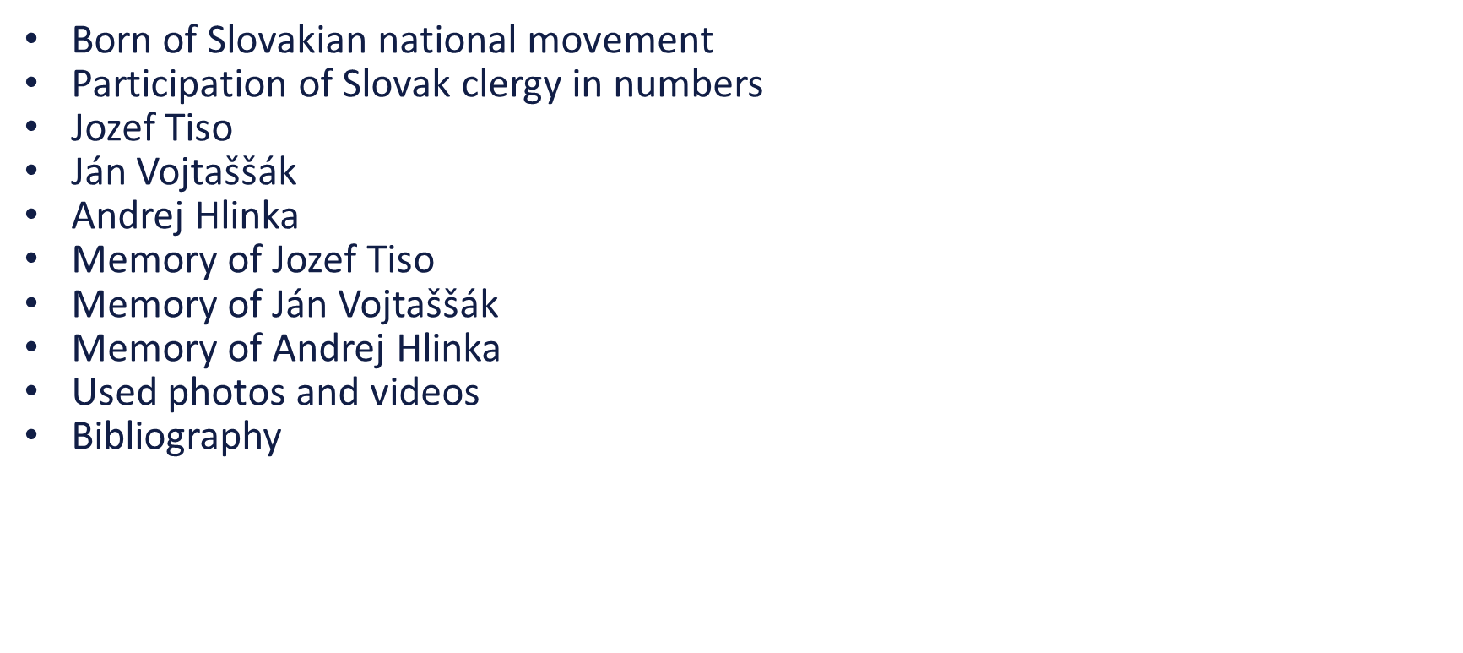
Presentation
Agenda

Slide 3
Born of Slovakian National Movement
Lack of political and cultural elites.
The Slovak National Enlightenment. Creation of the dual monarchy in 1867. Intensive Magyarization from 1867 to 1914.
Lack of Slovak secular elites led to the clergy becoming the primary national elite; their folk origins created a strong bond with society.
The Church served as a center for education and national culture, defending national rights against Magyarization and Prague centralism.
Due to the lack of political elites, the Church took on a major role—first the Protestants, then the Catholics.
Černová massacre in 1907.
Foundation of the Slovak People's Party.

Slide 4
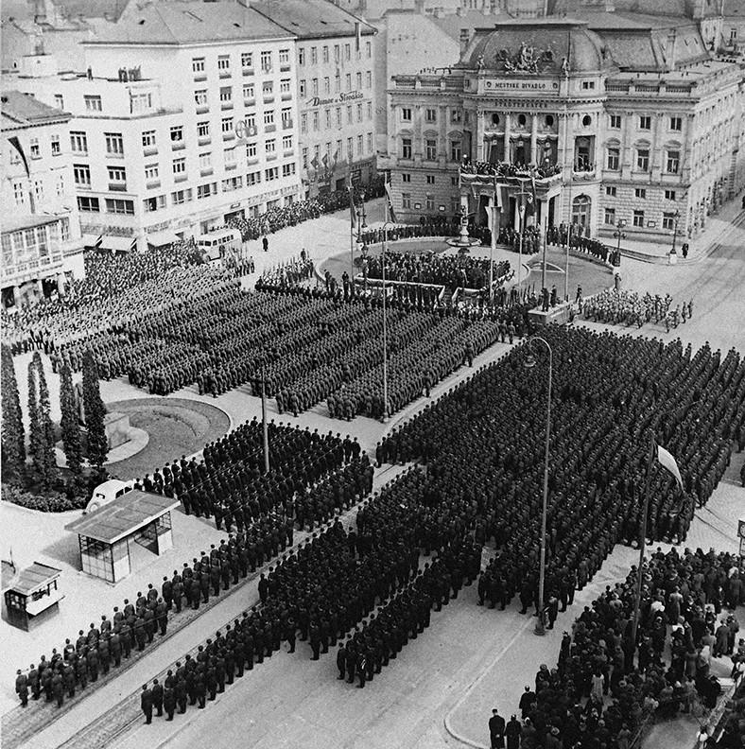
Participation of Slovak Clergy in Numbers
Czechoslovak Parliament: 7 of 12 HSĽS deputies were priests in 1920, and 8 of 23 in 1925
Overrepresentation of clergy: out of 13 clergymen in the 300-seat parliament, the majority were Slovak priests from HSĽS
Party structures: priests led 16 of 59 district party committees and 2 of 6 regional committees (vice-chairs in two others)
Regional elections (1928): 8 clergy among 34 HSĽS candidates for the regional assembly
Slovak Republic (1938–1945): 11 of 63 MPs (≈18%) were priests; the president was Jozef Tiso

Slide 5
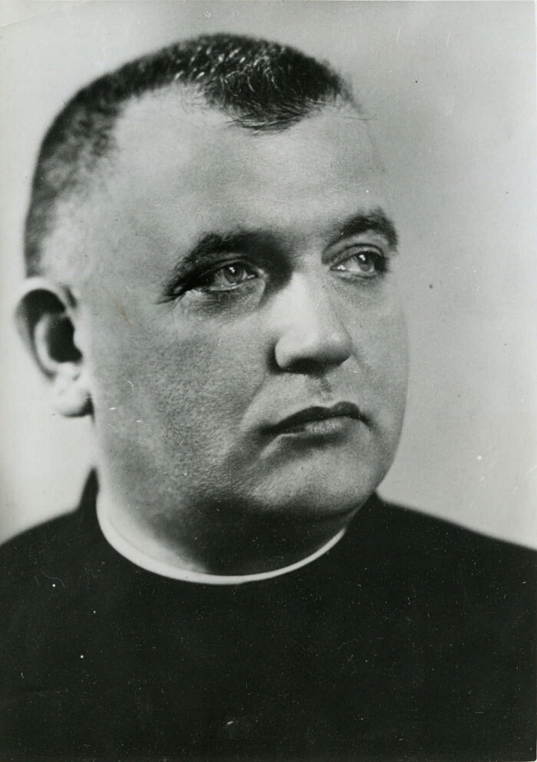
Jozef Tiso
Born in 1887 in Bytča; from the early 20th century associated with the Slovak People’s (Ludak) movement and a close collaborator of Andrej Hlinka.
Member of the moderate, pro-Catholic faction; served as Minister of Education and Youth Affairs in interwar Czechoslovakia.
President of the authoritarian Slovak Republic (1939–1945), a satellite of Nazi Germany. Considered co-responsible for the deportation of Slovak Jews to extermination camps, including Auschwitz-Birkenau, and for suppressing the Slovak National Uprising with German support.
Executed in a political trial (1947) by the authorities of postwar Czechoslovakia

Slide 6
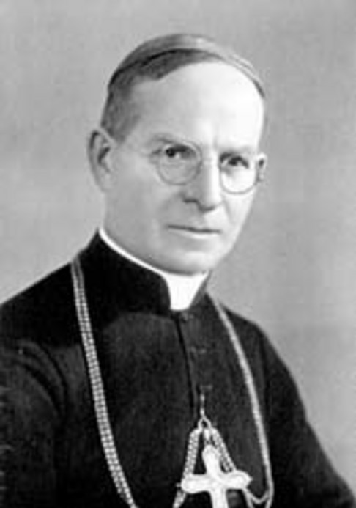
Ján Vojtaššák
Born in Zákamenné Catholic priest and Bishop of Spiš (1921–1965)
Politically active; supported Slovak autonomy and Štátna rada.
Controversial role during Jewish deportations; intervened to stop some.
Persecuted by Communists after WWII; imprisoned 1950–1963.
Beatification process started 1996.

Slide 7
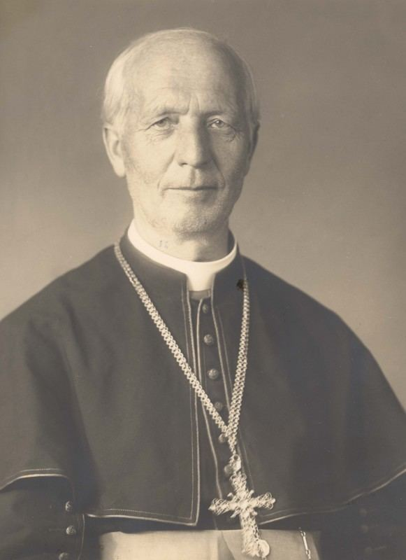
Andrej Hlinka
Born in Černová (then Hungary, now Slovakia) Catholic priest and leader of church movements.
Gained fame through conflict with Bishop Sándor Párnávy and the Černová massacre.
After World War I, became leader of the Ľudák (People’s) movement, nationalist and conservative.
From 1928–1938, his party adopted traits of modern fascist movements.
Died in 1938, before the creation of an independent Slovakia. Later regarded as a patron of the movement and father of modern Slovakia.

Slide 8
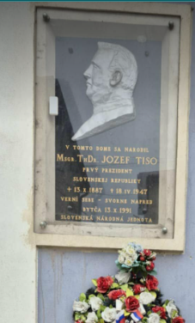
Memory of Jozef Tiso
Complex Nationalist Legacy
Defender of Slovak Autonomy: For some nationalist circles, he is viewed as a "martyr" for the cause of Slovak independence who successfully negotiated the creation of a Slovak state under nazi Collaboration and War Crimes
Role in the Holocaust
Deep Social Polarization
Lack of national or regional memorisation
The unequivocal apostasy of only narrow neo-fascist groups

Slide 9
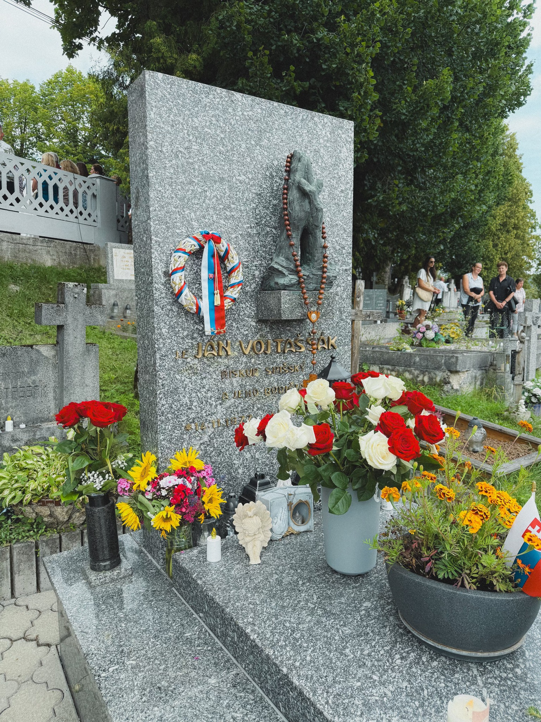
Memory of Ján Vojtaššák
Icon of Martyrdom and Resistance (main memory field)
Architect of Education and Culture: He is highly regarded for his contributions to the Spiš region, where he founded the diocesan museum, schools, and cultural centers to promote national education
Controversial Political Role: His legacy is complicated by his high-ranking position as Vice-Chairman of the State Council in the collaborationist Slovak Republic (1939–1945).
Allegations Regarding the Holocaust
Halted Beatification Process: Although Pope John Paul II supported his path to sainthood, the Vatican suspended the process in 2003 following protests from Jewish organizations and historians.
Absent from political discourse

Slide 10
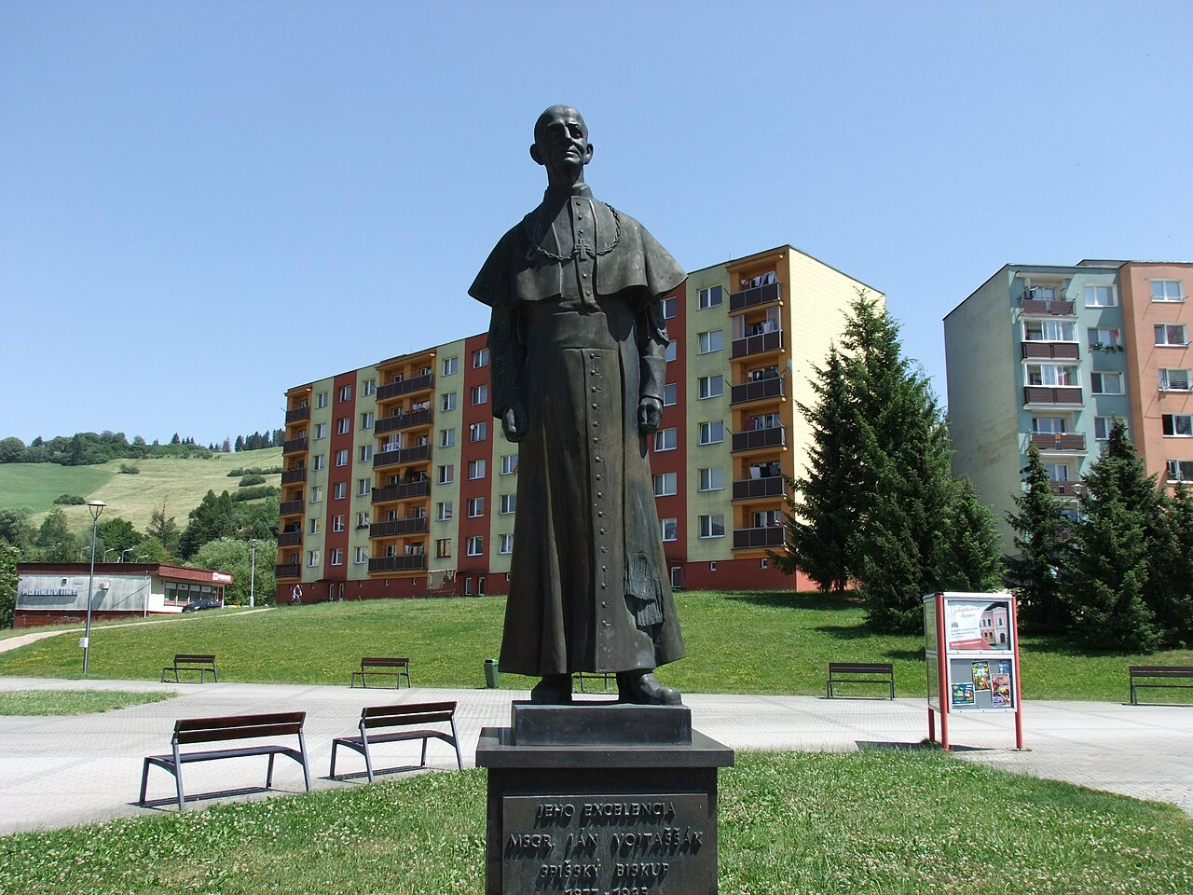

Slide 11
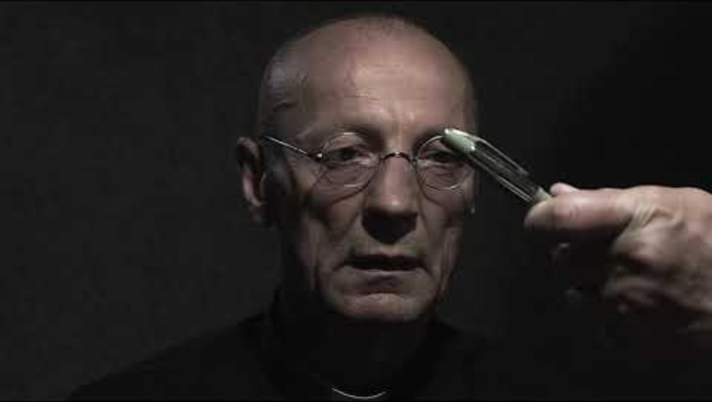
FILM

Slide 12
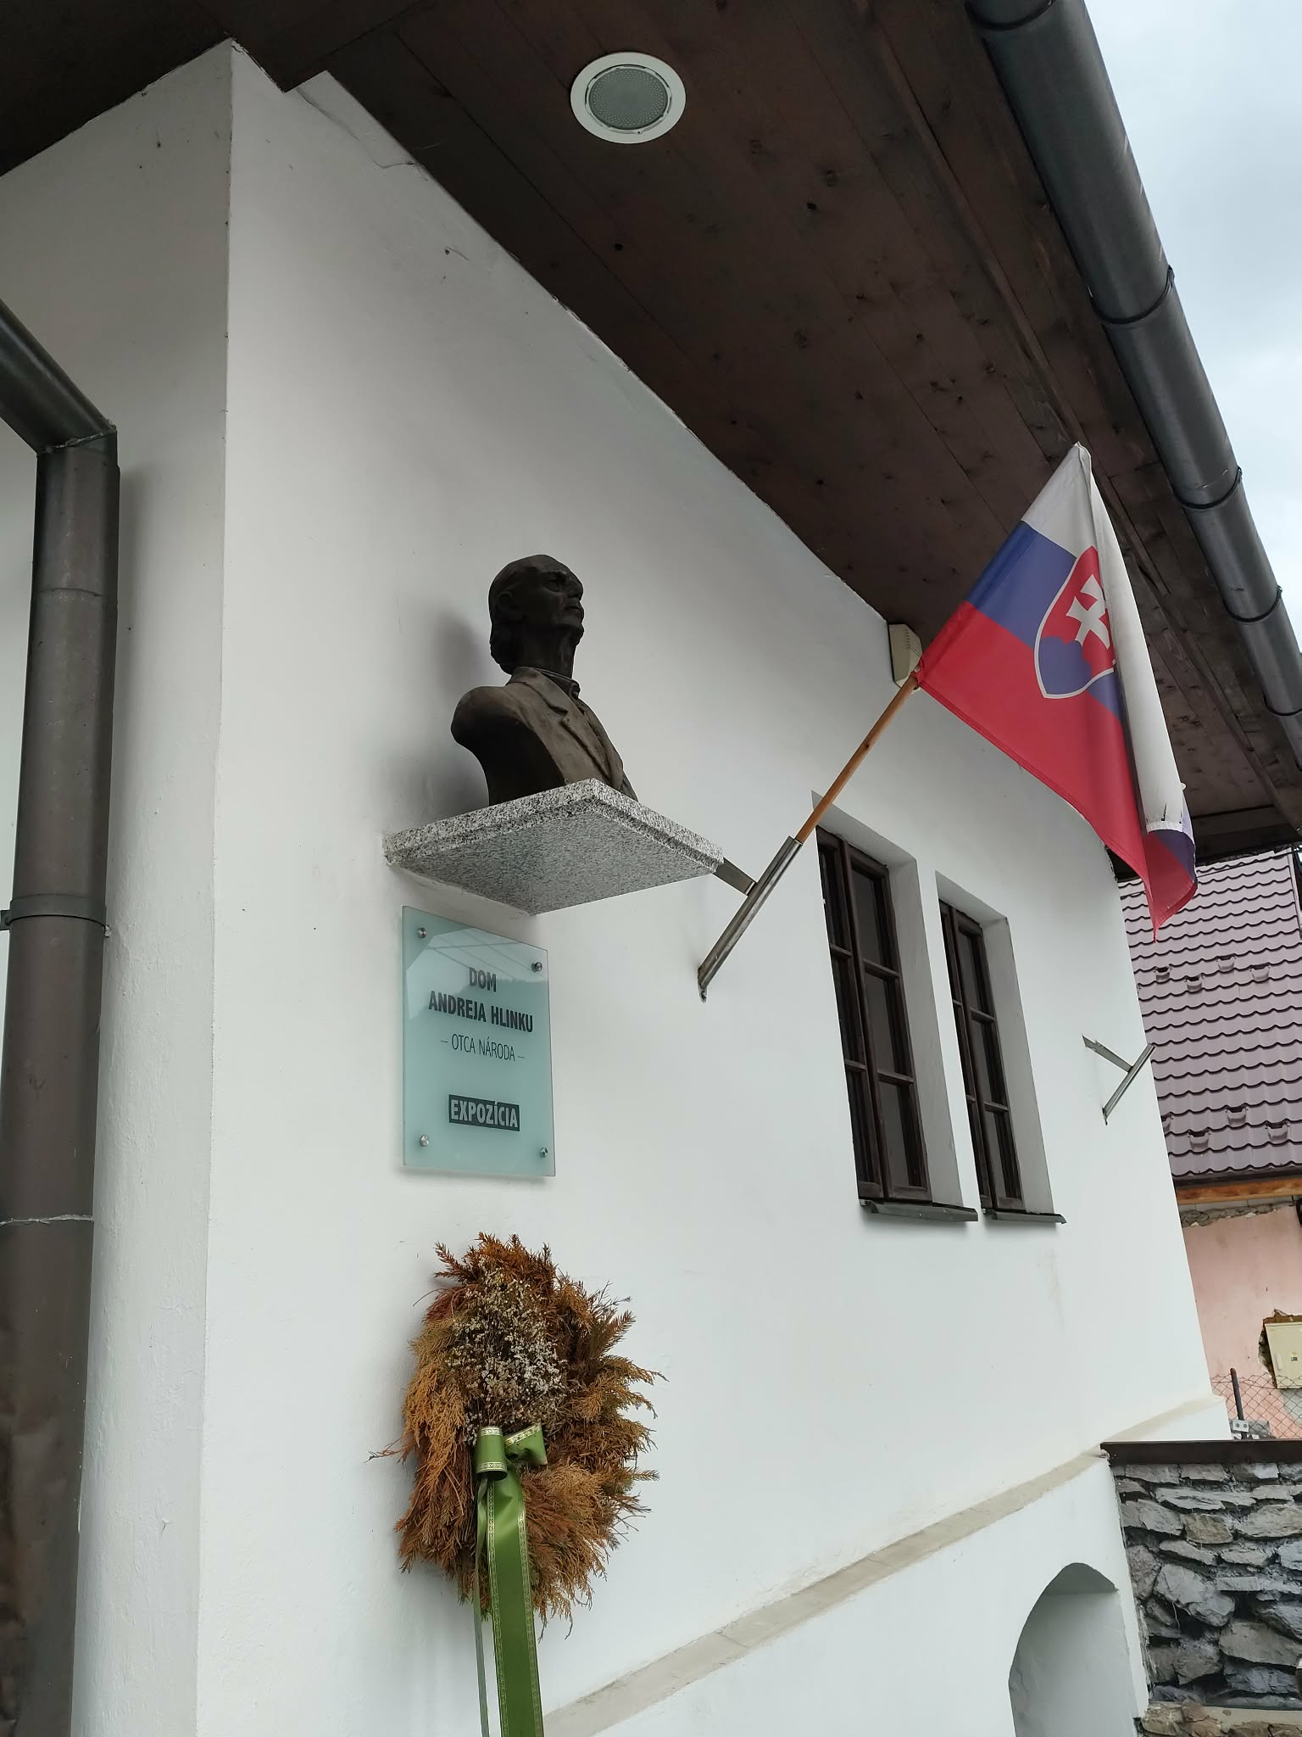
Memory of Andrej Hlinka
Symbol of the Slovak national movement (main memory field)
Canonical figure in national memory: Today portrayed as a key leader in the struggle for Slovak rights around the time of the Creation of Czechoslovakia in 1918
Commemoration in public space: Remembered through monuments, street names, and sites such as the Mausoleum of Andrej Hlinka in Ružomberok.
Element of political identity: His legacy is referenced by conservative and nationalist circles
Historical debates: Discussions focus on the later use of his ideas by the Hlinka's Slovak People's Party and associations with the period of the Slovak Republic (1939–1945)
Presence in public discourse: He remains an important reference point in debates on Slovak history and identity

Slide 13
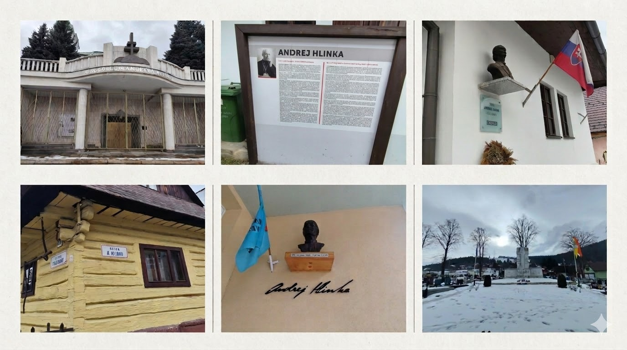

Slide 14
Figure | Relationship with Political Parties | Canonisation Status | Official Commemoration
Jozef Tiso | Supported by narrow neo-fascist groups; viewed by some nationalist circles as a "martyr" for Slovak independence. Executed by postwar Czechoslovak authorities in a political trial. | None. Activity of Milan Durica and some minore grupe. | Absent from national or regional commemoration; his legacy causes deep social polarization.
Ján Vojtaššák | Absent from modern political discourse. Historically served as Vice-Chairman of the State Council in the collaborationist Slovak Republic. | Beatification process started in 1996 with support from Pope John Paul II. Process suspended by the Vatican in 2003 following protests. | Regarded as an "Icon of Martyrdom" and an architect of education/culture in the Spiš region. Commemorated with local monuments.
Andrej Hlinka | His legacy is a key element of political identity for modern conservative and nationalist circles. He was the leader of the Ľudák (People's) movement. | None; regarded as a patron of the movement and "father of modern Slovakia". | A canonical figure in national memory. Remembered through monuments, street names, and the Mausoleum of Andrej Hlinka.

Slide 15
Used photos and videos
Celebration of the National Day in Bratislava - https://commons.wikimedia.org/wiki/File:Celebration_of_the_National_Day_in_Bratislava._Members_of_Hlinka_Guard_and_Slovak_Army.jpg
Jozef Tiso - https://www.prlib.ru/en/item/1295684
Tombestone Jána Vojtaššáka https://www.facebook.com/photo/?fbid=122227086722088477&set=pcb.122227087340088477
Monument Jána Vojtaššáka https://commons.wikimedia.org/wiki/File:Socha_biskupa_J%C3%A1na_Vojta%C5%A1%C5%A1%C3%A1ka,_s%C3%ADdlisko_Brezovec,_Doln%C3%BD_Kub%C3%ADn,_Slovensko_-_07.jpg
NEW TRAILER VOJTASSAK I GIORNI DEI BARBARI - https://youtu.be/RuEngfb_WzM?si=Cw-hMcXAAYqDEbOY
The rest from a private archive
AI copilation of own photos

Slide 16
Bibliography
A. Krawczyk, Słowacja księdza prezydenta (Jozef Tiso 1887-1947), Kraków 2015.
F. Kozminski, Udział kleru w słowackim ruchu narodowym w latach 1920-1945 oraz współczesne próby rehabilitacji, Kraków 2023.
M. Ďurica, Józef Tiso 1887-1947 Rys biograficzny, Warszawa 2019.
L. Kościelak, Historia Słowacji, Wrocław 2010.
J. Felak, At the Price of the Republic: Hlinka's Slovak People's Party, 1929–1938, Pittsburg
1995.
P. Olexak, Florián Tománek: Život a pôsobenie katolíckeho kňaza, politika a publicistu, Ružomberok 2019.
W. Oszczęda, Udział Słowacji w niemieckiej wyprawie wojennej przeciwko Polsce w roku 1939, „Almanach Muszyny” 2004.

Slide 17

FOLLOW OUR
JOURNEY

