Slide 1

WELCOME TO
OUR PROJECT
www.memory-makers.eu
Memory Makers | Project No. 101196478
Funded under the Citizens, Equality, Rights and Values programme (CERV)

Slide 2

YOUTH DRIVING THE FUTURE OF REMEMBRANCE
Memory Makers champions the importance of diversity in historical recognition, ensuring that all voices, no matter how silent they have been through the ages, are heard and valued.
We are here today thanks to the EU CERV REM fund. We believe remembrance must evolve and engage. This project empowers young people across Europe to preserve and reinterpret historical memory, with a focus on groups often left out of mainstream Holocaust education.

Slide 3
A little about CERV REM
CERV REM stands for the Citizens, Equality, Rights and Values Programme – European Remembrance strand. It is an EU funding programme that supports projects aimed at:
Preserving historical memory of the 20th century's darkest chapters—especially totalitarian and authoritarian regimes.
Promoting democratic values, human rights, and inclusive remembrance.
Encouraging transnational dialogue and critical reflection, especially among young people.
Why is CERV REM important now?
Rising populism, hate speech, and disinformation challenge democratic values across Europe.
Many young Europeans have limited knowledge of the Holocaust or the persecution of minority groups.
CERV REM enables cross-border collaboration to safeguard historical truth and defend democratic values.

Slide 4





Why We Need This Now
Despite decades of research and public education, Holocaust denial and distortion are on the rise, especially online.
The experiences of marginalised groups—LGBTIQ individuals, women, people with disabilities, Roma, and resistors remain underexplored in public consciousness.
We are also seeing a worrying resurgence of hate speech, antisemitism, anti-Roma racism, and LGBTIQ-phobia, particularly among youth.
OUR PARTNERS
France (lead) Poland Lithuania Greece Ireland

Slide 5
Our Response - What Memory Makers Will Do
Memory Makers is a response to these challenges. Over 20 months, we will:
Deliver 10 educational and commemorative events across 5 countries – France, Poland, Lithuania, Greece, and Ireland. Today starts this process.
Involve 500+ young participants as “Memory Makers” – youth oral historians and human rights advocates.
Explore, reinterpret, and digitally preserve survivor testimonies from across victim groups - create educational materials and campaigns that weave narratives from Holocaust survivors and other impacted groups into mainstream historical education.
Create and promote a Library of Learning – a freely accessible online resource with youth-made videos, podcasts and teaching tools.
Empower young people to use social media for digital storytelling and advocacy.

Slide 6
Where is the innovation?
Memory Makers reflects on our history but is focused on connection. It stands out because:
It includes stories not often told: from persecuted women, Roma communities, and LGBTIQ survivors.
It links the past with the present: from Nazi ideology to today’s hate narratives.
It uses the tools young people engage with – short-form video, podcasts, animation.
It trains youth to become ambassadors of memory – offline and online.

Slide 7
And to today..
Event 1: Youth Symposium on Historical Narratives and Human Rights

Slide 8
WORK PACKAGE 1
We’re proud to have the European Centre for Human Rights as project lead, based here in Strasbourg, with participatory status at the Council of Europe and strong ties to the Conference of INGOs.
Today is about exchange of ideas. We reflect on the past as vividly relevant to today's challenges to help young people build the skills necessary to become a force for human rights storytelling and advocacy.
We’re asking for your support –to promote our work and help us share our ethical, inclusive approach to remembrance across your networks.

Slide 9
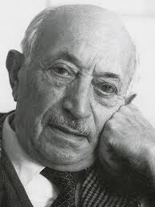
CLOSING
"I swore never to be silent whenever and wherever human beings endure suffering and humiliation.
We must always take sides.
Neutrality helps the oppressor, never the victim.
Silence encourages the tormentor, never the tormented. Sometimes we must interfere.
When human lives are endangered, when human dignity is in jeopardy, national borders and sensitivities become irrelevant.
Wherever men or women are persecuted because of their race, religion, or political views, that place must—at that moment—become the center of the universe.“
Simon Wiesenthal
Jewish Austrian Holocaust survivor

Slide 10
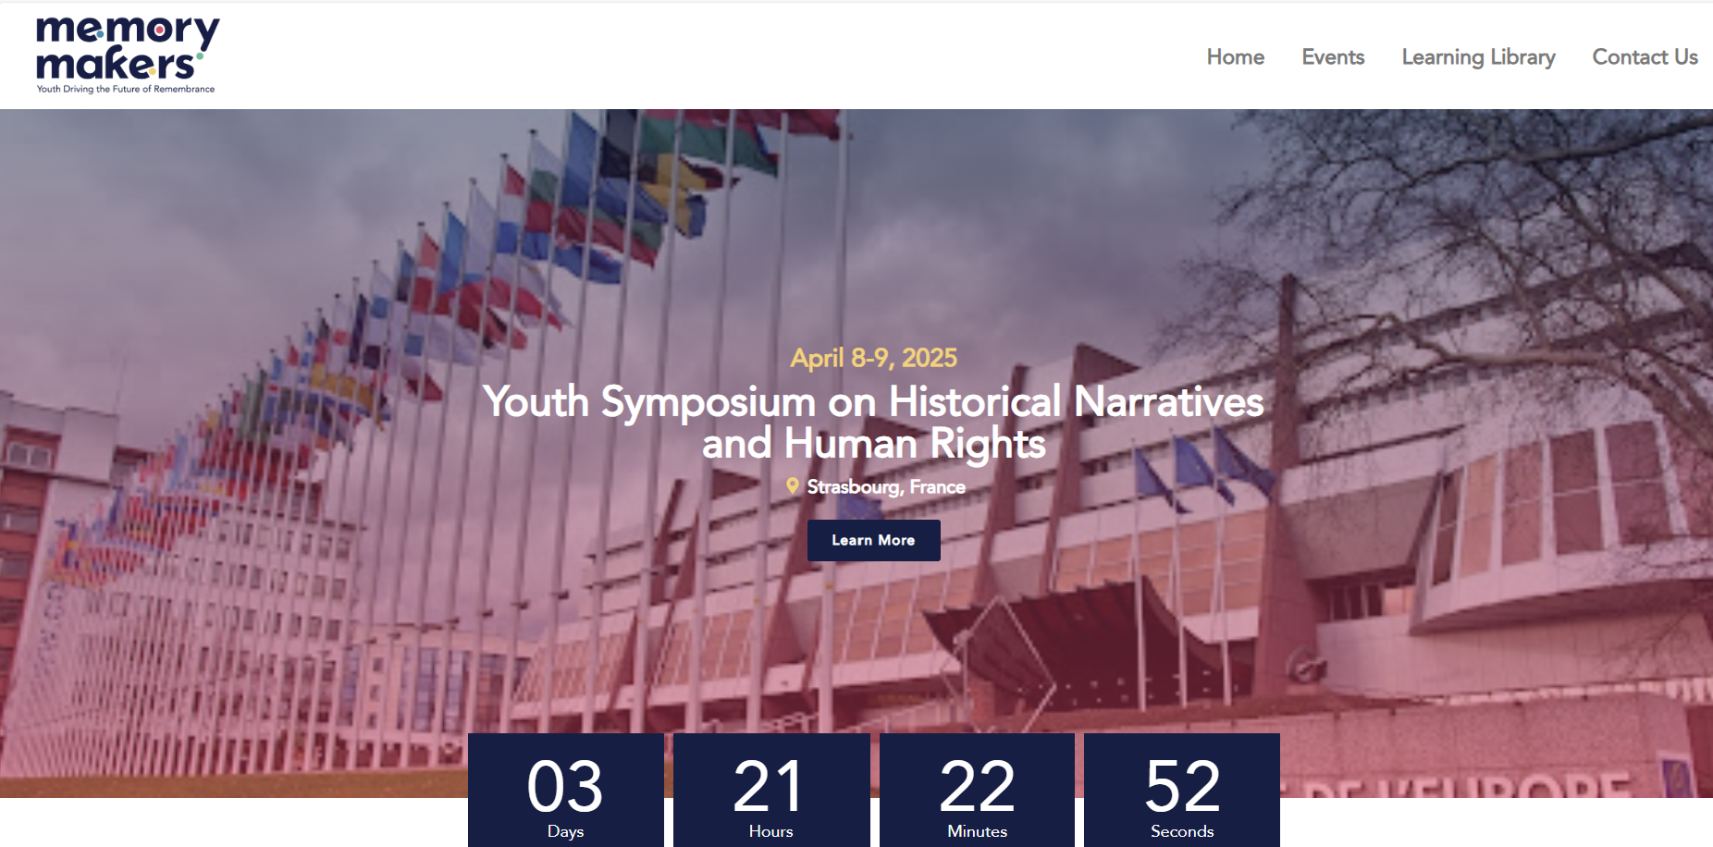
Our website will keep you up to date
www.memory-makers.eu

