Slide 1
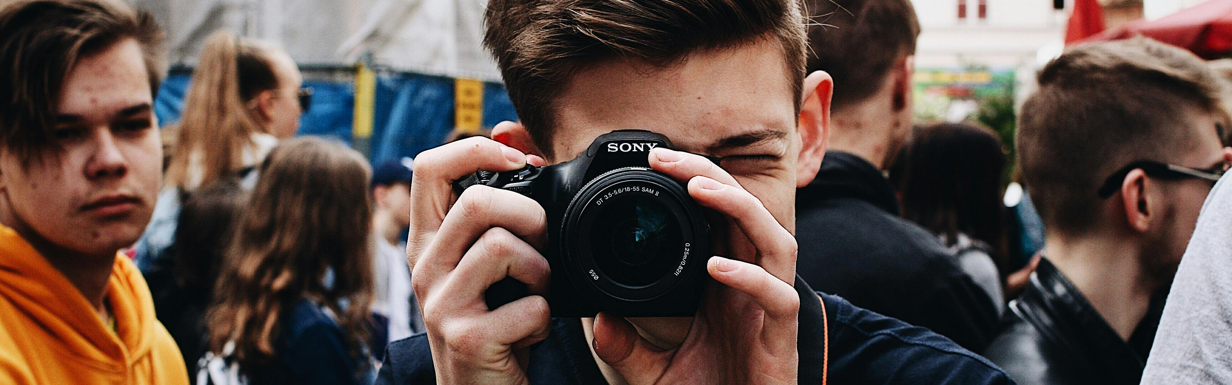
Youth Engagement in Combating Hate Speech Albania
www.memory-makers.eu

Slide 2
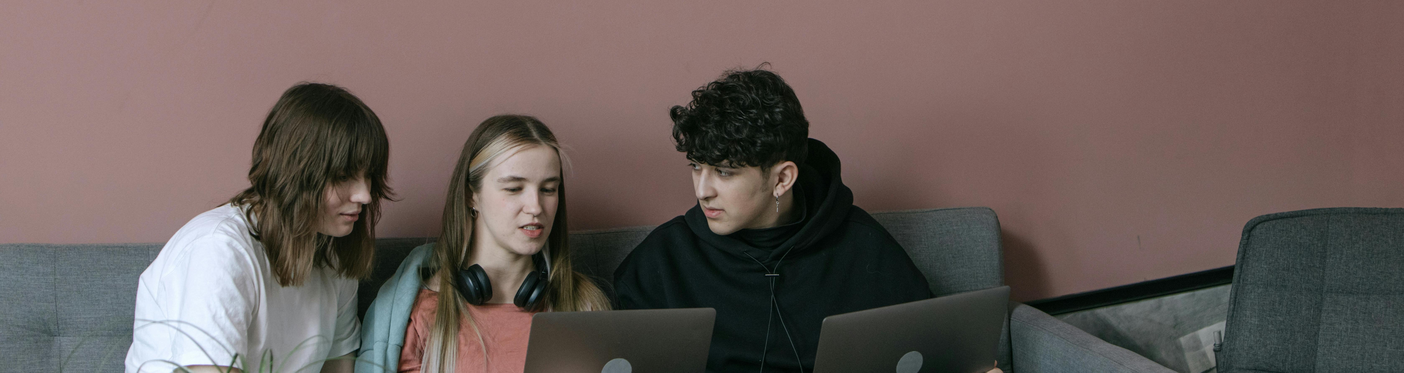


Irena Topalli
Beyond Barriers
Association- ALBANIA

Slide 3
Beyond Barriers Association (BBA) – Albania
Founded in 2004, leading youth NGO in Albania with 20+ years of experience.
Mission: empower youth, promote inclusion, participation, and human rights.
Active in Erasmus+, ESC, CERV, IPA, COE, and UN programmes.
Works on youth policy, civic engagement, social inclusion, volunteering and non-formal education.
Host and recruiting organisation for European Solidarity Corps volunteers.
Recognised for youth-led campaigns (e.g., SpeakUP against hate speech, Roots & Branches of Hate Speech; leading NHMS campaigns; advocating for Youth Law and Volunteering Law).
Partner in regional and EU networks.

Slide 4
Landscape - what is the situation in Albania
RDN 2.0 (2023): Hateful/discriminatory discourse targets Gender 41%, Ethnicity 38%, Sexual minorities 11%.
11 cases of hate crime were reported to the police in the reporting period 2023-2024 (EU Commission Report). Data collection and statistical reliability on hate crime is still weak and not fully ensured.
ODIHR/OSCE: very low official hate-crime numbers vs. higher prevalence in media discourse. There is capacity and reporting gaps.
Safer Internet Centre (iSIGURT.al): national portal for reporting online abuse and hate speech; rapid takedowns on TikTok noted in 2025 report.

Slide 5
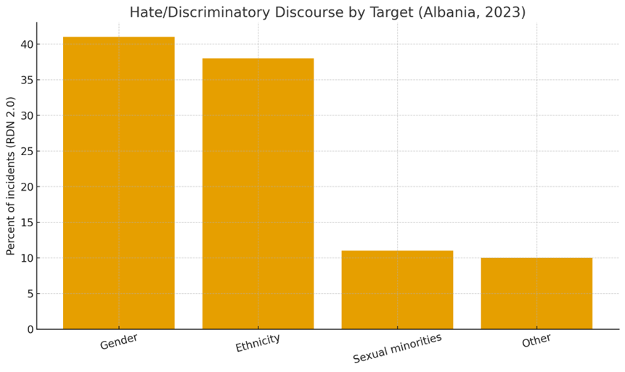
What’s most widespread?
(media monitoring 2023)
Source: Reporting Diversity Network 2.0 — Albania monitoring report (2023).

Slide 6

Where youth see it most?
Social platforms (comments, live streams, memes).
Clickbait talk shows and in sports or celebrity content.
Election and migration debates. Gendered and anti‑LGBTI slurs are used.

Slide 7
Why do we focus on youth?
Highest exposure: 76% of EU youth report seeing disinformation/fake news weekly (Eurobarometer 2024).
Emotional impact: hate speech harms identity, self-esteem, and sense of safety.
Under-reporting: young people less likely to use formal channels like police or CPD.
Key identity years: adolescence/young adulthood make them more vulnerable to exclusion.

Slide 8
Why youth are most effective
Peer credibility: counterspeech by youth peers resonates more than official messages.
Digital creativity: memes, TikToks, short videos reach audiences faster and better.
Policy recognition: CoE NHSM, EU Youth Strategy, OSCE /UN / RYCO/ YPS Agenda all centre youth roles.
Ripple effects: youth shift norms among peers, families, schools, shaping digital culture.

Slide 9
Youth roles that work!
Spot & report: use available platform tools; escalate to CPD for discrimination cases.
Counterspeech: positive narratives, facts + empathy, amplify diverse voices.
Peer leadership: school/university clubs, ambassadors, micro‑campaigns.
Media literacy: detect manipulation and AI‑generated content; verify before share.

Slide 10
Examples of (youth-led) initiatives in Albania
Beyond Barriers organises the Speak Up Against Hate Speech campaign, conducts national online strategies, and trainings. Developes Digital Content Creation and Social Media Ethics.
CoE Albania- working on the NH and antidiscrimination in different levels.
No Hate Speech Movement is a national youth mobilisation developing tools still used in trainings.
UNDP/UN (2023) organises youth‑led micro‑projects countering hate speech.
OSCE develops youth‑focused workshops with institutions on safer digital spaces.

Slide 11
Practical how‑to (what we also promote in our work)
Document: screenshot, URL, time; don’t engage in flame wars.
Report: use existing platforms; CPD/Police if incitement/violence.
Counter: post fact‑based, respectful replies; tag allies; shift narrative.
Support: check‑in with targets; offer helplines and reporting links.
Track: use a shared sheet to see what worked and repeat.

Slide 12
Legal quick guide for youth:
Criminal Code 265–266: incitement to hatred; 50(j) bias‑motivation aggravates.
Law on Protection from Discrimination: file a complaint to CPD (free).
AMA Code (2023): bans hate speech/sexism in broadcasting-complain to AMA.

Slide 13


www.beyondbariers.org
Contact Info:
office@beyondbarriers.org
Presenters contact info:
ira.topalli@gmail.com
THANK
YOU!

