Slide 1

Youth Digital Engagement for Combating Hate Speech & Incitement in Kosovo
www.memory-makers.eu

Slide 2


Youth Digital Engagement for Combating Hate Speech and Incitement in Kosovo
Hera Luma
Advocacy Program Manager at
Advocacy Training and Resource Centre

Slide 3
ATRC’s initiatives to countering hate!
Combat Hate in Kosova - supported by MATRA PROGRAM of the Embassy of the Netherlands in Kosovo.
Products: Hate O Meter I & II, Analysis on Actual Cases of Hate Speech in Kosovo and Institutional Response, engage youth in identifying and monitoring hate speech.
Countering discrimination, hate speech, and gender-based violence - supported by the European Union Office in Kosovo.
Products: School Safety Report, train 30 young political party members on the prevention of hate speech and initiation of anti-discrimination actions.

Slide 4


How legislation regulates Hate Incitement and Hate Crime in Kosova
Article 141 of the Criminal Code of Kosova, which states that: “Anyone who publicly incites or spreads hatred, dissension and intolerance between national, racial and religious, ethnic and other groups, or on grounds of sexual orientation, gender identity and other personal characteristics, in a manner which may disrupt public order, shall be punished with a fine or imprisonment of up to five (5) years”.
Article 4 paragraph 1 sub-paragraph 1.4 of the Law on Protection from Discrimination, refers directly to hate speech as “Incitement to discriminate is considered discrimination on the grounds set out in Article one (1) of this Law protected personal characteristics, and includes any promotion of hatred when it is done intentionally”

Slide 5
Who is affected the most by online hate speech in Kosova?
Youth
About 23% of the population in Kosovo is youth of age 15 to 29.
Hate speech is primarily spreading through social media platforms. Youth, being heavy users of digital media, are implicitly part of the audience exposed to these messages.
Immigrants and Refugees
Immigrants and Refugees are portrayed as violent, dangerous, arsonists, looters, and suspected of infiltration by terrorists.

Slide 6
Who is affected the most by online hate speech in Kosova?
Ethnic Minorities
Are among the victims of hate speech. Hate O Meter Reports indicate that member(s) face prejudice, and derogatory terms are used to refer to them.
LGBTIQ+
The dominant reporting frames are those targeting members of this community as deviant, nationally incompatible, and dangerous.

Slide 7

How It Affects Youth?
On the School Safety Report (ATRC,D4D, Internews Kosova) - students reported that hate speech is often presented under the guise of humour.
Those engaging in hate speech that fuel bullying within the school settings often do not distinguish between harmless jokes and harmful behaviour.
Students’ perspectives highlight the need to include them in policy-making to effectively address bullying and hate speech.

Slide 8
How It Affects Youth?
Hate Speech Impacts Youth:
Psychological wellbeing: since hate speech and bullying damage self-esteem, cause anxiety, depression, feeling of shame or isolation. The report notes students feel unsafe, especially in less monitored spaces. Also, there are testimonies about hurtful comments about appearance etc.
Socialization: there’s treatment of hate speech as “just a joke” which helps normalise discriminatory attitudes, and prejudice. It shapes how youth see themselves, how they treat others, and how they cope. Youth who experience hate speech may withdraw, or conversely may also act out.
Misuse of digital space for hate incitement: Kosovo is the leader in the Western Balkans region with 98.6% of households having some form of internet access in 2023, surpassing the EU average of 93.08%

Slide 9
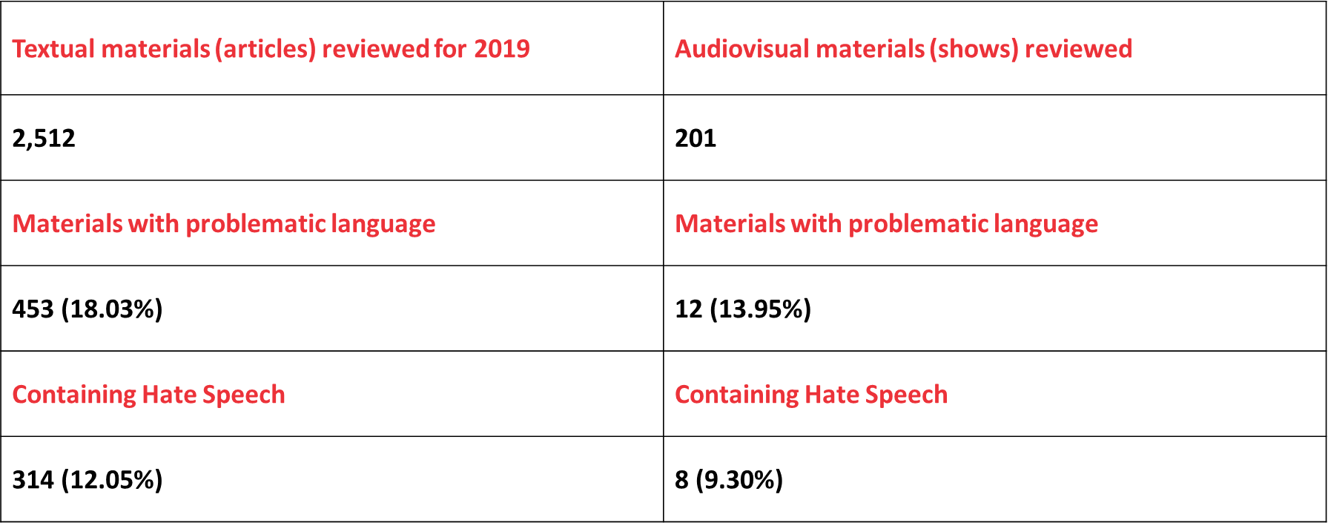
Hate O Meter I
The analysis of articles and programs from these media outlets was carried out over two six-month periods:
Hate O Meter I - January 1 – June 30, 2019.
For the examination of textual materials, both the total population sample and a simple random sample was applied.

Slide 10
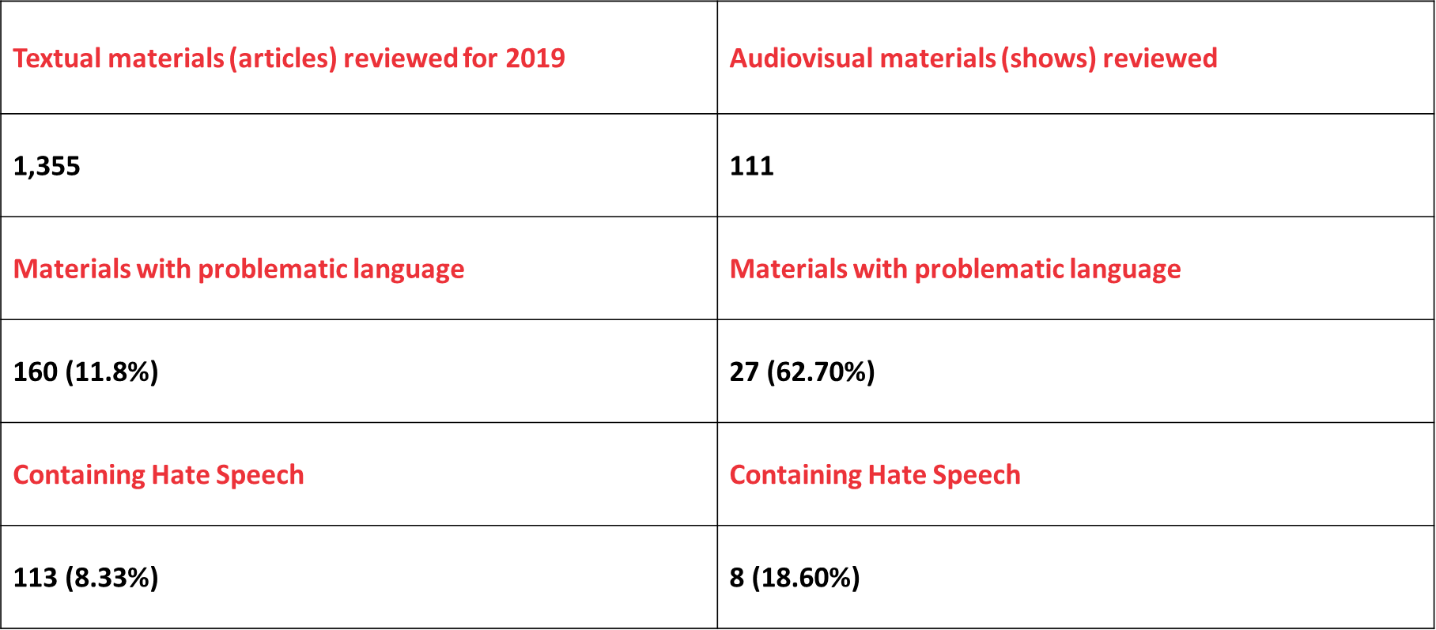
Hate O Meter II
The analysis of articles and programs from these media outlets was carried out over two six-month periods:
Hate O Meter II January 1 – June 30, 2020.
For the examination of textual materials, both the total population sample and a simple random sample was applied.

Slide 11
PREVALENCE OF HATE SPEECH ONLINE
MEDIA
2,512 articles 12.05% of online articles and 9.30% of TV shows contained hate speech
In online articles, hate speech mainly framed communities as violent and threatening, followed by offensive depictions of traditions and lifestyles, and to a lesser extent, incitement to violence. In TV shows, hate speech was dominated by offensive and negative portrayals, prejudicial language, and violent representations of target groups.
SOCIAL NETWORKS
In Hate O Meter I, an article was detected that incites hatred and engages in fear-mongering against a Roma woman who was attacked in multiple municipalities of Kosovo. The article falsely claims (paraphrased) that ‘a woman from Llapi’ possesses a weapon and is part of a criminal network that kidnaps children. Such reporting led to violence and acts of savagery against this woman.

Slide 12
Main findings of the Hate O Meter reports
2 out of 10 online news contained elements of hate speech
Roma, Ashkali, and Egyptians are mostly targeted with hate speech
Approximately one and a half out of every ten programs broadcasted on Kosova from major television channels contain elements of hate speech.
There was one article with content including calls for the killing of LGBTIQ members (Hate O Meter I)

Slide 13


According to the OECD (2024)
Kosovo is the leader in the Western Balkans region with 98.6% of households having some form of internet access in 2023, surpassing the EU average of 93.08%.

Slide 14


Analysing the Spread of Hate Speech in Kosovo
Online Media
Dissemination
Institutional Reaction
to Hate
Widespread Social
Media Use
Freedom of Expression vs.
Incitement
Digital Usage
Cross-Cutting
Issues
Lack of Digital
Regulations
Community
Resilience
No Mandate for
Online Media
Youth Initiatives
Focus on Licensed
TV Channels
Social Cohesion
Efforts

Slide 15
ATRC’S INITIATIVES TO COUNTER HATE SPEECH
Teaching and engaging youth to monitor, identify and report Hate Speech online.
Engaging with youth representatives of political parties through Tuesday Salons.
Capacity building through institutionalization of curriculums on addressing hate incitement, speech and crimes - for Kosovo Police, Judges and Prosecutors on identifying hate incitement cases and investigating hate crimes.
Sub-granting to small CSOs to implement educational activities in high schools, such as trainings that teach youth about available support mechanisms and where to report hate speech encountered online.

Slide 16

THANK
CONTACT INFO
www.advocacy-center.org
info@advocacy-center.org
hera@advocacy-center.org
YOU!

